Slide 1



Assessing the Risk of Future Aquatic Invasive Species Establishment in a changing world
Sara Stahlman
Pennsylvania Sea Grant

Slide 2
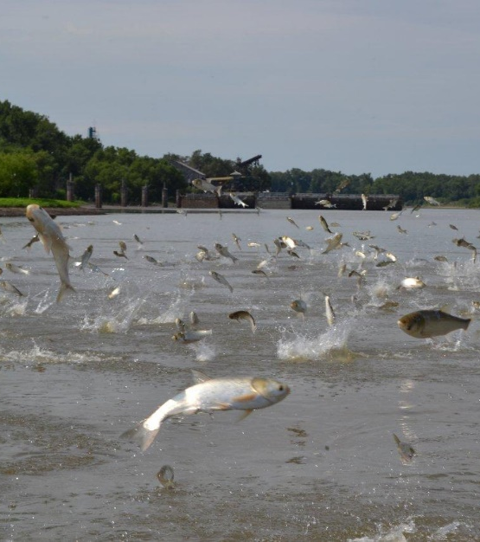
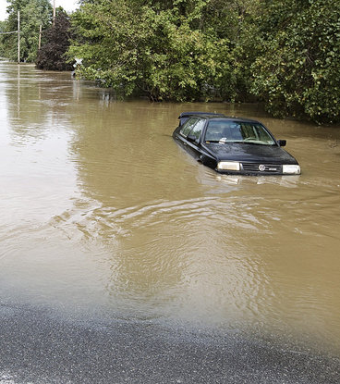
AIS are one of the biggest threats to species biodiversity, food security, and livelihoods
(IUCN, 2017).
Climate impacts can affect the distribution, spread, abundance, and impact of invasive species
(Hellman et al. 2008).
Notes:
So in this presentation, I’m looking at two very important stressors: AIS which we all know are considered of the biggest threats to species biodiversity, food security, and livelihoods, and climate change which has the potential to impact the distribution, spread, abundance, and impact of the species we are trying to manage. So lets look at how might these two stressors might work synergistically, and how will that will affect our management of aquatic invasive species.
Impacts from climate change are expected to alter biodiversity, cause changes in phenology, species ranges, and affect species interactions and ecosystem processes (Hellman et al. 2008).

Slide 3
What WE Expect in Pennsylvania
Warming temperatures
Rapid warming the last few decades (last decade warmest on record)
The commonwealth has warmed more than half a degree (F) in the last century
Notes:
So first we need to think about what kinds of changes and impacts we are expecting to see into the future. So for in Pennsylvania over the next century, and most other places, including NY, the climate is overall getting warmer. Data shows that we’ve experienced rapid warming in the past few decades, and the last decade has actually been the warmest on record. In the last century, we’ve warmed more than half a degree F and projections have us continuing to rise and experience more extreme heat.

Slide 4
Days Per Year
Over 90°F
Blue = 10 or fewer
Red = up to 120 days
Northeast Climate Impacts Assessment (NECIA). 2008. Climate Change in Pennsylvania: Impacts and Solutions for the Keystone State.
Notes:
Things actually have the potential to get really hot. This graphic is showing the number of days per year over 90 degrees in Pennsylvania with blue being 10 or fewer day and red reaching up to 120 days per year over 90 degrees.

Slide 5
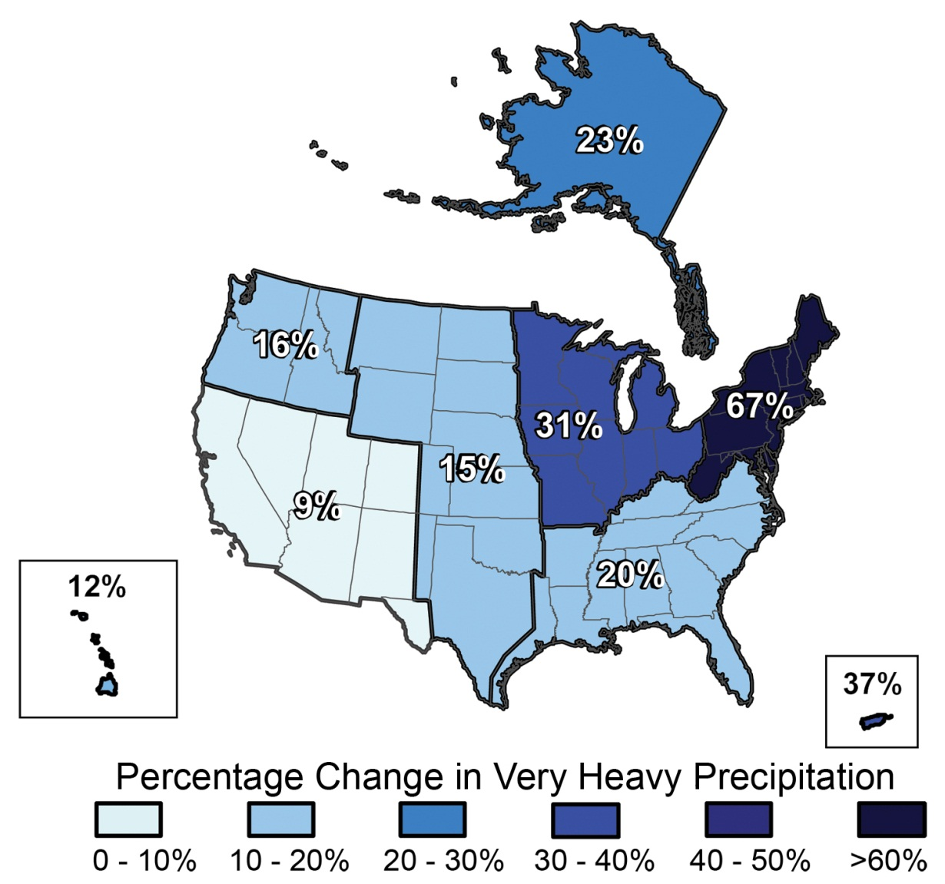
5-10% increase in overall average annual precipitation in the last century.
Change in precipitation events from 1958-2007
Precipitation from heavy storms has increased 70% in the Northeast
During the next century, annual precipitation and the frequency of heavy downpours are likely to keep rising.
USGCRP, Global Climate Impacts in the United States 2009
Notes:
Now looking at changes in precipitation; Overall, there’s been a 5-10% increase of average annual precipitation in the last century. This map is focusing on heavy precipitation events, and is showing the percent change in intensity of precipitation from 1958-2007, So if you look at the NE region, including PA and NY, there’s been the most pronounced increase in these heavy downpour events with an almost 70% increase.
Looking into the next century, annual precipitation as well as frequency of intense rain and storm events are likely to continue to rise; although we are expecting to see these changes occur more seasonally- meaning more precipitation in the winter and spring, and less during summer and fall.
Rising temperatures will melt snow earlier in spring and increase evaporation, thereby drying the soil during summer and fall.
As a result, the changing climate is likely to intensify flooding during winter and spring and drought during summer and fall

Slide 6
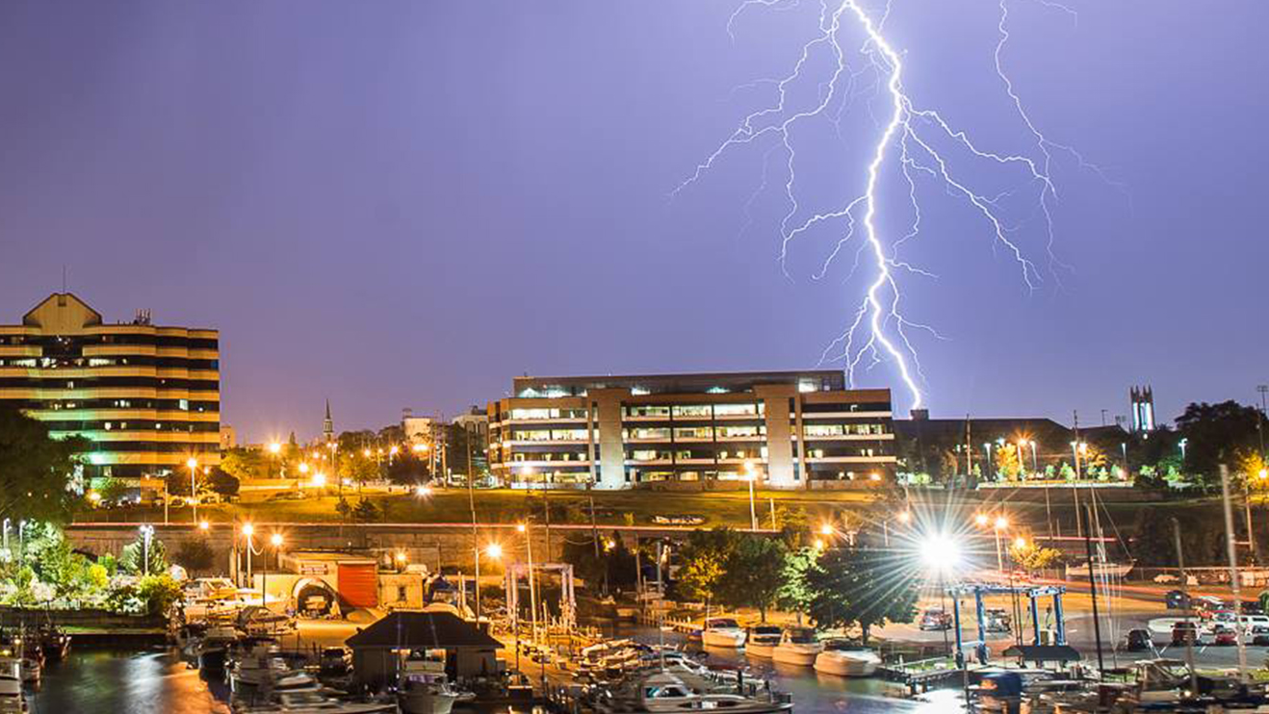
Increase in Extreme Climatic Events
Notes:
So we are also expected to see increases in other extreme climatic events along with heavy rain and storm events. Things like severe flooding, extreme heat, drought, snow and ice, and wind storms. These events are and already have been changing in frequency, magnitude, and duration

Slide 7
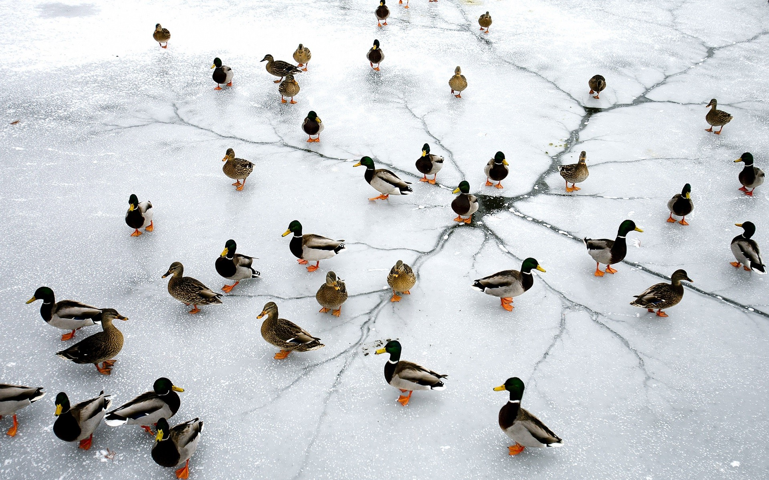
What does this mean for invasions?
Invasive species will respond to climate change differently than native species due to their characteristics and their responses will have ecological and economic implications (Hellman, et al. 2008)
Notes:
The big question then becomes, how might all of the changes we just talked about, impact invasion of species. We know that nvasive species will probably respond to climate changes differently than native species a lot of this is due a lot to their general characteristics, things like having broad climatic tolerances and large geographic ranges… and their responses to climate change will likely have significant implications, both ecologically and economically.

Slide 8
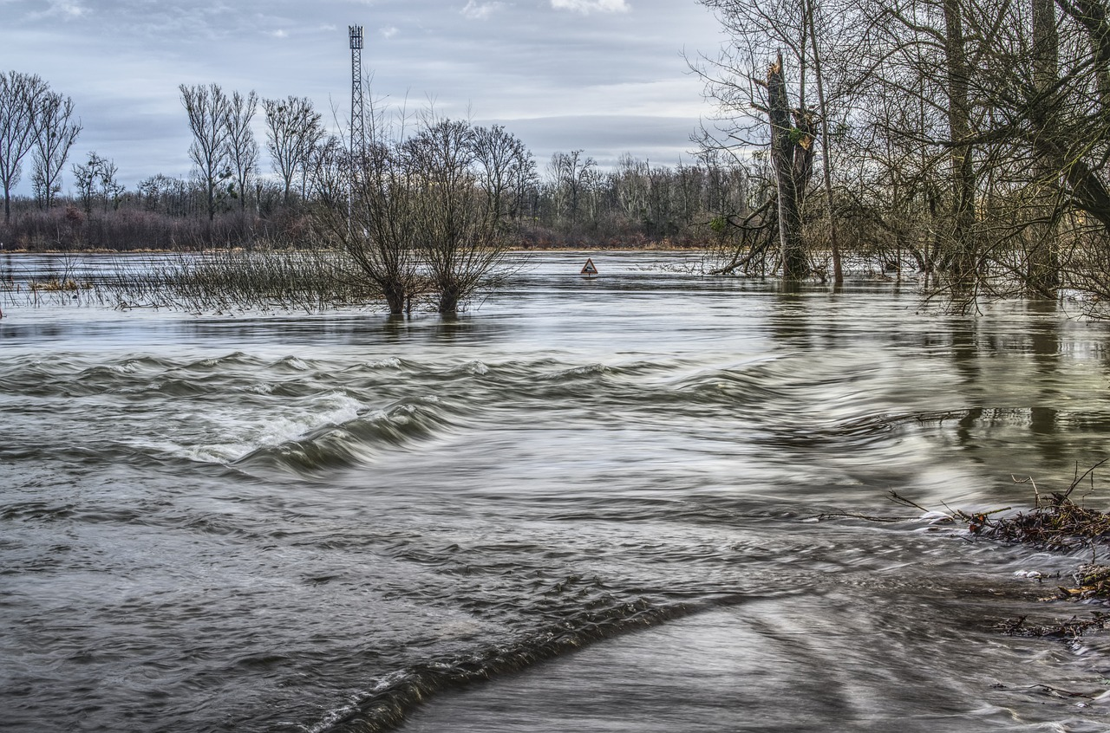
Altered Transport and Introduction Mechanisms
Flooding, storm surges and heavy winds can facilitate movement
Heat waves and drought can decrease biotic resistance
Create opportunities and resources for invasives c
Notes:
Changes in temperature and precipitation may alter transport and introduction mechanisms. Meaning species will have more ways to get here, and have a better chance of surviving once they are here. For example, flood waters can provide opportunities for species to escape confinement or other barriers and be carried to new locations; Heavy winds events can transport things like bacteria and fungi; Heat waves and drought can decrease biotic resistance of a system by causing persistent stress and disturbance, eventually causing mortality events or the shifting out of resident species thereby opening up opportunities and resources for invasives to then come in.

Slide 9
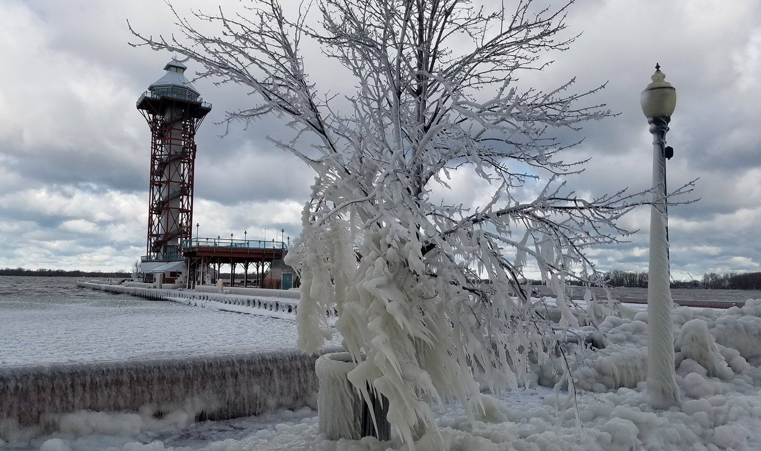
Altered distribution of existing invasive species
Many species have range limitations set by extreme cold or ice cover
Mild winters increase survival and create longer growing seasons
Existing invasive species will most likely expand their ranges more quickly than native species
Notes:
So we will see introduction of new species through new pathways, but we will also see altered distributions of existing invasive species. Warming temperatures are likely to facilitate spread since many invasive species have range limitations set by extreme cold or ice cover. So as things warm, and those barriers start to diminish, species will then be able to expand their range to areas where they previously couldn’t survive. Because of their many dispersal traits, existing invasive species will most likely expand their ranges more quickly than native species will.

Slide 10
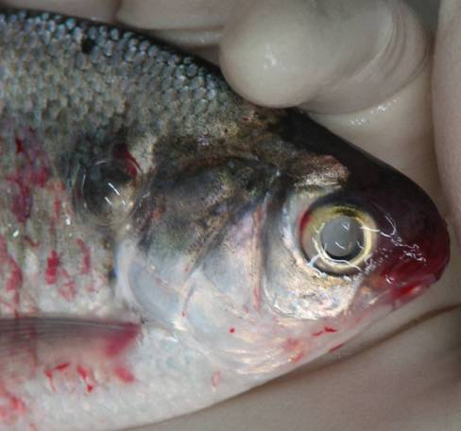
Altered Impact of Existing Invasive Species
Increased CO2 levels plus warming temperatures can increase the growth rate of the invasive plant Hydrilla
VHS impacts may decrease because mortality occurs causes in colder waters
Notes:
There’s also going to be altered impact of existing invasive species: Some species may see exacerbated impacts; while others may see diminished impacts. For example studies have found that increased CO2 levels coupled with warming temperatures can increase the growth rate of Hydrilla, which already has a high growth rate, growing over an inch per day. However; the invasive virus Viral Hemorrhagic Septicemia may see diminished impacts because it typically causes mortality in colder waters so warming could possibly diminish the number of mortality events caused by this virus.

Slide 11
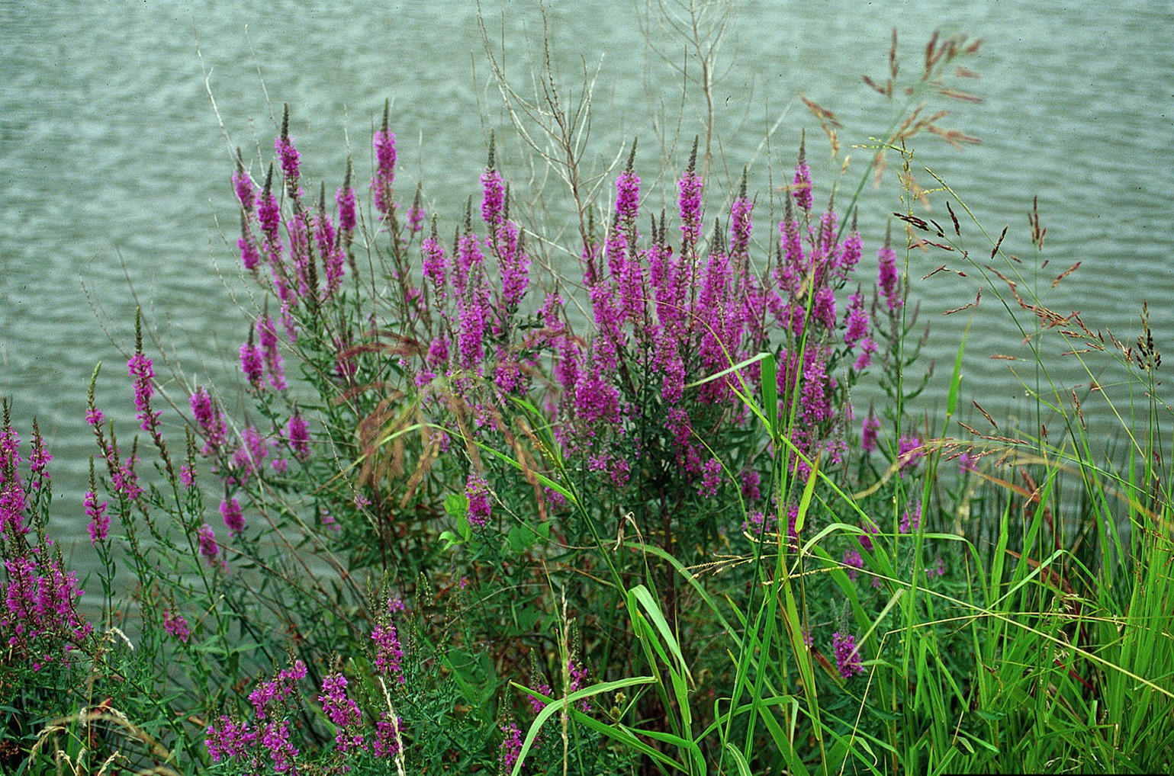
Altered effectiveness of control strategies
More aggressive and expensive control methods may be needed
Hand pulling for water chestnut or water hyacinth no longer effective
Chemical controls – how will climate impact pesticides?
Altered effectiveness of biocontrol
FURTHER MONITORING NEEDED
Notes:
Last, we might need to start re-thinking the kinds of control strategies we’re using to control species under these different climate scenerios. For example, areas where hand pulling for species like water hyacinth and water chestnut were once sufficient, may no longer be the case and they may need more aggressive, sustained, and expensive methods. We also may need to increase our use of chemical controls, which brings up questions about climate impacts to the fate and behavior of these pesticides. And then the effectiveness of current biocontrol agents and the species they are targeted to control will probably need to be reevaluated. And Ultimately a lot more monitoring is going to be needed.

Slide 12

Implications for AIS management
The future of management of invasive species will need to adapt to involve new tools developed from research that integrates climate and invasive species
How specific invasive species may behave under an altered climate
Which new species may emerge as invasive?
Notes:
So we are looking at a really big issue here, with many different components which will all have implications for AIS management. Future AIS management will need to adapt especially since issues with AIS are immediate, while climate change is more subtle and long term so often times resource managers have a difficult time knowing when they should address it. So we are going to need to start relying on new tools and strategies that focus on research that integrates climate change and invasive species.
Two key questions to consider are “How will specific invasive species behave under an altered climate?” and “which new species may emerge as invasive?” and I have the second one here highlighted in red, as my project focuses a lot more on this particular question.

Slide 13
Assessing the Risk of Future Aquatic Invasive Species Establishment in Pennsylvania based on climate suitability
Developed from three existing studies:
Evaluating the risk of aquatic invasive species range expansions in a changing climate in Pennsylvania (Grise et al., Thesis 2011)
Wisconsin’s changing climate and forecasting invasive species spread (Jason E. Granberg, Presentation to the Great Lakes Panel on AIS, 2018)
A simple, rapid methodology for developing invasive species watch lists (Faulkner et al. 2014, Biological Conservation)
Notes:
So my work pulls from 3 existing studies, one was previous work I did for my graduate thesis research doing climate matching using an Australian-based software called CLIMATCH, but had the same basic principles. This is almost like a validation study of that work using updated software that is more “US-centric”.
The second is work being done by Jason Grandberg in Wisconsin who is also using the RAMP tool to forecast invasive species spread and establishment using climate matching.. So I did pull some of his methodology
And last, Faulkner’s methodology for developing invasive species watch lists.

Slide 14
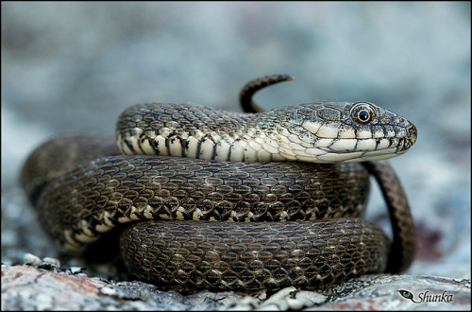
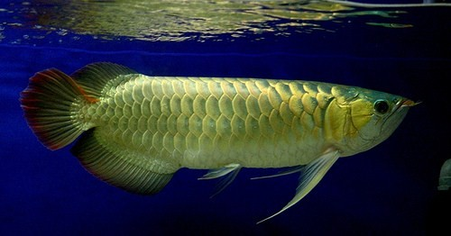

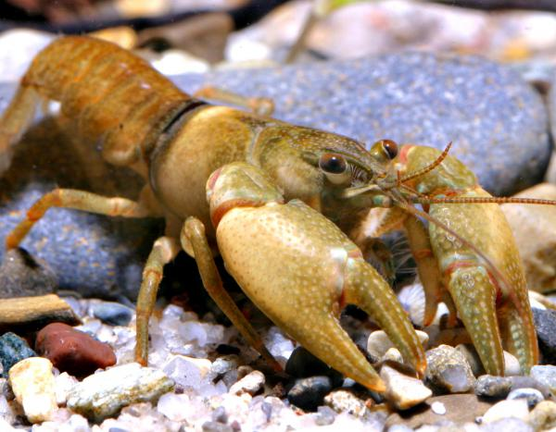
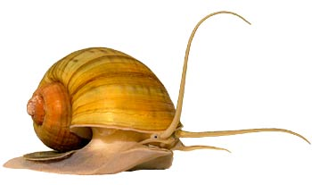
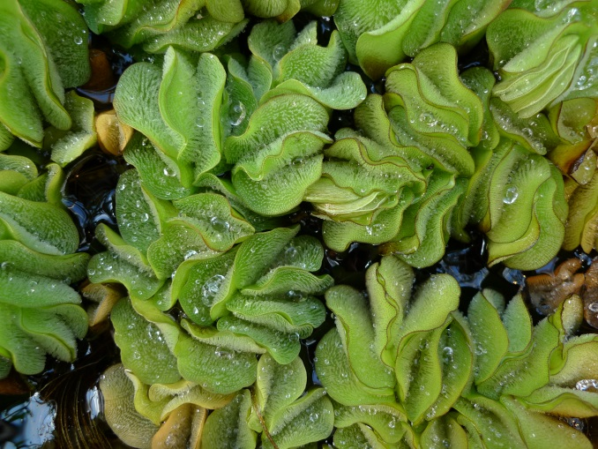
Which species should be considered high risk for future invasion into Pennsylvania under various climate scenarios?
Notes:
Essentially, I’m asking the question at a very HIGH level: What species should be considered high risk for future invasion into Pennsylvania under various climate scenarios?
Arawana, tesselated water snake, ditch fencing crayfish; florida applesnail

Slide 15
Notre Dame’s Science-Based Tools for Assessing Invasion Risk (STAIR)
Which traits allow a species to transition from introduced to established (having sustained, reproducing populations)?
Fish: Howeth, et. al. 2015 found that the match between the climate of the Great Lakes and the known range of a given species is the best predictor for whether it will become established; if the climate match is greater than 71.7 percent, then the species is likely to become established.
Plants: Combination of life history, climate tolerance, invasion history, ecology
Mollusks: Whether a species will become invasive depends on just one trait: the number of eggs or live offspring released per female per year; expanded to include climate match
Notes:
So why climate matching. Ultimately, I chose climate-matching as the main risk assessment strategy here because climate is a main basic filter. We know even if all other environmental conditions and resources are right, if the climate is too cold, or too warm for it’s tolerances, a species will not be able to persist. In addition, looking at work done by Notre Dame, Loyola University, and others doing work on risk assessments, they actually found that climate match came up as a main predictor that is used for Fish, Plants, and Mollusks when looking at traits that allow the transition from introduced to established. So for fish it’s actually the best predictor for whether a species will become established..for plants, it’s coupled with information on life history, invasion history, and ecology, and for mollusk, climate match is coupled with reproductive output

Slide 16
Selecting Species for Analysis
Obtain a list of potential invasive species (fish, plants, invertebrates)
Species list from 2011 study (Grise et al. 2011)
USGS NAS database
Global invasive species database
Species found in analogue states
USFWS Ecological Risk Screening Summaries (High risk species)
Filter out species
Species already present in the target region
No intentionally stocked species
No hybrids
118 SPECIES
Notes:
So diving more into the process end of things. The first step was to obtain a list of potential species that may pose a threat to Pennsylvania in the future; ie species that are not currently in Pennsylvania, but that are south of PA and have the potential to move northward. In my previous work, I had already developed an extremely large list of species by going through USGS Non-indigenous aquatic species database and choosing species that were not currently present in Pennsylvania, but again were south; and there were a few other filters, like we didn’t use intentionally stocked species, and we also didn’t use hybrids. To add to this list for this go around, I also looked at additional species in the Global invasive species database, species found in analogue states- or states that will have a future climate similar to Pennsylvania, and high risk species listed in the USFWS Ecological Risk Screening summaries. Overall I ended up with 118 species to look at

Slide 17
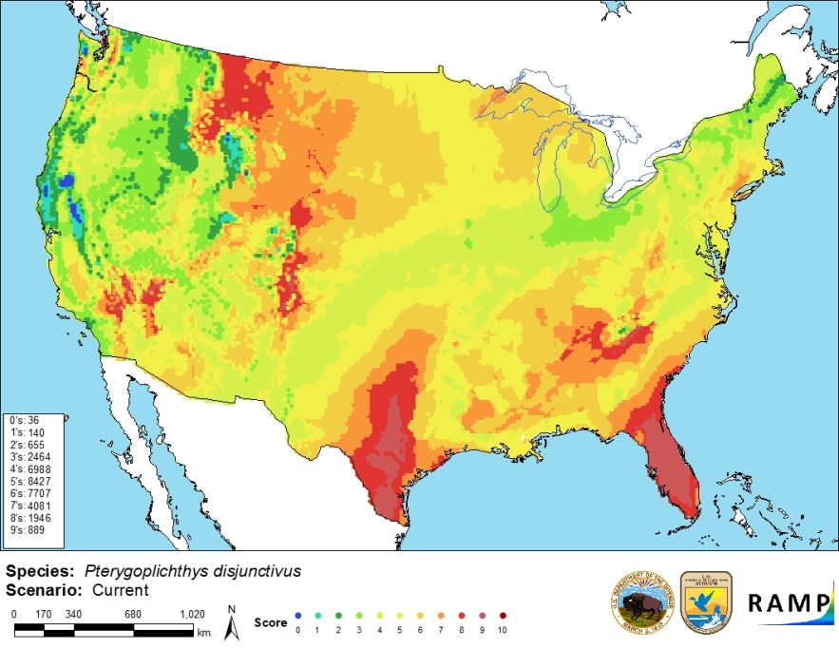
USFWS RISK ASSESSMENT MAPPING PROGRAM (RAMP)
Runs in ArcGIS
Uses16 climate variables and Euclidean algorithm
Temperature
Precipitation
Includes current and future climate scenarios (2050 and 2070)
RCP 2.6
RCP 4.5
RCP 8.5
RCP= Representative concentration pathway
Notes:
Here’s a little overview of the RAMP program, again it was developed by the USFWS, and it runs in ArcGIS, so basic knowledge of GIS is necessary to run the program, versus Climatch which I used in my first study, that was a browser based program that anyone could access. RAMP and CLIMATCH both run using the same 16 climate variables, which includes temperature and precipitation variables (average mean temperature, max/min temperatures of warmest coldest month, etc.) and the same Euclidean algorithm used in the Climatch program. But unlike climatch Ramp also has the built in ability to run under current and future climate scenarios… so it incorporates climate change right into it. These scenarios include a mid-future scenario at 2050 and a longer term scenario at 2070. There’s three representative concentration pathways, or RCPs which represents greenhouse gas emission scenarios relative to timeframe, for example, RCP 4.5 assumes that global green house gas emissions peak around 2040 and then decline where as an RCP of 8.5 emissions continue to rise through the 21st century.

Slide 18
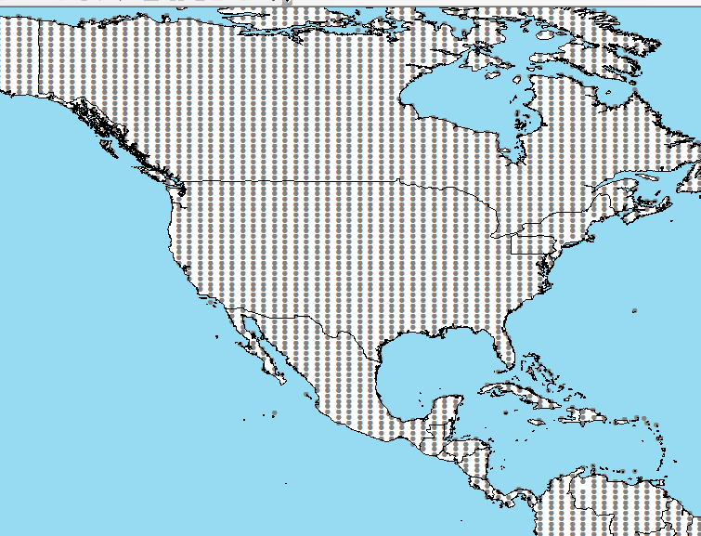
Increased from 1,960 U.S. weather stations in climatch to 42,638 points
Notes:
Another plus to using RAMP is the number of weather data points available for the United States, in CLIMATCH there was only 1,960 US weather points, which is now almost 43,000 points in RAMP, giving more a finer scale view of things.

Slide 19
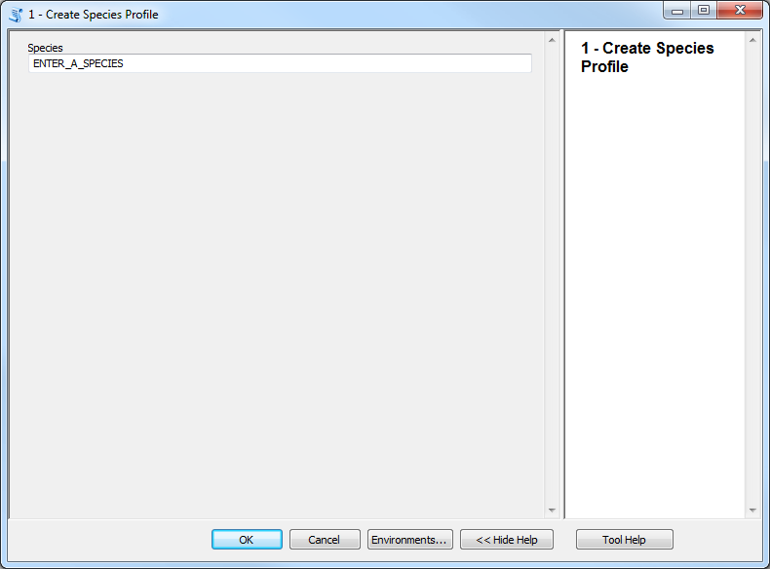
RAMP creates a species profile by directly obtaining species record information from the Global Biodiversity Information Facility (GBIF)
Notes:
Within the RAMP program, a dialogue box is used to enter the scientific name of your species of interest, and the program will automatically create a species profile folder by directly obtaining species record information from GBIF and pulling that information into a file.

Slide 20
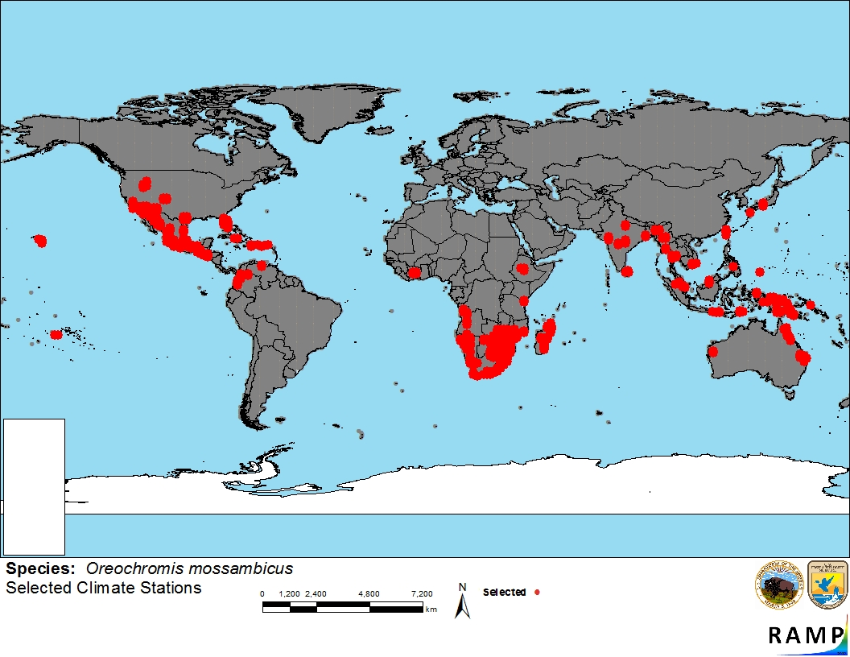
Pre-selection of species current range
Notes:
Based on the data pulled from GBIF, the program then creates a pre-selection of a species current range, so this is an example of Mozambique Tilapia showing occurrence records housed within the GBIF database

Slide 21
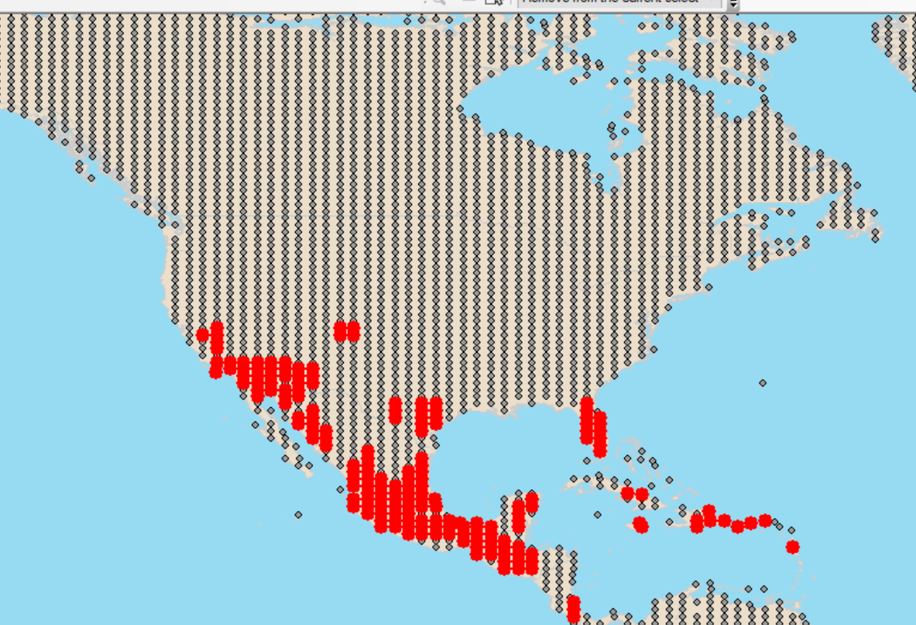
Identify and Remove the Outliers and unverified records
Notes:
But you have to look closer. RAMP allows you to go in and either add or remove weather stations based on additional knowledge or additional occurrence data and information for the species. So it’s important to go in and identify and remove any outliers you might see or unverified records. So for example, using USGS NAS to cross reference the information shown here for the Mozambique Tilapia, several of the US points that showed up in GBIF, I actually ended up removing, either they didn’t show up in USGS to verify the occurrence, or in this case a few points such as those in Idaho were records of the species being found in thermal pools and so weren’t an accurate representation of that species climate tolerance. So this is probably the most difficult step in trying to go through and verify all the points.

Slide 22
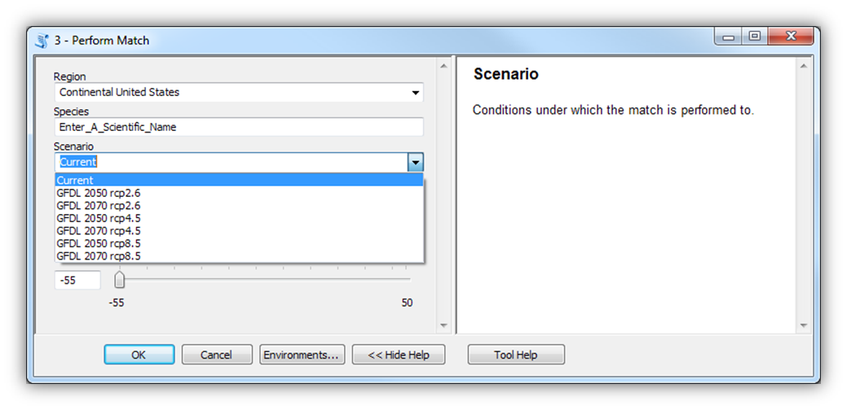
1. Choose a target range 2. choose a Climate scenario 3. run the match
Notes:
Once you are satisfied with the occurrence data in the pre-selection, you can move on to Step 3 which is actually performing the climate match. You have a choice of region, such as looking globally, the Continental U.S. or state by state. You then enter the scientific name of your species of interest and then choose your climate scenario. For this project, I’m running all of these scenarios from current climate on to compare species suitability depending on the different greenhouse gas concentrations and time frames.

Slide 23
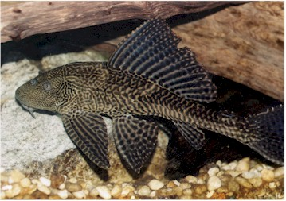
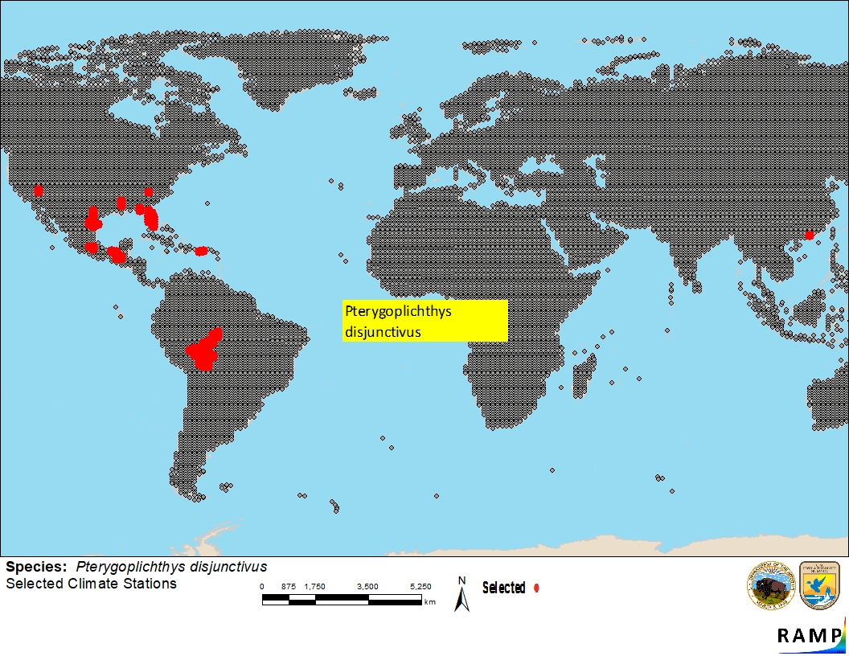
Example: Vermiculated Sailfin Catfish (Pterygoplichthys disjunctivus)
Notes:
So here’s an example of the process run all the way through with the vermiculated sailfin catfish. This is the occurrence data that I settled on for this species before running the match. So you can see a current range of South America, Mexico, and parts of the Southern United States.

Slide 24
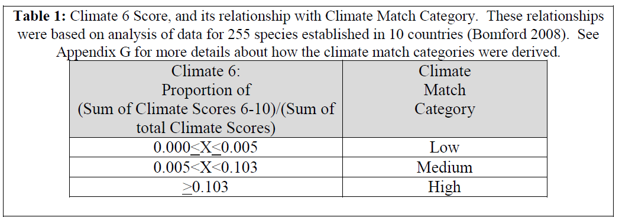
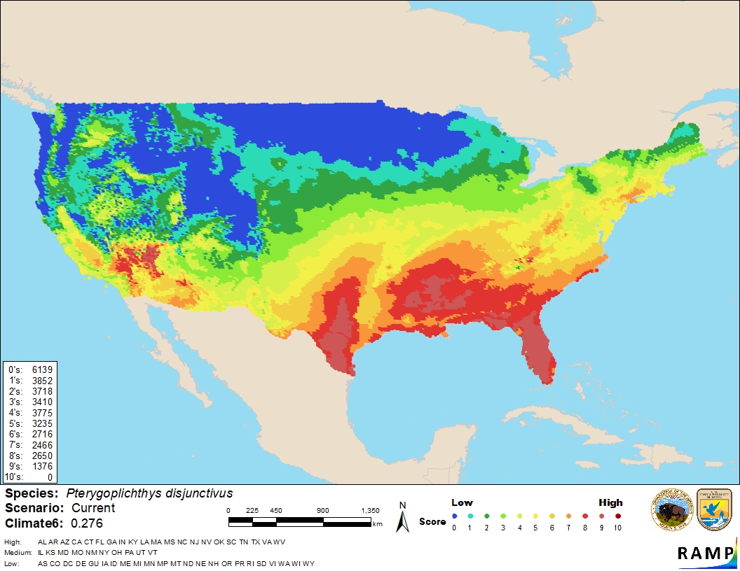
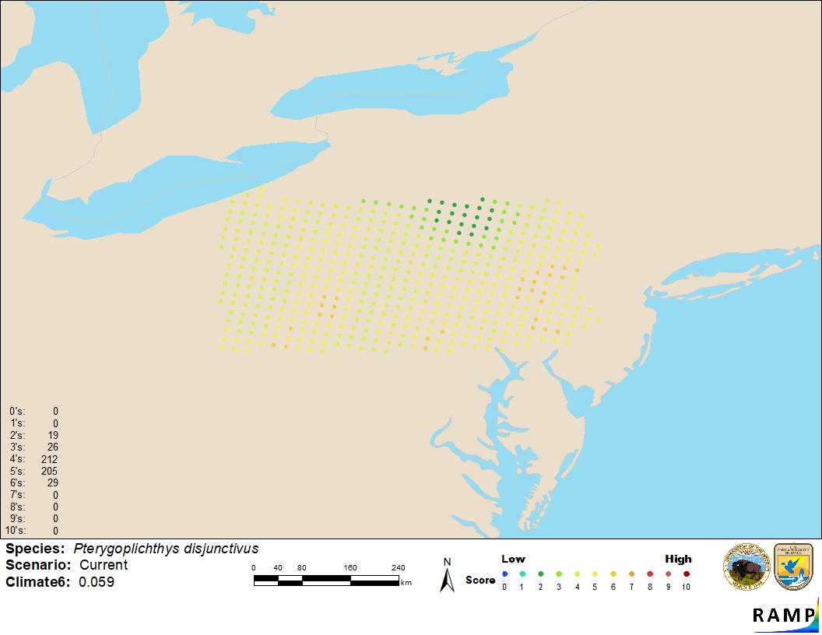
MEDIUM RISK
29/491 data points in PA=.059
Notes:
Then we ran the match for our current climate scenario. Here you can see results for the Vermiculated Sailfin Catfish for the entire United States, and then a closer up look at climate match for Pennsylvania. The output includes a color-coded numerical scale from 0-10 with 0 or blue being the lowest match and 10 in red being the highest match. Match is designated based on the species, climate6 score, which is the sum of climate scores 6 and greater, divided by the total number of climate scores. So for this example, there are a total of 491 data points used in Pennsylvania, and there are 29 points with a score of 6 (none higher), so 29/491 gives us a climate6 score of 0.059. So now if we look at the chart for climate match category, we see our climate match 6 score falls in the medium risk category.

Slide 25
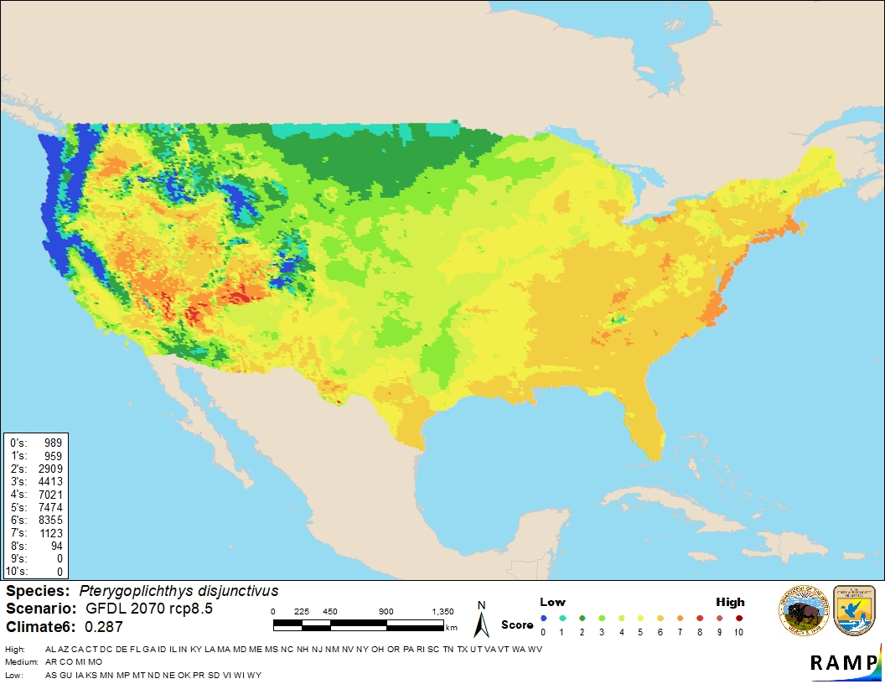

HIGH RISK
386/491 data points in PA=.786
Notes:
Now we can compare our current baseline with a future scenario. So here looking at the same output for Vermiculated Sailfin catfish, but looking at an RCP of 8.5 in 2070. Now to calculate our climate 6 score, we see we have 384 6’s and 2 7’s for at total of 386/491 gives us a climate score of .786, and we have now moved into the high risk category for this species. So this process is repeated for each of the 118 species identified for the project to help us find those species that are moving from low and medium risk ranges into the high risk zone.

Slide 26
Fish Scores
(current)
Scores greater than 6 (red line) are compatible with current climate
Notes:
So I’m still working on this project, and I’ve only managed to complete the fish species at this time. So this graph is showing the current average ramp score across all the species that were run through the RAMP analysis. Those species with score above 6 depicted by the red line, are species that are currently compatible with our climate.

Slide 27
Fish Scores
(future)
Notes:
Now we can compare those current scores with those of a future scenario. So here, we see the same species responses to a future scenario of rcp 8.5 in 2070 which is shown in the green line. You can see here quite a bit of variability in species that have both increased and decreased in suitability based on future climate impacts. You can also see species that have crossed the boundary from being previously unsuitable for our current climate, and becoming suitable in this scenario.

Slide 28
Fish Risk
Risk Level | Number of Fish Species
Low risk (no change) | 16
High risk (no change) | 32
Increased risk | 7
Decreased risk | 2
No Change: 84%
Increased Risk: 12%
Decreased Risk: 2%
Notes:
So let’s take a look at the fish risk and the percent change in risk based on climate. 16 species of fish were considered low risk from the start, and remained low risk throughout each climate scenario. 32 species were considered high risk currently and remained that way in each scenario. 7 increased in risk and 2 decreased in risk. So 84% of species experienced no change, 12 % increased in risk, and 2% decreased in risk.

Slide 29
High Risk Fish
Common Name | Scientific Name | Increase in Climate6 score | Change in Risk
Vermiculated Sailfin catfish | Pterygoplichthys disjunctivus | 73% | Increased from Medium to High Risk
Blue Tilapia | Oreochromis aureus | 37% | High risk
Redbelly Tilapia | Tilapia zillii | 26% | High risk
Amazon sailfin catfish | Pterygoplichthys pardalis | 47% | High risk
Nile Tilapia | Oreochromis niloticus | 54% | High risk
Least Killifish | Heterandria formosa | 94% | Increased from Medium to High Risk
Rough shiner | Notropis baileyi | 76% | Increased from low risk to high risk
Butterfly Peacock Bass | Cichla ocellaris | 84% | Increased from low risk to high risk
Notes:
So let’s look at a snapshot of some of our high risk fish. This isn’t a comprehensive list yet, but just an example of some of the species we are looking at. I included some examples of high risk species that didn’t have a change in risk level, and some that had increases in risk. So we see again here the vermiculated sailfin catfish, the least killifish, the rough shiner, and the butterfly peacock bass all had increases in their climate6 scores.

Slide 30
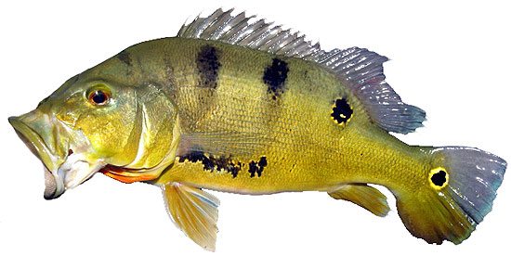
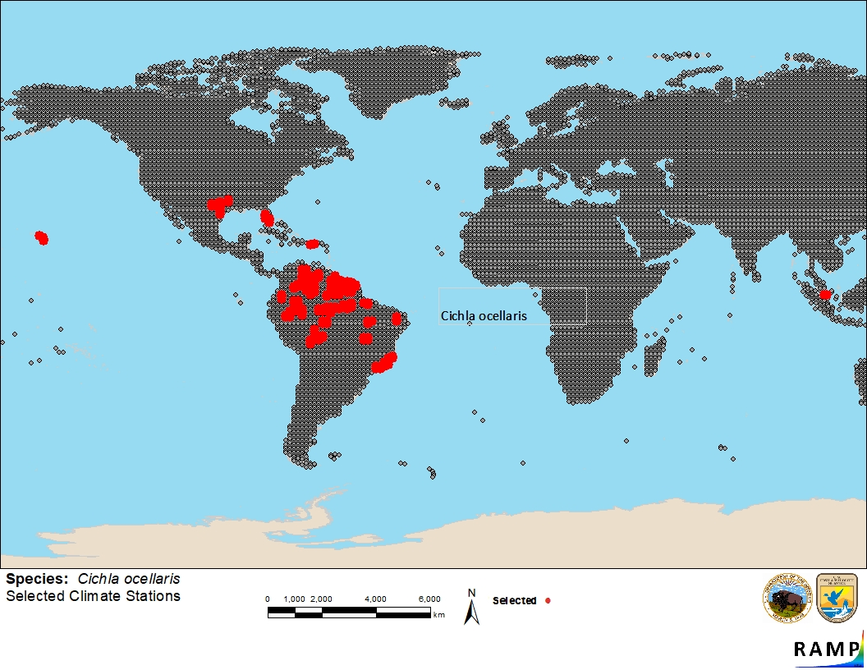
Butterfly Peacock Bass (Cichla ocellaris)
Native Range: South America
Introduction: Stocked by state agencies in Florida as a sport fish and biological control agent
Impacts: Voracious piscivore capable of greatly modifying ecosystems where introduced. Some studies have reported as much as a 25% decline of forage fish from canals in which C. ocellaris have been introduced.
Current Climate6: 0
2050 rcp 8.5: 0.344
2070 rcp 8.5: 0.841
Increase of 84% suitability!
Notes:
So let’s look a little bit closer at one of the species that is currently not considered a threat with a climate6 of 0, but becomes a threat by mid-century, with an increase of 84% suitability by the end of the century. The butterfly peacock bass is native to restricted areas in South America. It’s has been intentionally stocked as a sport fish and as a biological control by some state agencies in Florida where it established. It’s also been introduced to areas in Hawaii and Guam, and Puerto Rico. In areas where it has been introduced, it has had a significant impact on populations of native fish, with some studies reporting as much as a 25% decline of forage fish.

Slide 31
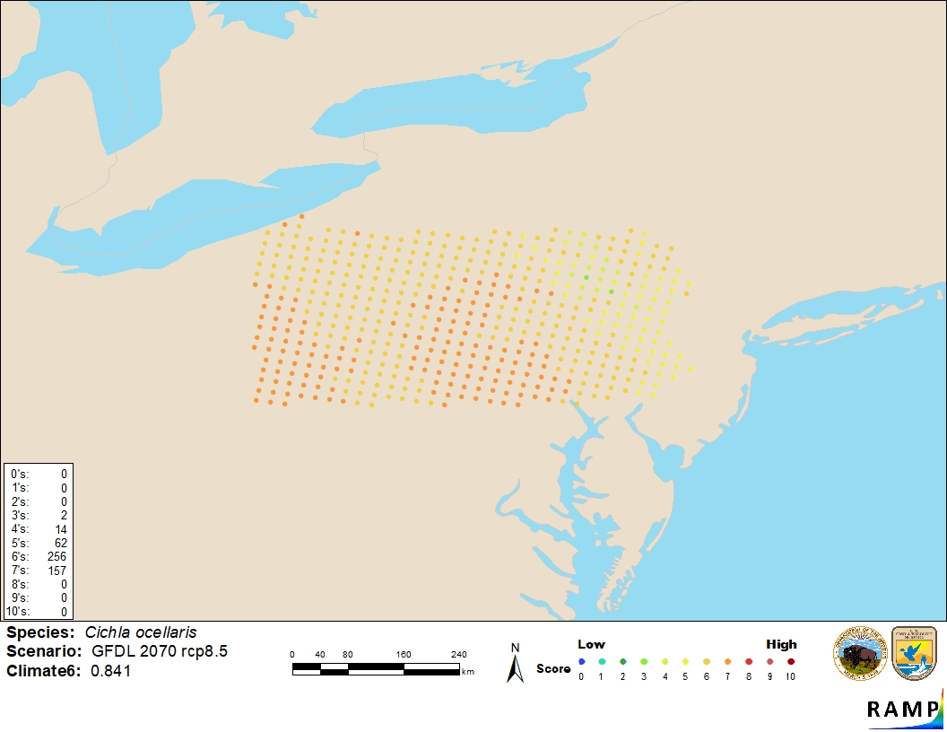
413/491 score of 6 or greater
= Climate6 of 0.84

Slide 32
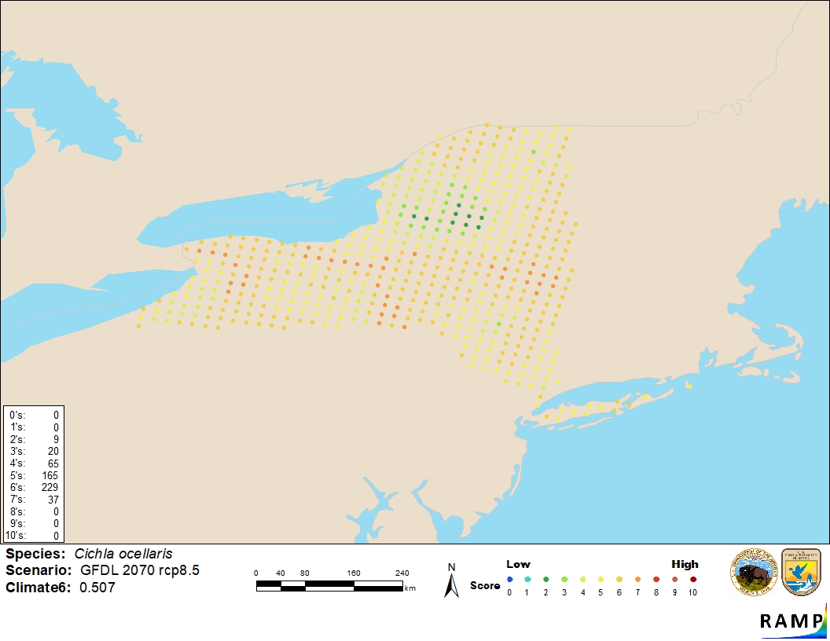
0/425 score of 6 or greater
= Climate6 of 0
266/425 score of 6 or greater
= Climate6 of .507

Slide 33
Limitations
Distribution changes of invasive species are difficult to relate to climate because they may not have had time to spread to their climatic limits
The rate at which a species spreads depends on many system and species-specific factors, and these factors make it difficult to form broad generalizations
Provides only a first “filter”
RAMP source records pulled from GBIF are difficult to QA/QC and may be subjective; one record included or not included may have a significant impact on the output
Notes:
So again, this study is meant to look at things in more of a big picture sense and there are many limitations to doing a study like this. First is that distribution changes of invasive species are difficult to relate to climate because not all species may have had time to spread to their climatic limits, so there’s issues with accuracy concerning distributions that are used in the analysis.
Second, the rate at which a species spreads depends on many system and species specific factors beyond climate matching, which make it difficult to form broad generalizations, so this work should be viewed as a “first pass” at narrowing down an extremely large list of species to give a more manageable number of species to look at more in depth.
Last as I mentioned previously, RAMP source records pulled from GBIF are difficult to quality control and may be subjective. One record included or not included may have a significant impact on the output. So depending on whether you choose to include a record or not, may make a big difference.

Slide 34
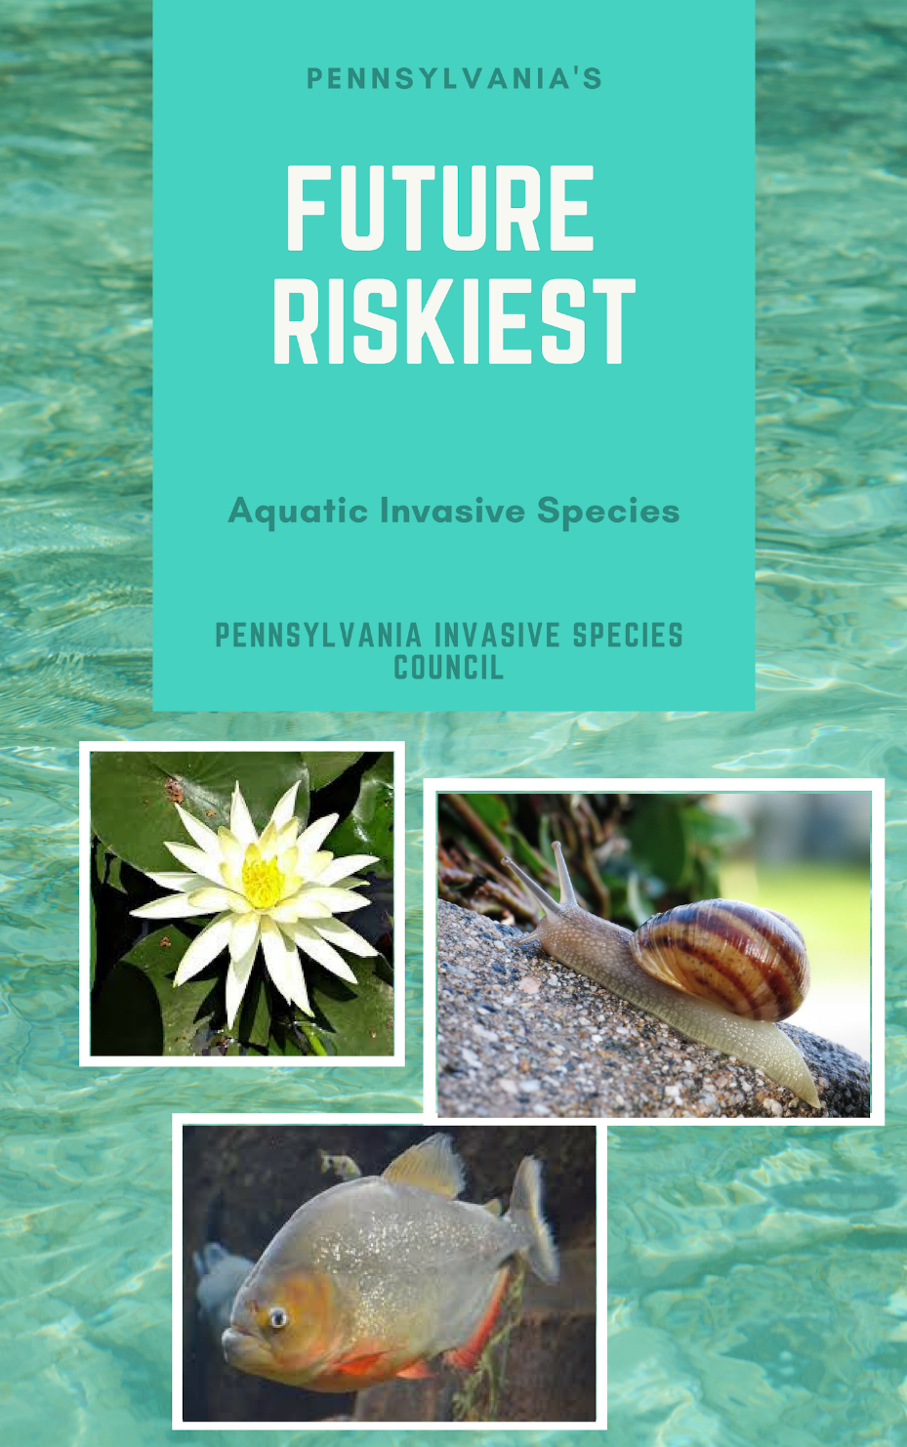
Supplement Pennsylvania’s Aquatic Invasive Species management plan
Notes:
My hopes for work like this is to help our natural resource managers begin to think more proactively rather than reactively about aquatic invasive species, and provide some insight on which species we may want to consider looking at in the future. Currently, Pennsylvania's AIS management plan does not include climate change considerations, so as I finish running the analysis on the additional species, I would also like to include more in-depth analyses on the species that come out as “high risk” so that we can then pull together a list of Pennsylvania’s future riskiest species and provide some considerations for future work. Also, as Shown in the peacock bass example, many if not most of the species run through this analysis would probably have similar results for New York, making this work and the results applicable to other areas with similar climates.

Slide 35
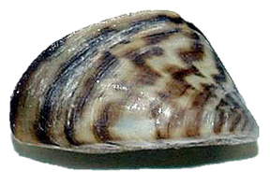
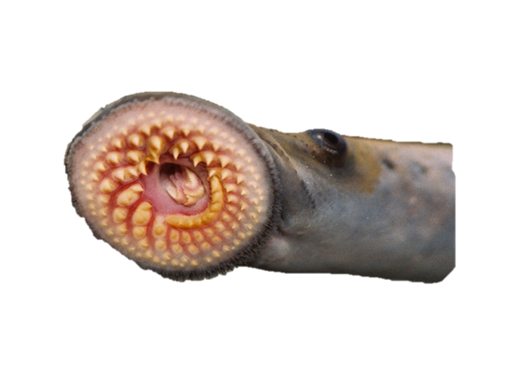
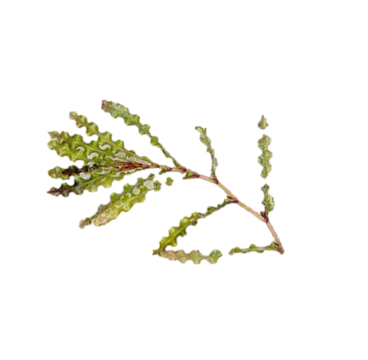

RESEARCH
EXTENSION
EDUCATION
Sara Stahlman
Extension Leader
Pennsylvania Sea Grant
814-217-9011 ext. 109
sng121@psu.edu
Building Bridges Between Science and People seagrant.psu.edu
Notes:
So with that, I’ll take any questions you all might have

