Slide 1
Herbicides as Part of Integrated Strategies for Aquatic Plant Management
Robert J. Richardson
North Carolina State University
Crop and Soil Science Department

Slide 2
Integrated Aquatic Plant Management
Monitoring and surveys
  Invasive weeds
  Non-target populations
Planning and Decision Making
  Review monitoring and management each year
  Determine what you don’t know
  Coordinate research or other data collection
Implementation of Management

Slide 3
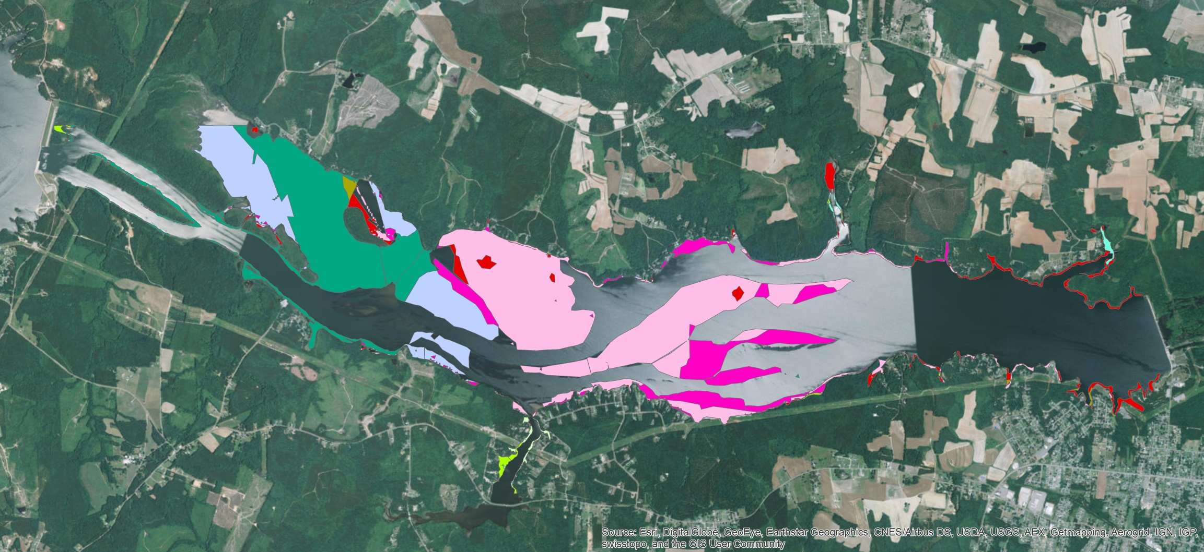
Roanoke Rapids SAV Distribution 2014
1,800 A vegetation

Slide 4
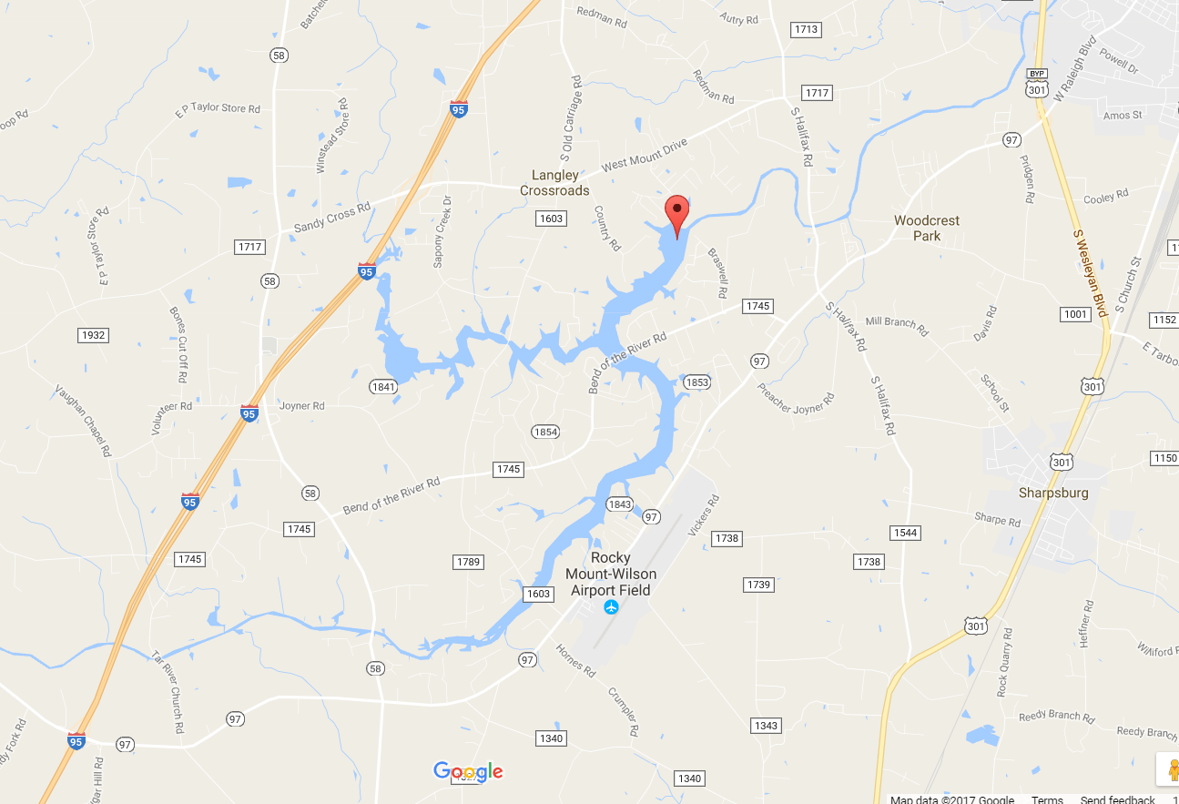
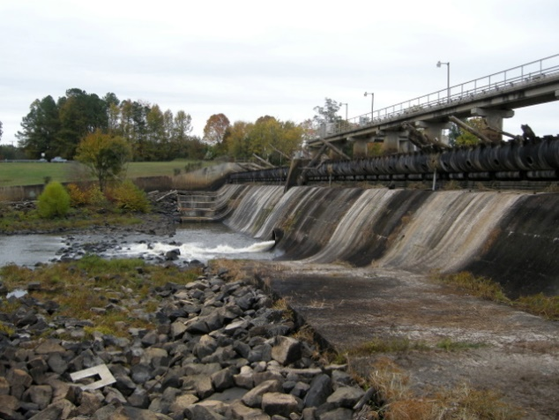
Developing Programs
Tar River Reservoir
Notes:
- herbicide trials to determine sensitivity of a native submersed plant to herbicides that are typically used to control hydrilla.
- Eno River State Park organized volunteers to determine the feasibility of hand-removal.
NCAWP, with NCSU, performed spot treatment herbicide applications to determine effectiveness under Eno flowing conditions.
- Dr. Greg Cope performed toxicity tests on glochidia (larval) and juvenile stages of some aquatic mussel species and the Panhandle Pebblesnail (Somatogyrus virginicus), using herbicides that are being considered.
- Hydrilla management at West Fork Eno Reservoir, Corporation Lake, and Lake Orange has been conducted by the NCAWP in conjunction with the Town of Hillsborough, Orange-Alamance Water Systems, and Lake Orange, Inc., respectively.

Slide 5
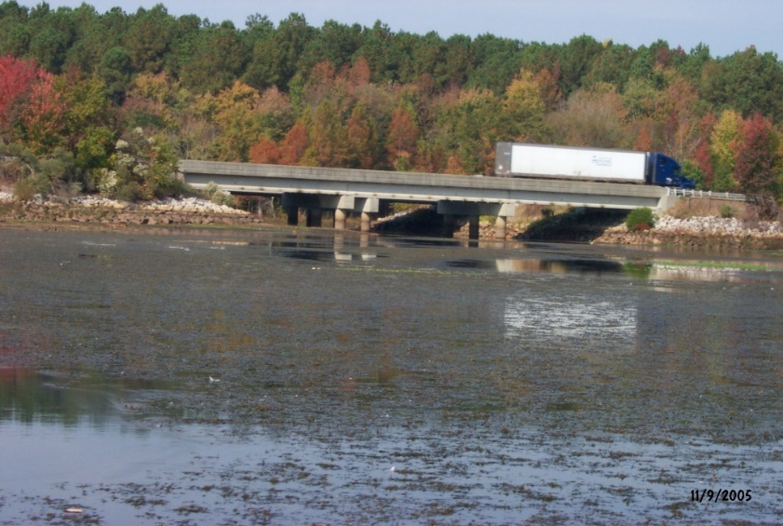
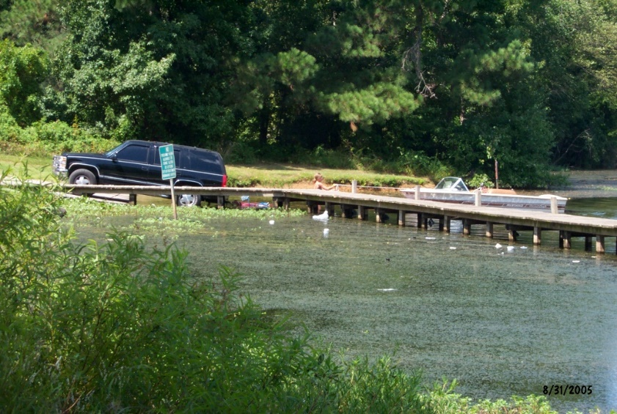
Tar River Reservoir – Simple Scenario
1650 acre reservoir
~333 ac of hydrilla found in 2005
Rare species in Tar River (downstream); nothing of significance within infested area
Treated annually with Fluridone from 2007 to 2012
Notes:
Dewatered in 2007 due to drought conditions (done after fluridone treatments)
Tar river reservoir is source of drinking water for town of Rocky Mount
Hydrilla infestation began in sapony creek arm in early 2000’s

Slide 6
Tar River Reservoir
Goal: Eradicate hydrilla from reservoir.
Fluridone treatments eliminated standing hydrilla biomass and severely depleted tuber bank by 2012.
  Target application rate of <5 ppb
Transitioned to ultra-low grass carp stocking rate (0.5 fish per tuber acre*) in 2013.
*Tuber acre = total acres previously occupied by hydrilla
Notes:
Tar river 1st year mortality: 33%
2013, just a staging year, needed to get fish into system

Slide 7
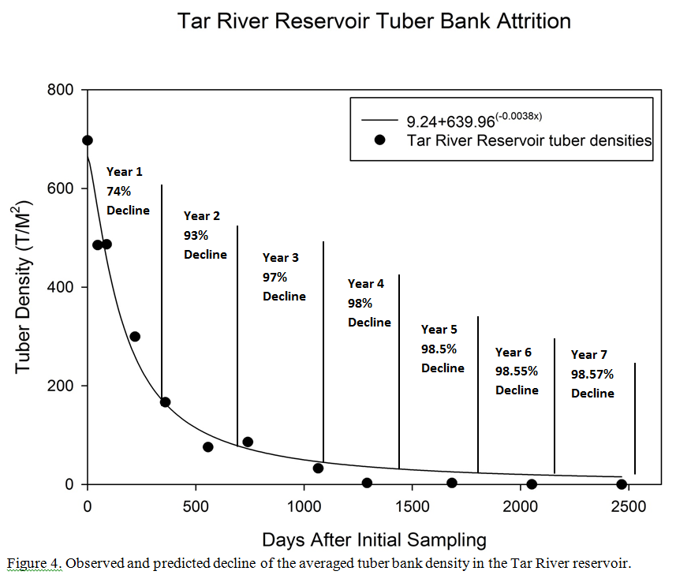
Fluridone
Fluridone
Fluridone
Fluridone
Fluridone
Grass carp
Grass carp

Slide 8
Summary – Tar River Res
No hydrilla observed after first 2-3 years of management
Tubers documented to decline annually
Very low grass carp stocking rate provided “functional” eradication

Slide 9
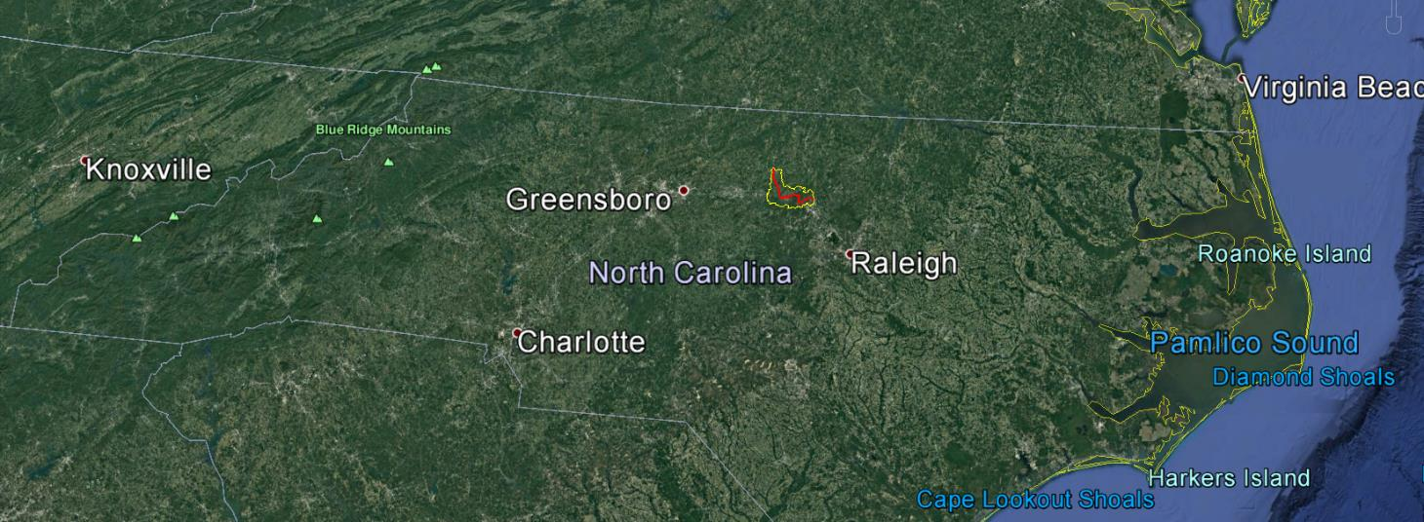
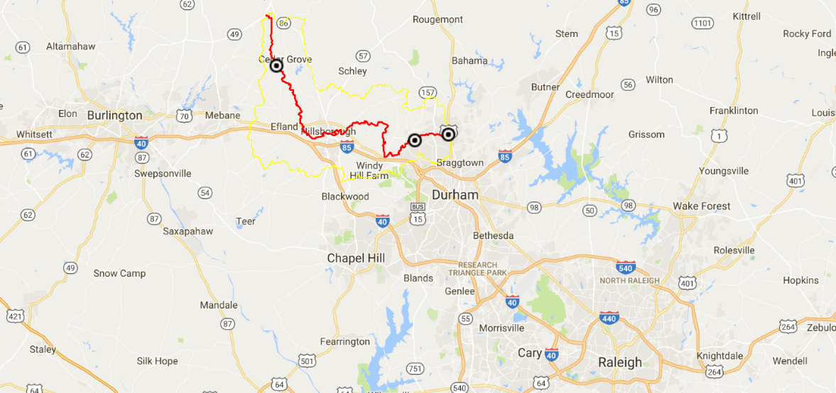
Eno River, North Carolina

Slide 10
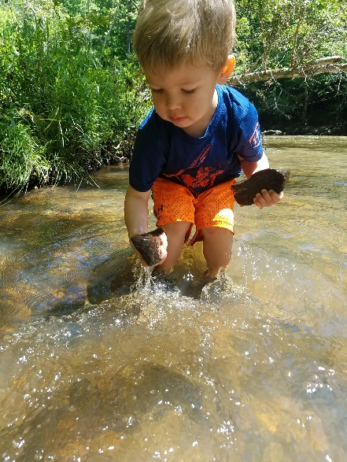
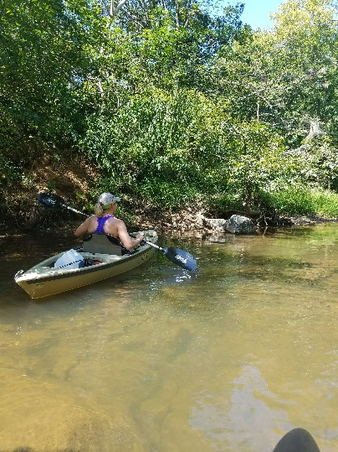
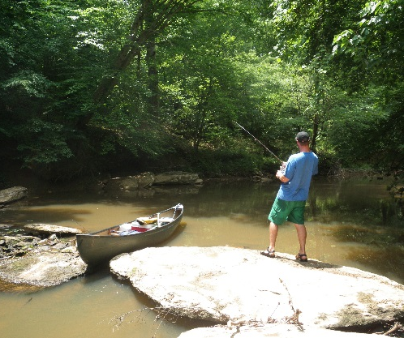
Eno River
~ 28 River Miles in Length
~ 150 Square Miles of Watershed
Forms Headwaters to Neuse River Basin
Shallow and Swift
Riffle / Run / Pool Habitats
  Rock Outcroppings / Waterfalls
Roanoke Bass – Gamefish Species of Greatest Concern
High Recreational Value

Slide 11
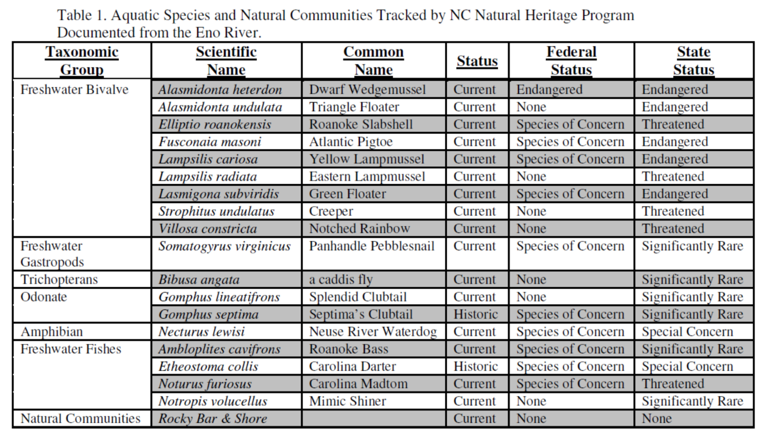

Slide 12
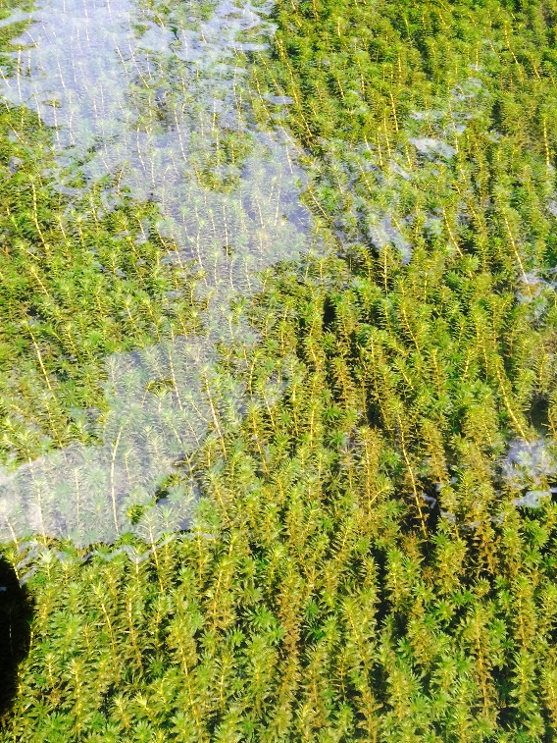
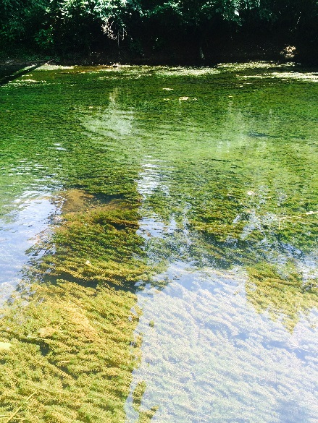
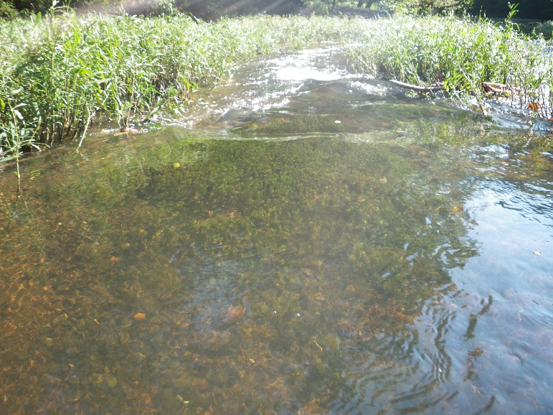
Eno River and Hydrilla

Slide 13
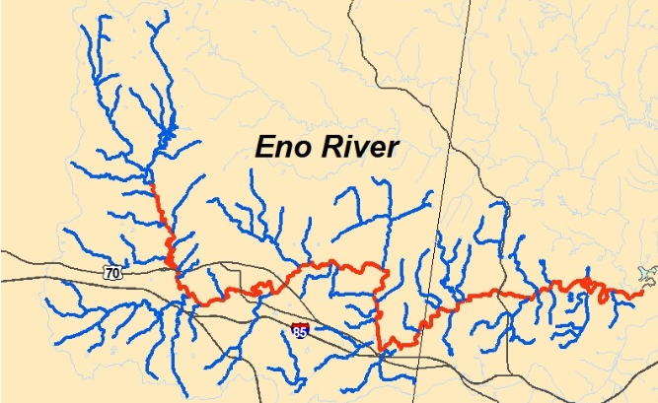

Eno River and Hydrilla
First Recorded in Lake Orange
  Early 1990’s
First Reported in the Mainstem
  2005
  Eno River State Park

Slide 14
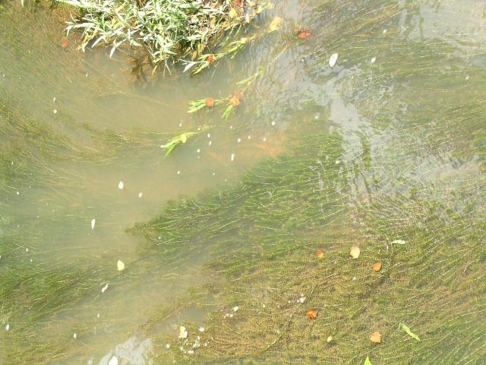

Slide 15
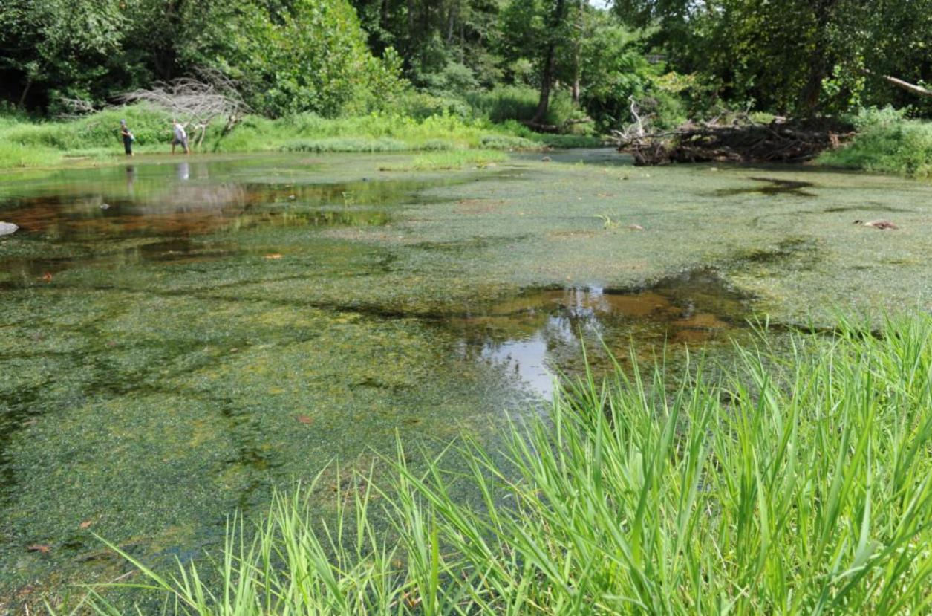
Eno Hydrilla Infestation
August 2011

Slide 16
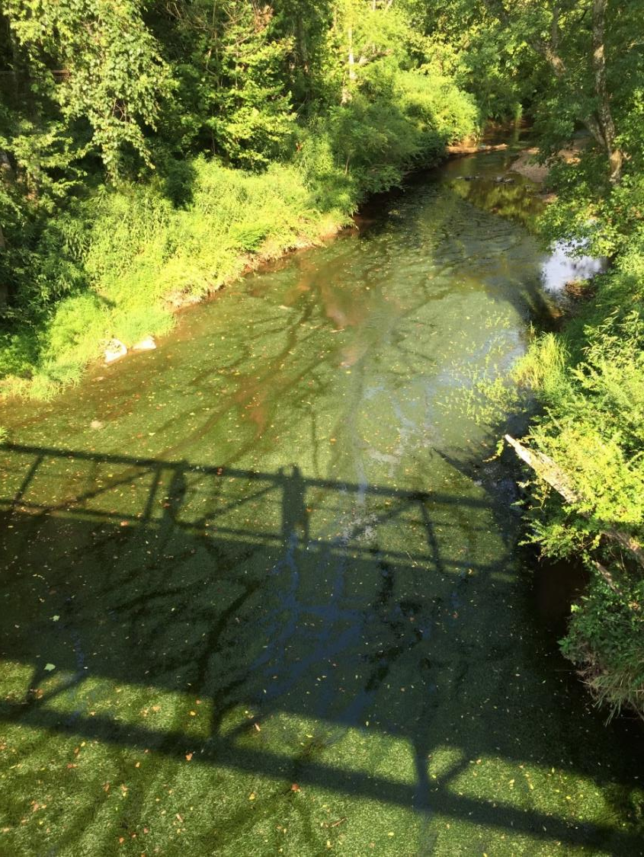
Eno Hydrilla

Slide 17
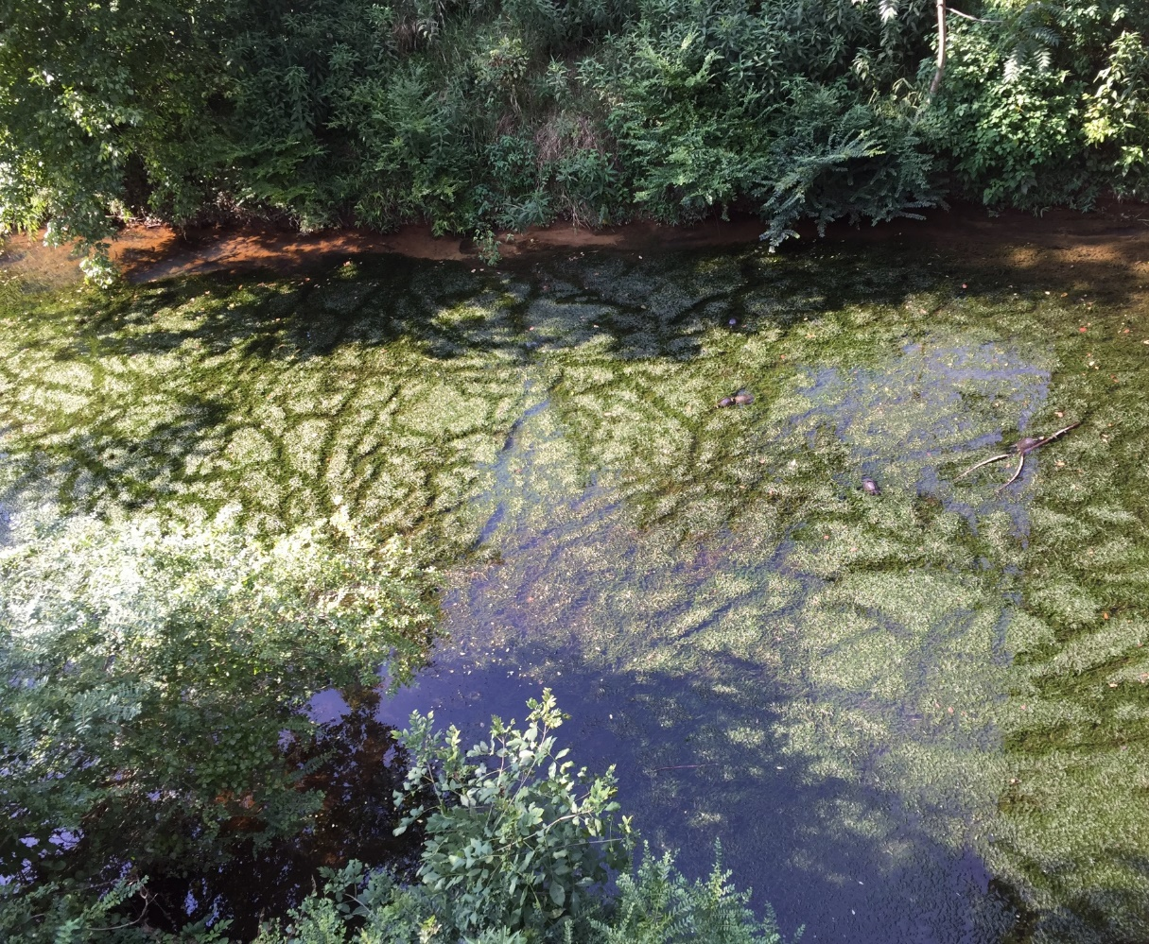
Eno Hydrilla

Slide 18
Selecting Control Options
Weed Growth
Control Options for Stage of Weed Growth
Prevention
Early
Invasion
Hand-
weeding
Benthic
Barrier
Mid
Invasion
Suction
Dredge
Weed Biomass
Late
Invasion
Habitat
Saturated
Mechanical
Harvesting
Grass
Carp
Biocontrol
Herbicide
Drawdown

Slide 19
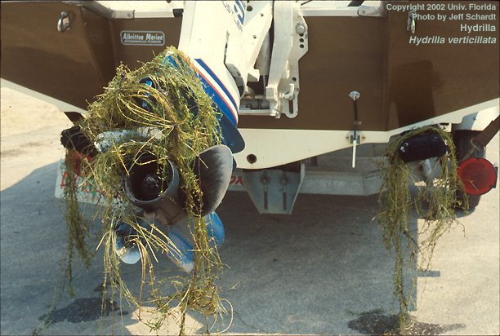
Selecting Control Options
Weed Growth
Control Options for Stage of Weed Growth
Prevention
Prevention
Too late for that…
Early
Invasion
Mid
Invasion
Weed Biomass
Late
Invasion
Habitat
Saturated

Slide 20
Selecting Control Options
Weed Growth
Control Options for Stage of Weed Growth
Handweeding
Most common management form
Generally for special situations with no other options
Highly labor intensive/inefficient
  Aquatic plants may be up to 98% water
  Volunteers are cost effective, but limited
    Liability: back injury, risk of heart attack or stroke
Plants may reproduce as fast as removed
Pulling will disturb soil and may disturb native species
Tried and failed on Eno
Early
Invasion
Hand-
weeding
Mid
Invasion
Weed Biomass
Late
Invasion
Habitat
Saturated

Slide 21
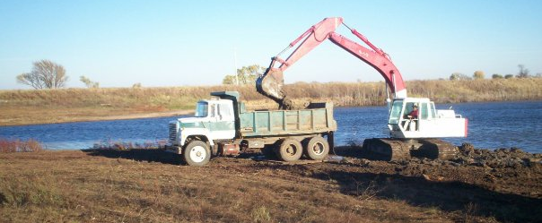
Selecting Control Options
Weed Growth
Control Options for Stage of Weed Growth
Mechanical Techniques
Short term control only
Produces many fragments than can spread infestation (Falls Lake)
Can be very destructive to non-target species
Cannot access all areas of the Eno
Not a viable option
Early
Invasion
Mid
Invasion
Suction
Dredge
Weed Biomass
Late
Invasion
Habitat
Saturated
Mechanical
Harvesting

Slide 22
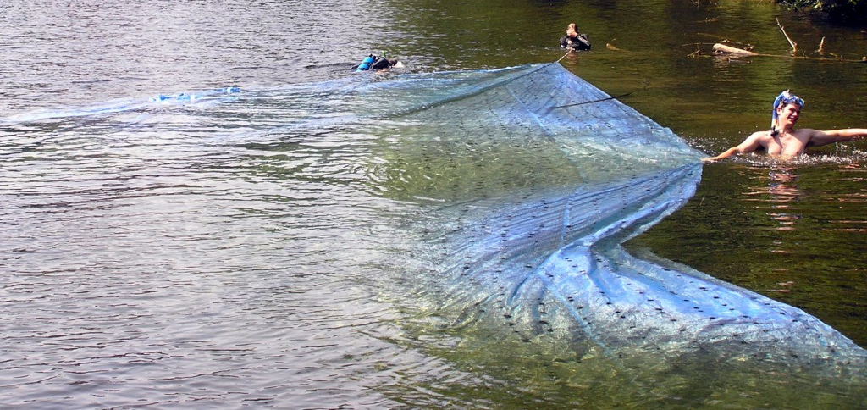
Selecting Control Options
Weed Growth
Control Options for Stage of Weed Growth
Benthic barrier
Woven fabric placed along sediment
Prevents weed growth from sediment
Ineffective once sediment deposits on top
Used in impoundments, not rivers
Impacts to non-target organisms
Not selective, not an option for Eno
Early
Invasion
Benthic
Barrier
Mid
Invasion
Weed Biomass
Late
Invasion
Habitat
Saturated

Slide 23
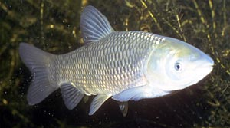
Selecting Control Options
Weed Growth
Control Options for Stage of Weed Growth
Triploid Grass Carp
Introduced from Asia
Sterile version may be stocked
Feeds on plants only
Generally a non-specific herbivore although they do like hydrilla
Concerns:
  Will they stay in Eno?
  If so, how much will they feed on riffleweed?
Research needs to address concerns before large scale stocking of Eno
Early
Invasion
Mid
Invasion
Weed Biomass
Late
Invasion
Habitat
Saturated
Grass
Carp

Slide 24
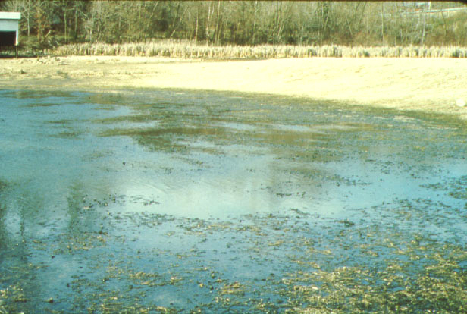
Selecting Control Options
Weed Growth
Control Options for Stage of Weed Growth
Drawdown
Cannot dewater a flowing river
Impacts to non-target species
Not an option
Early
Invasion
Mid
Invasion
Weed Biomass
Late
Invasion
Habitat
Saturated
Drawdown

Slide 25
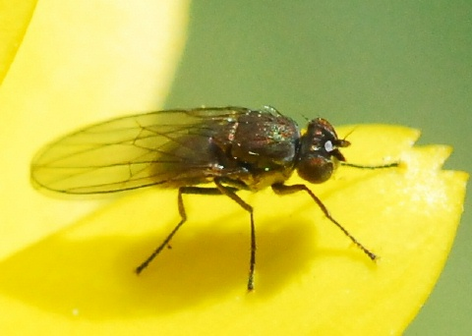
Selecting Control Options
Weed Growth
Control Options for Stage of Weed Growth
Host specific biocontrol
Agents released for dioecious hydrilla in Florida have had no significant impact
These agents must overwinter on hydrilla to survive
Monoecious hydrilla in NC has no overwintering biomass
Not an option
Early
Invasion
Mid
Invasion
Weed Biomass
Late
Invasion
Habitat
Saturated
Biocontrol

Slide 26
Selecting Control Options
Weed Growth
Control Options for Stage of Weed Growth
Herbicides
Specific products may be selective or non-selective to plants
Usually plant-specific modes of action
Can be used on small to large scale depending on system
Aquatic herbicides do not bioaccumulate
Registered by EPA and NCDA
Extensive use history in NC:
  Lake Gaston
  Lake Waccamaw
  Lake Tillery
Early
Invasion
Mid
Invasion
Weed Biomass
Late
Invasion
Habitat
Saturated
Herbicide
Notes:
Herbicides have been used in flowing water systems:
Erie canal
Western irrigation canals

Slide 27
Eno River and Hydrilla
Eno River Hydrilla Management Task Force – 2013
    Technical Advisory Board
      Town of Hillsborough
      Cities of Durham / Raleigh
      Orange and Durham County
      North Carolina State University
      NC Division of State Parks and Recreation
      NC Wildlife Resources Commission
      NC Division of Water Resources
      NC Department of Health and Human Services
      NC Department of Agriculture and Consumer Services
      US Fish and Wildlife

Slide 28
Activities of Task Force
Meetings, meetings, meetings….
  State agency meetings since 2007
  Plan course forward
Research:
  Herbicide impacts to riffleweed (primary native plant)
  Herbicide impacts to non-plant species
  Grass carp tagging and monitoring
  River surveys
Attempted hand removal – failed
Spot herbicide application – failed
Hydrilla management in nearby impoundments
Notes:
- herbicide trials to determine sensitivity of a native submersed plant to herbicides that are typically used to control hydrilla.
- Eno River State Park organized volunteers to determine the feasibility of hand-removal.
NCAWP, with NCSU, performed spot treatment herbicide applications to determine effectiveness under Eno flowing conditions.
- Dr. Greg Cope performed toxicity tests on glochidia (larval) and juvenile stages of some aquatic mussel species and the Panhandle Pebblesnail (Somatogyrus virginicus), using herbicides that are being considered.
- Hydrilla management at West Fork Eno Reservoir, Corporation Lake, and Lake Orange has been conducted by the NCAWP in conjunction with the Town of Hillsborough, Orange-Alamance Water Systems, and Lake Orange, Inc., respectively.

Slide 29
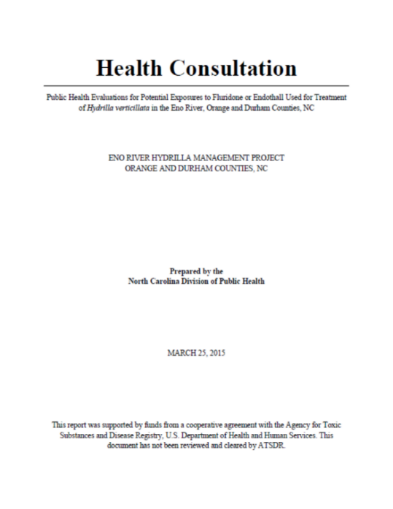
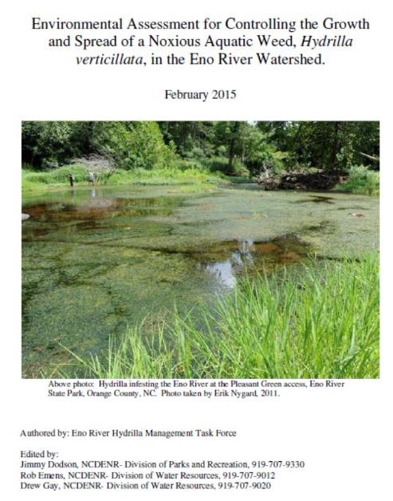
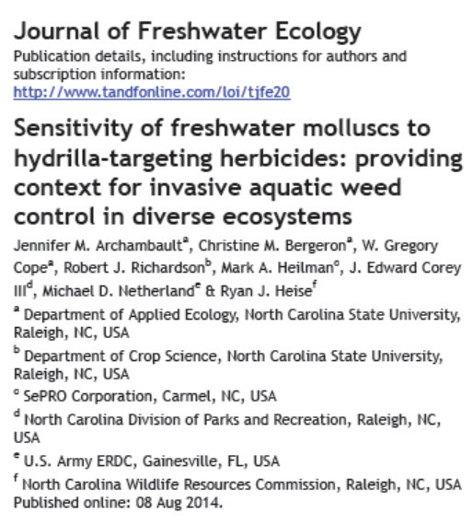
Public Health and Environmental Assessments for
Eno River Hydrilla Management

Slide 30
Implement Pilot Study
Goal: Reduce hydrilla biomass in the target area with no impacts to non-target species
Objectives:
  Determine effectiveness in controlling hydrilla in highly variable flow Eno River
  Monitor non-target species for any impacts
What is success?
  Reduction of hydrilla biomass to non-problematic levels
  Reduction of hydrilla turion bank is even better
Future: Must determine next step if outcome is positive or negative
Notes:
- herbicide trials to determine sensitivity of a native submersed plant to herbicides that are typically used to control hydrilla.
- Eno River State Park organized volunteers to determine the feasibility of hand-removal.
NCAWP, with NCSU, performed spot treatment herbicide applications to determine effectiveness under Eno flowing conditions.
- Dr. Greg Cope performed toxicity tests on glochidia (larval) and juvenile stages of some aquatic mussel species and the Panhandle Pebblesnail (Somatogyrus virginicus), using herbicides that are being considered.
- Hydrilla management at West Fork Eno Reservoir, Corporation Lake, and Lake Orange has been conducted by the NCAWP in conjunction with the Town of Hillsborough, Orange-Alamance Water Systems, and Lake Orange, Inc., respectively.

Slide 31
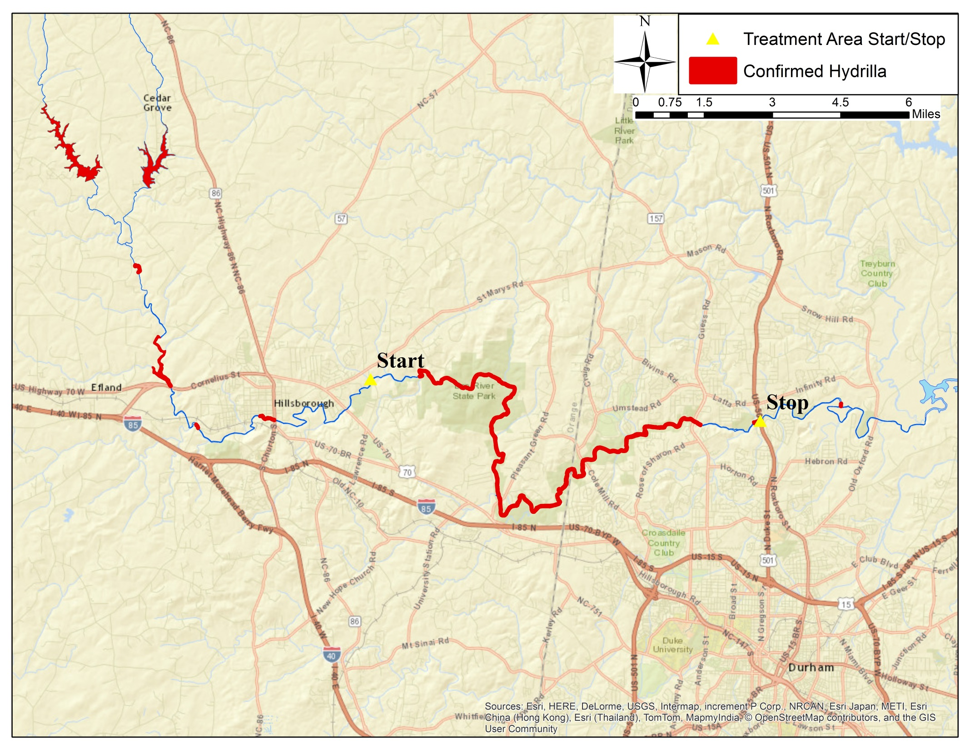
Management Pilot Study
Expected loss of herbicide activity due to dilution by US501
Herbicide drip at Lawrence Rd.

Slide 32
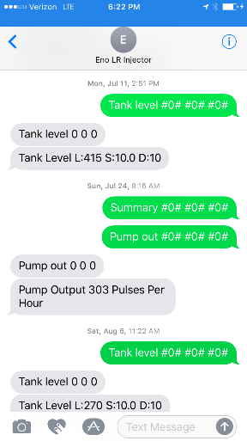
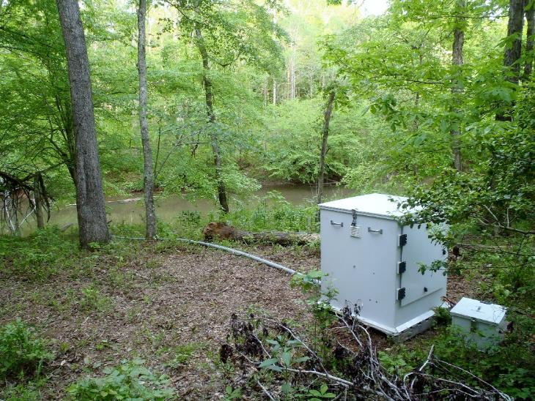
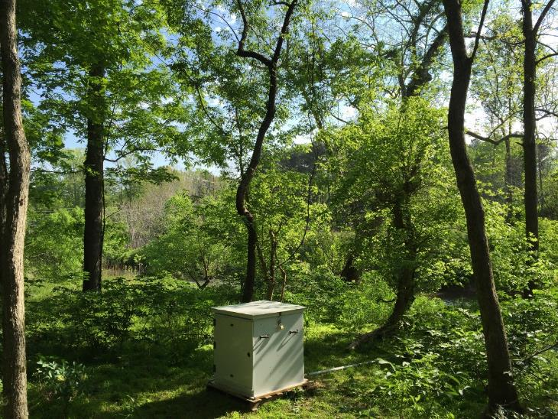
Implementation of Sonar Genesis low-dose injection treatment
2015 – single injector
2016 – two injectors
Eno River – Lawrence Road Injector
Eno River – Pleasant Green Injector
Remote control of automated injection systems with cellular
communications and rate corrections based on USGS discharge data
at locations 4 miles upstream and at downstream end of management zone

Slide 33
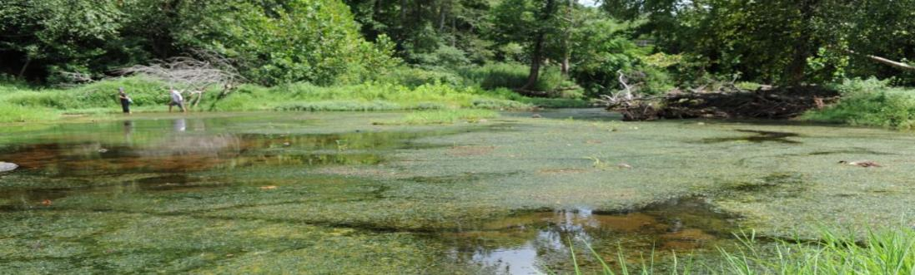
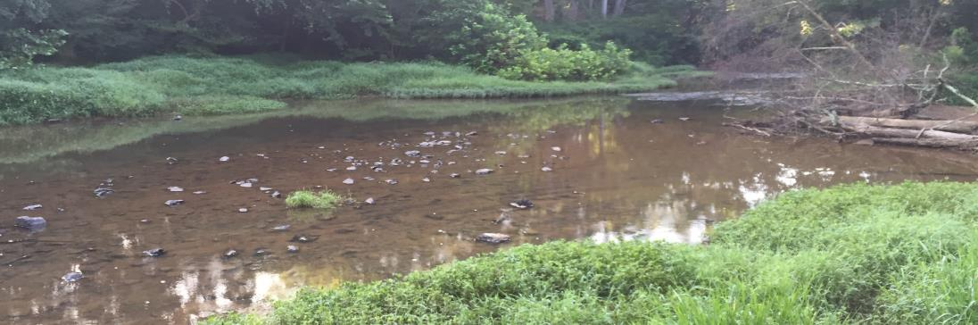
Before / After
2011
2016
Mark A. Heilman, Ph.D.
Senior Aquatic Technology Leader

Slide 34
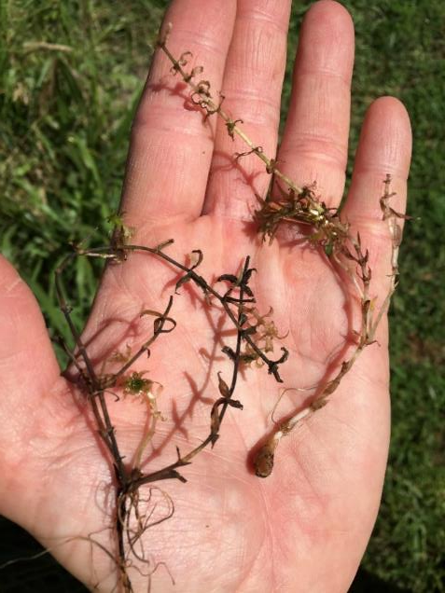
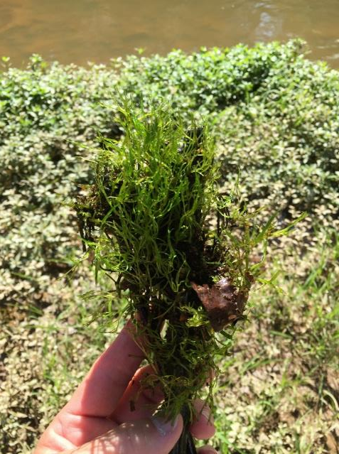
June 10, 2016 – Sonar-injured hydrilla (left) and healthy riffleweed (right) at Pleasant Green access
June 10, 2016 – Sonar-injured hydrilla (left) and healthy riffleweed (right) at Pleasant Green access

Slide 35
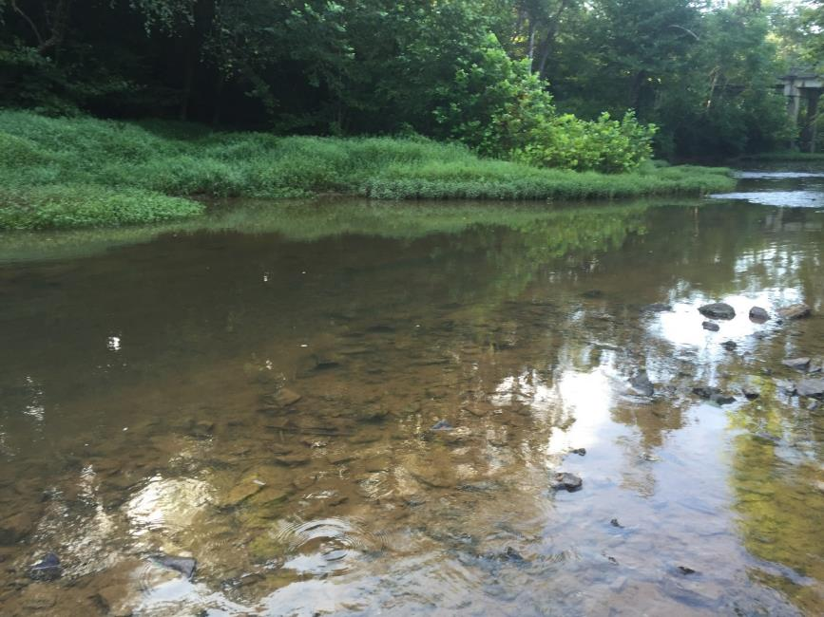
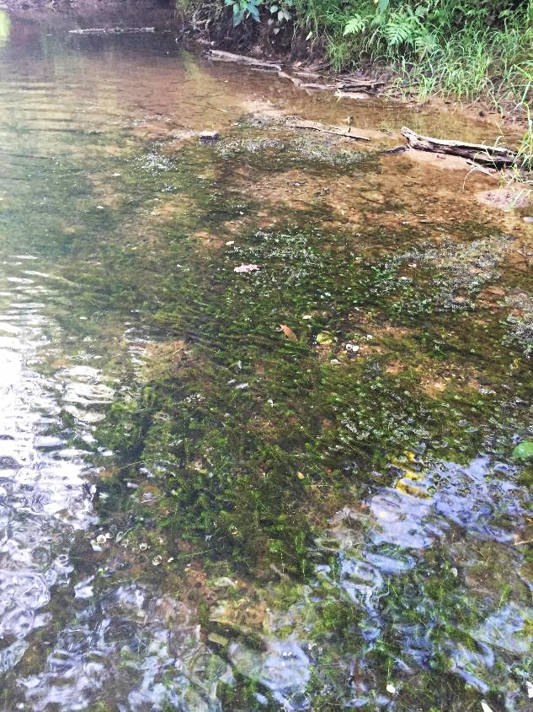
Post Treatment
Pleasant Green Access
August 2016
Unmanaged
Upstream Area (Hillsborough)
August 2016
2015 - 2016 Hydrilla management on the Eno River, NC
using fluridone
Notes:
It was a very successful effort as visible from photography of one of the river’s impacted public access points from a few years ago without management, and that same area with hydrilla controlled in 2015.

Slide 36
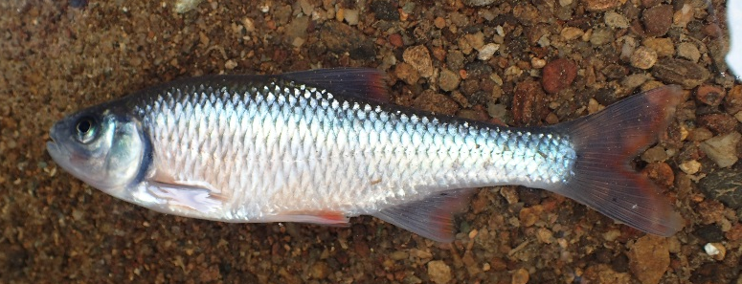
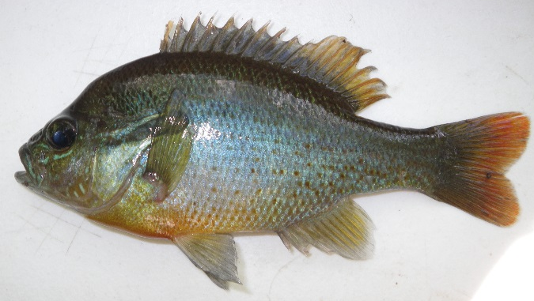
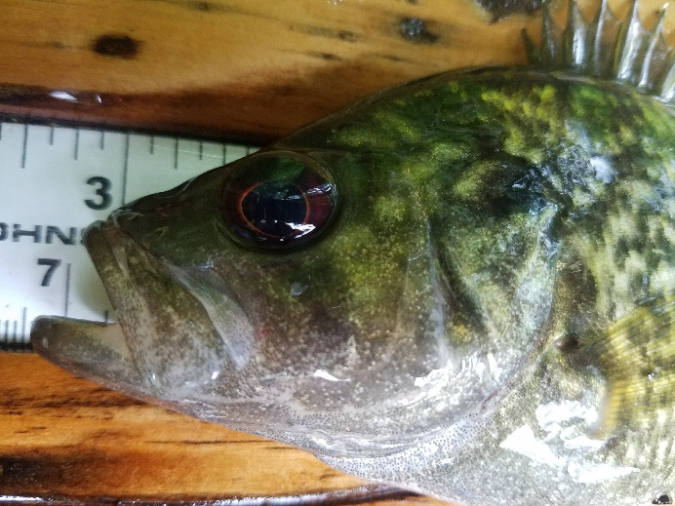
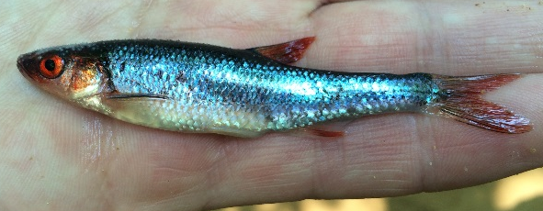
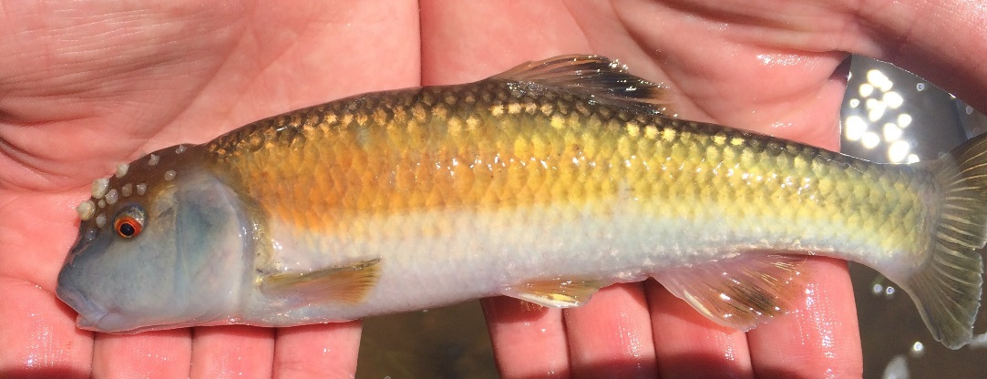
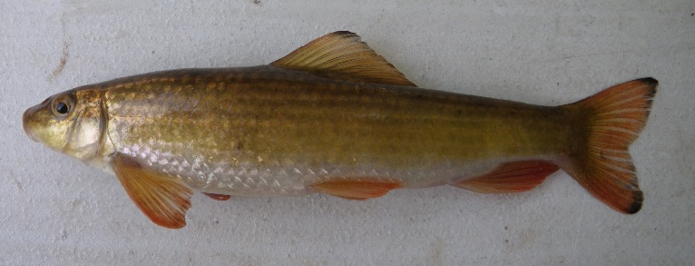
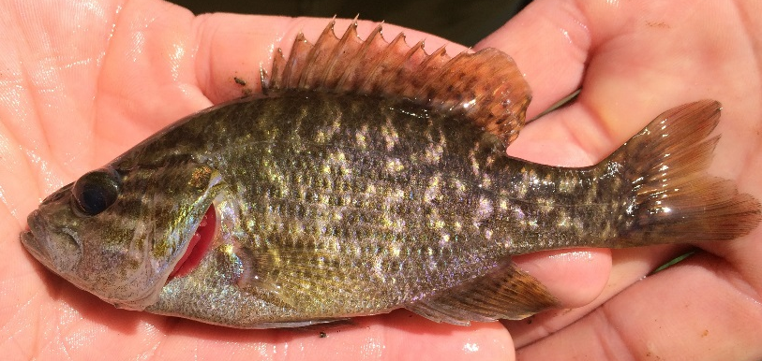
Results
  Total Fish Collected
    49,664

Slide 37
Results - Fish
Overall Fish Community
  No Effect of Hydrilla Removal on:
    Fish Densities
      NC IBI metrics
Roanoke Bass
  No Effect of Hydrilla Removal on:
    Density
    Condition
**No Acute Significant Effects Found of Hydrilla Removal on Fish Communities in a Lentic System**

Slide 38
Conclusions
Hydrilla has been successfully controlled within the treatment area
No negative impacts to non-plants have been observed
No negative impact to native riffleweed was observed
Transient chlorosis on native and common American waterwillow was observed in first year of treatment
Treatment has been moved upstream

Slide 39
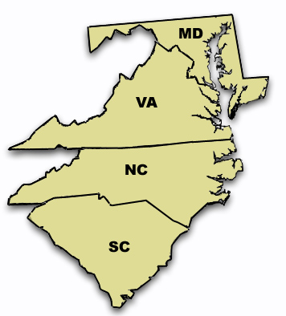
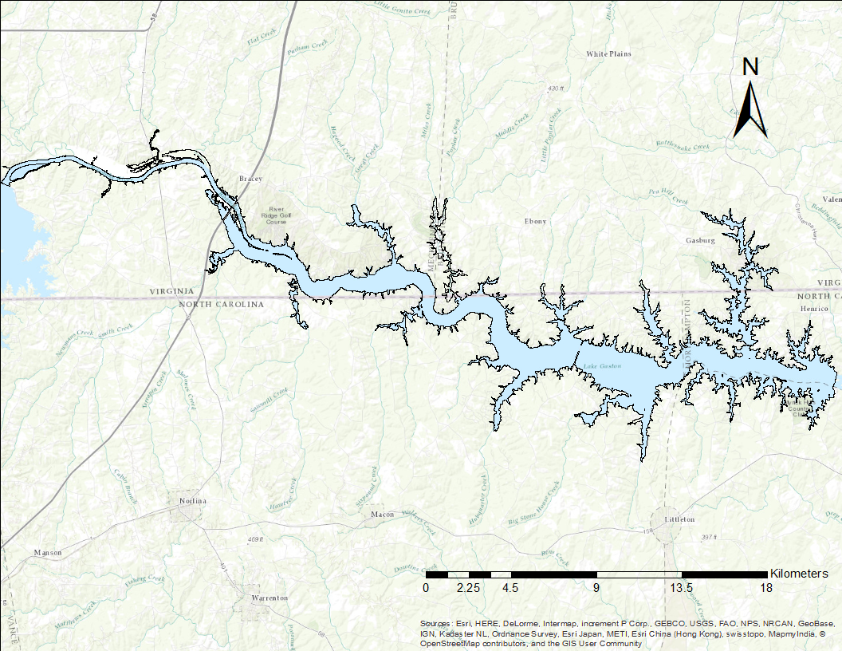
Lake Gaston

Slide 40
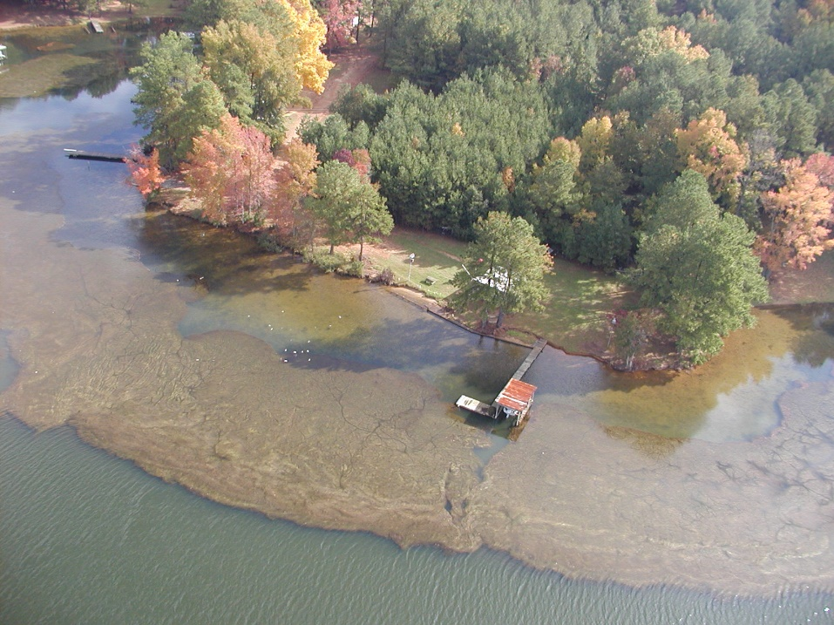
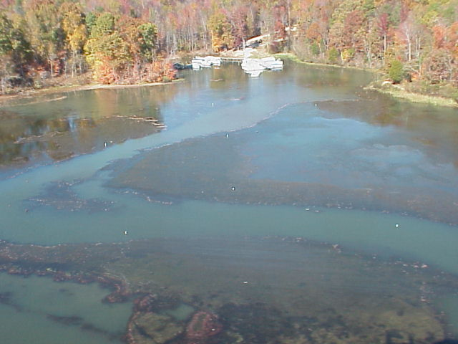



Slide 41
Lake Gaston
20,300 acre reservoir on the Roanoke River in VA and NC
Hydrilla infested ~3,000 acres with potential for infesting 40% of the lake or a potential total acreage of 8,100 acres (Madsen 2006)
Myriophyllum spicatum, Najas minor, Egeria densa, and Lyngbya wollei also infest the lake
2004 property values: $1.2 billion
Stakeholders goal: Control hydrilla, but maintain some vegetation (limited grass carp use)

Slide 42
Historic Management
Before 2006, management consisted of:
  Erratic grass carp stocking, no formal plan
  Herbicide treatments rotated on yearly basis
    Treat hot spots and respond to public complaints
A Technical Advisory Group was formed around 2005
  Review previous year of management
  Make recommendations for upcoming year
    Management (herbicides and grass carp)
    Monitoring, research, etc.

Slide 43
Management Post-2006
Formal grass carp stocking plan
  Initial target rate of 12.5 fish per acre
  Monitor and increase until impact observed
  12.5 > 15 > 18.5 over multiple years
Herbicide treatments altered
  Maintain treatments for multiple years in areas to deplete turion bank
  Reserve some treatments for “hot spots”

Slide 44

2013

Slide 45

2014

Slide 46

2015

Slide 47

2016

Slide 48

Monitoring Grass Carp Effect

Slide 49

Turion Density
Control
Control

Slide 50
Fisheries
Surveys conducted on Lake Gaston every other year
No correlation between hydrilla levels (e.g. management) and fish populations
Similar to data from other lakes with hydrilla management
Game fish population changes have been observed, but always tied to disease or climate (drought)

Slide 51
Summary
Very low hydrilla levels on Lake Gaston
Tuber levels declined in all areas, some localized rebounds
Aquatic vegetation maintained throughout management
Current inputs far lower than historic levels
Continued management needed

Slide 52



Questions?

Slide 53

  Herbicidal Drip
    2015 Pilot Study
      Rhodoamine Dye Study
      Late May to Mid-July
      Single Injection System
      Low-level of Sonar® Genesis
      Target Concentrations
        Injection Site
          8 to 11 ppb
        End of Management Zone
          2 to 5 ppb
      Adjusted Daily Based on Flow Rates

Slide 54
Monitoring of Study
Herbicide concentration
  Monitored weekly/biweekly
  Sample sites
    Adjacent to injection site, midpoint, downstream
Biotic monitoring
  NCSU: Hydrilla phenology, tuber density, riffleweed abundance
  NCWRC: Sport fish, Roanoke bass, mussel, crayfish
    Sample sites inside and outside treatment area
  Fall vegetation (hydrilla) survey by state and local agency personnel

Slide 55
  Herbicidal Drip
    2015 Pilot Study
      Hydrilla Control
        Density Reduced by 90%
      Native Plants
        Noticeable Chlorosis on water willow
    2016 Pilot Study
      Hydrilla Control
        Density Reduced by 100%
      Native Plants
        No Noticeable Effects

