Slide 1

The Good, the Bad, and the INVASIVE
Mike Steiger
DNREC-Division of Fish and Wildlife
3002 Bayside Drive
Dover, DE 19901
(302) 735-2966
Michael.Steiger@Delaware.gov

Slide 2
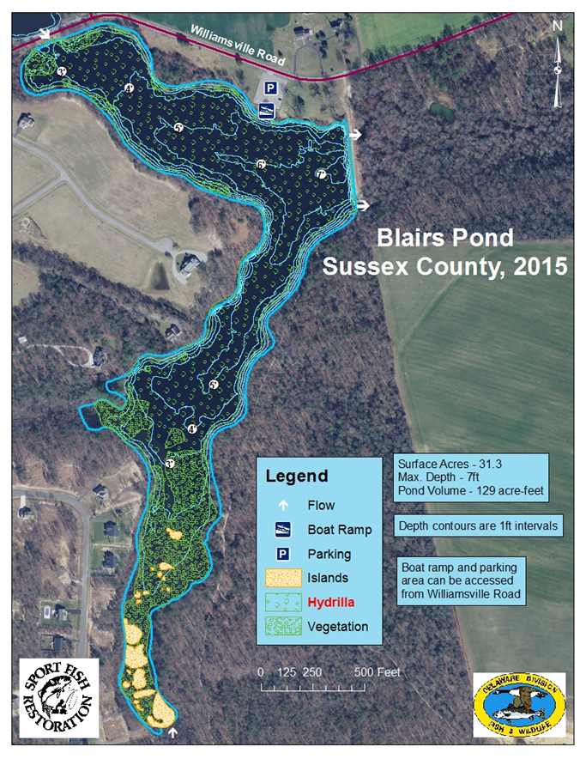
Case Study: Blairs Pond
28.5 Acres
Milford, Delaware
Fluridone(tradename Sonar*) applied from 2000-2016
Hydrilla was main target of treatments
3 half and 2 full pond pesticide treatments
2011 Aquatic Weed Harvester used to remove filamentous algae

Slide 3
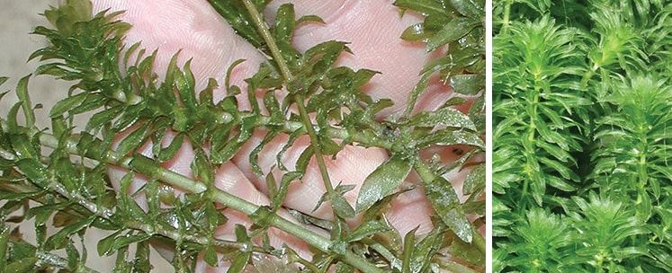
Blairs Pond Applications
Little to no Hydrilla observed as of 2017

Slide 4
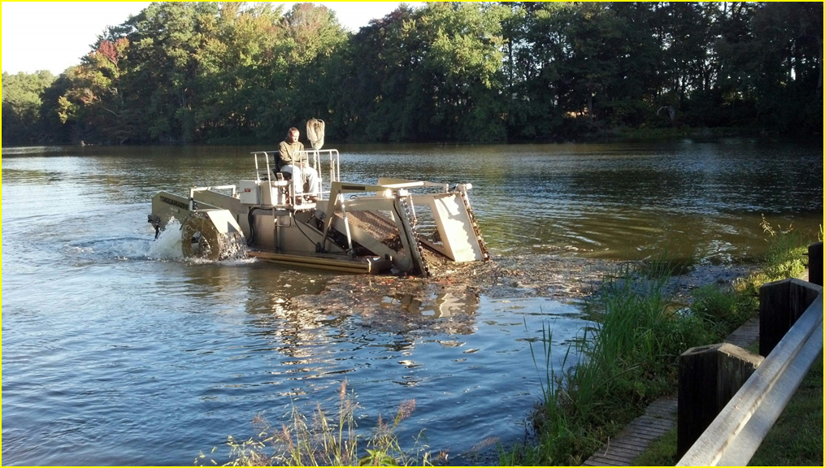
Blairs Pond Results
2011 Aquatic Weed Harvester harvested
260 yrds³ total
9.12 yrds³ per surface acres
Equivalent to 32 dumpsters of algae

Slide 5
Blairs Pond Results: Fish Community Largemouth Bass
Year | Type | Species | Amount(Acres)
2000 | Sonar© PR | Hydrilla | 6.9
2003 | Sonar© PR | Hydrilla | 3.7
2004 | Sonar© PR | Hydrilla | 9.4
2006 | Sonar© PR | Hydrilla | 16.7
2008 | Sonar© PR | Hydrilla | 16.7
2010 | Sonar© PR | Hydrilla | 16.7
2012 | Sonar© PR | Hydrilla | 28.5
2016 | Sonar© PR | Hydrilla | 28.5
Population Indices | 2000 | 2005 | 2010 | 2015
Total No. of Bass | 130 | 117 | 40 | 13
PSD | 24.3±9 | 69.7±10 | 61.5±18 | 42.9±35
RSD-P | 8.1 | 6.1 | 5.1 | 0.0
RSD-457 | 2.7 | 2.0 | 0.0 | 0.0
Mean Wr | 97.5 | 90.9 | 91.4 | 102.7
<100mm | 0.0 | 2.0 | 0.0 | 0.0*
100-199mm | 35.4 | 33.9 | 1.9 | 9.8
200-299mm | 155.4 | 59.7 | 28.9 | 6.6
300-380mm | 35.4 | 125.4 | 42.3 | 4.9
>380mm | 15.0 | 11.9 | 3.8 | 0.0
Total CPUE | 241.2 | 232.9 | 76.9 | 21.3
Total # of bass caught drops dramatically
Mean Relative weights or ”plumpness” goes up
2005 when Hydrilla was too dense, Wr were slightly lower

Slide 6
So many numbers… electrofishing

Slide 7
Largemouth Bass…
2010 population is dominated by larger fish
2015 very low population, mostly small fish

Slide 8
Bluegill…
2010 low numbers, dominated by larger fish
2015 low numbers, dominated by smaller fish

Slide 9
So many numbers…seining

Slide 10
Blairs Pond: Conclusion
Pesticide treatments have successfully reduced the abundance of Hydrilla
Filamentous and planktonic algae are now at nuisance levels
Largemouth bass and bluegill populations have suffered since the beginning
of the half and full pond treatments
An integrated pest management solution using different herbicides/techniques, and an
aquatic weed harvester is probably the best solution from a fisheries perspective

Slide 11
What is he saying?
Complete removal of an aquatic invasive species may not be the best course of action for Delaware
state owned ponds
Half and full pond treatments with a broad spectrum systemic herbicide have caused a negative
effect on game fish populations
An integrated pest management approach using contact herbicides for spot specific treatments
in combination with the use of an aquatic weed harvester is probably the best course of action for
controlling not eradicating Hydrilla in state owned ponds

Slide 12
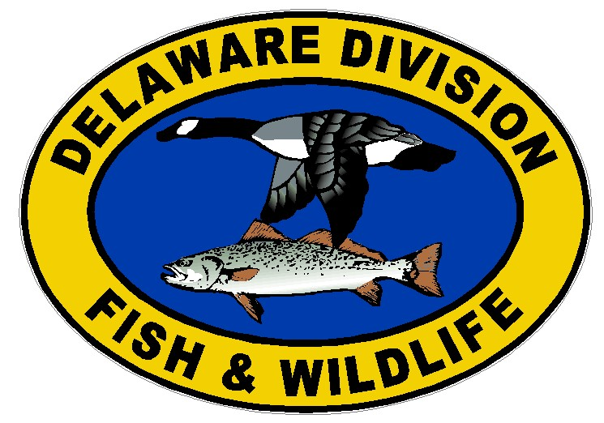
Thanks!
Edna J. Stetzar
Fisheries Biologist
DNREC-Division of Fish and Wildlife
3002 Bayside Drive
Dover, DE 19901
(302) 735-8654
Edna.Stetzar@Delaware.gov
Mike Stangl
Freshwater Fisheries Program Manager
DNREC-Division of Fish and Wildlife
Mark Zimmermann
Aquatic Plant Biologist
DNREC-Division of Fish and Wildlife
3002 Bayside Drive
Dover, DE 19901
(302) 735-2977
Mark.Zimmermann@Delaware.gov

Slide 13
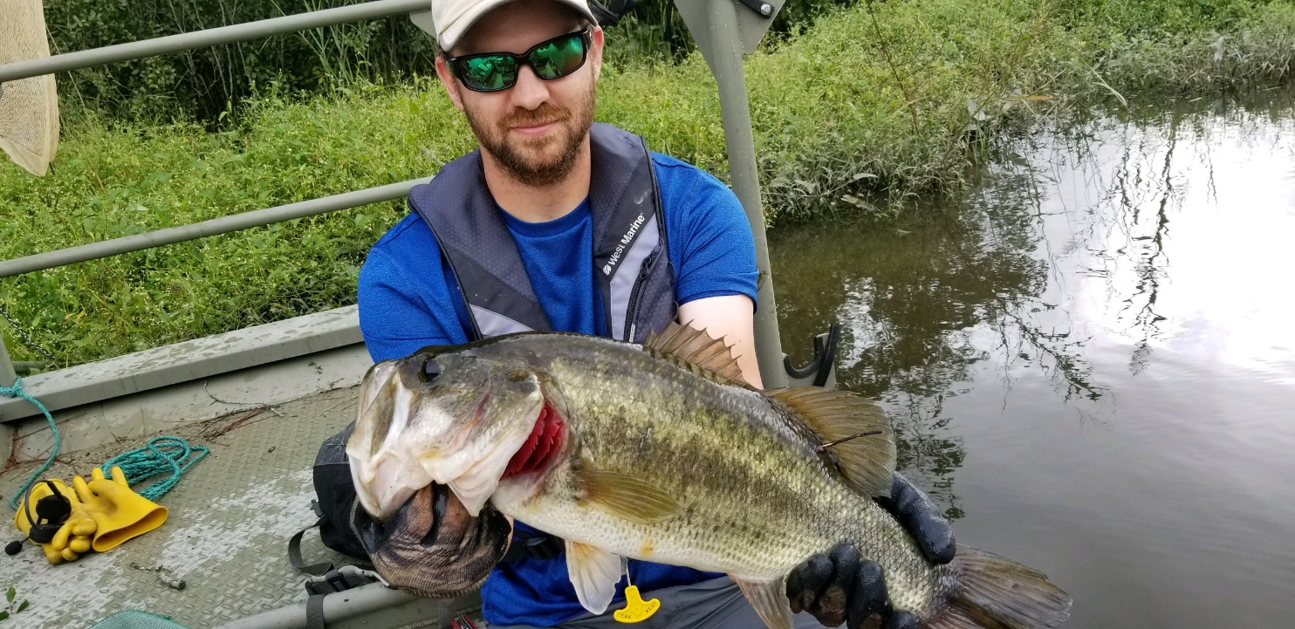
Questions?

