Slide 1


Engaging our Citizenry to Keep Our Lakes Clean
Volunteer Monitoring Programs
Beth Norman
Lacawac Sanctuary & Biological Field Station
April 9, 2019
Mid-Atlantic Sates Lake Forum

Slide 2
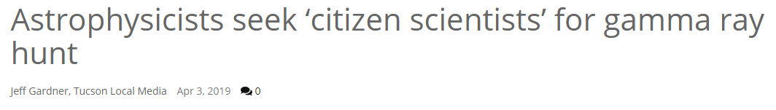

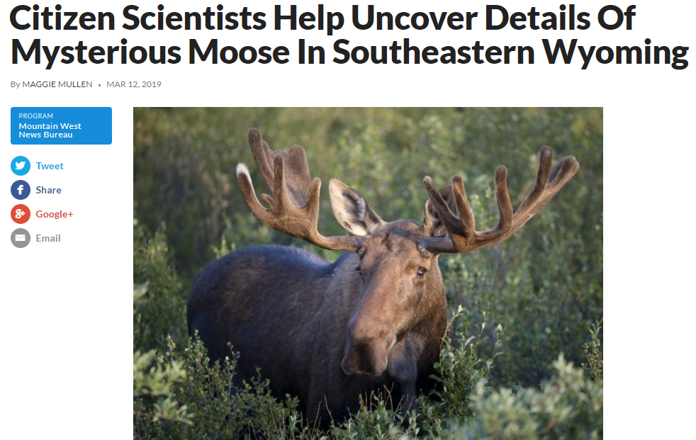
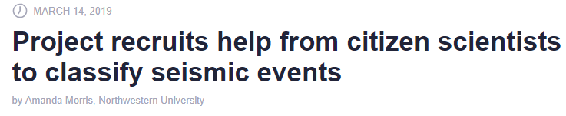


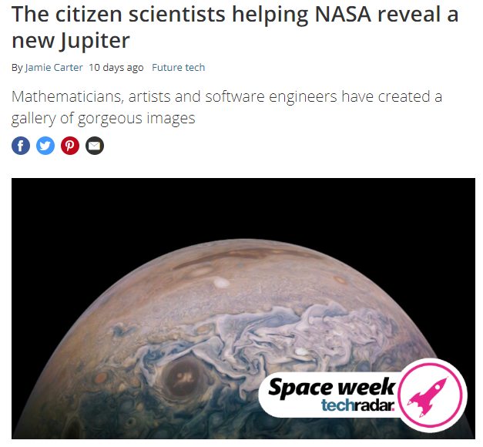

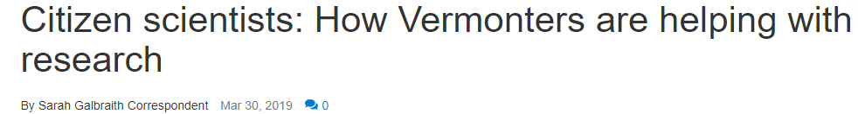

Slide 3
Pocono Lake Ecological Observatory Network: PLEON
A lake monitoring program focused on educating the public on water quality and lake management
Why?
Lakes are important economic resources for Pocono communities
Many lakes are private
Community associations are responsible for management and preservation strategies
Lakes are complex ecosystems and there are a lot of options!

Slide 4
Pocono Lake Ecological Observatory Network: PLEON
A lake monitoring program focused on educating the public on water quality and lake management
Goals
Empower the public to better understand and manage their fresh waters.
Create a community of scientists, students, educators, and landowners working to preserve Pennsylvania’s lakes.
Collect and communicate ecological data that help inform responsible lake management.

Slide 5
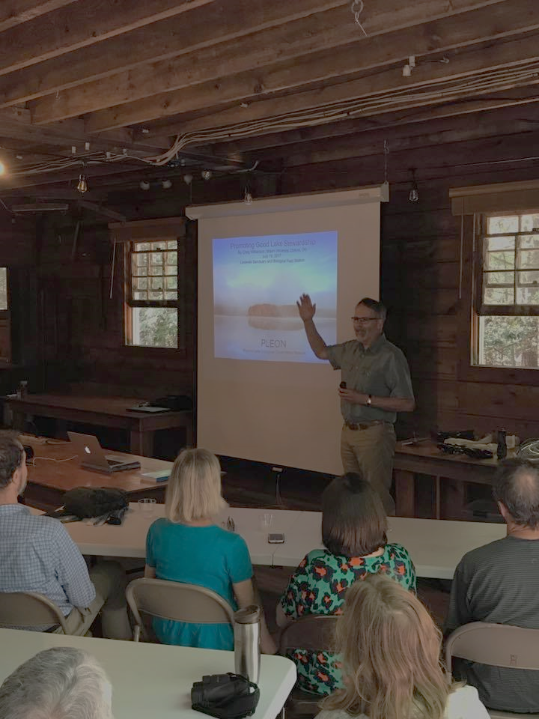
3 PLEON Components: Education
Free Workshop Series
Feature scientists active in lake research
Focus on increasing lake literacy
Facilitate interactions between the public and limnologists
2019 Series:
Ecology of Aquatic Plants
Promoting Good Lake Stewardship
Harmful Algal Blooms

Slide 6
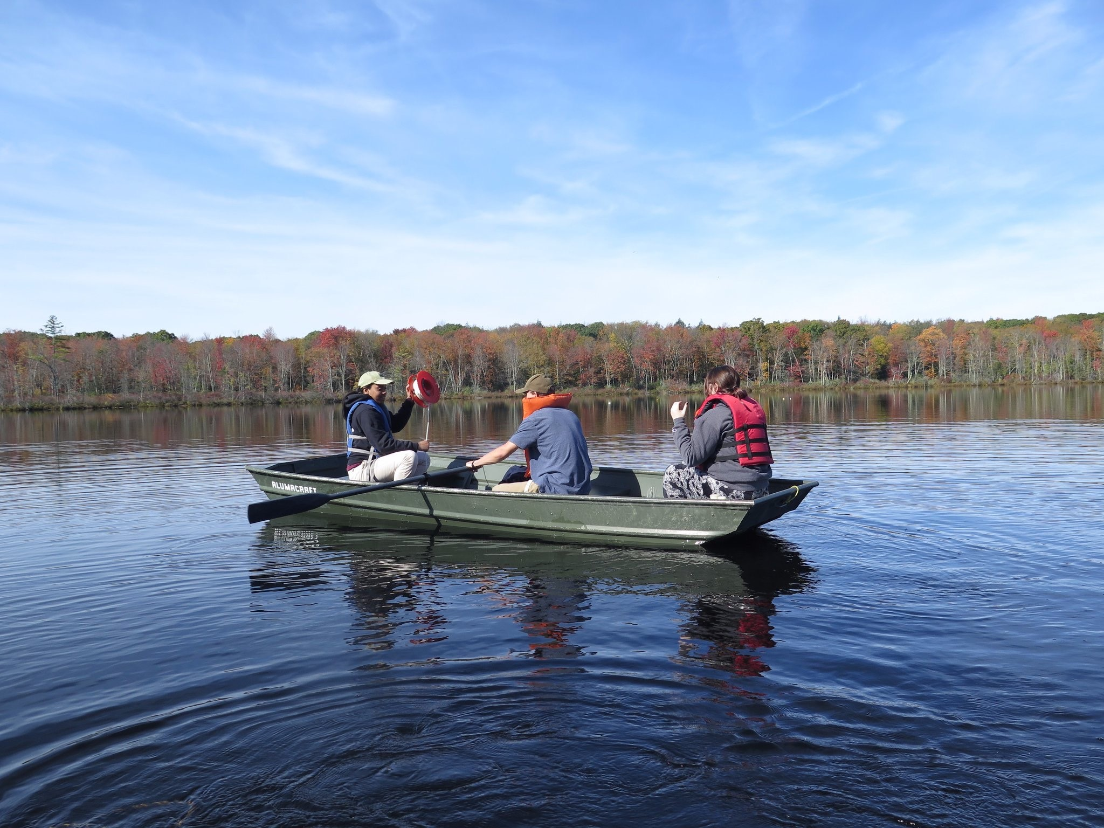
3 PLEON Components: Monitoring
Lake Monitoring Services
Work with lake associations
develop customized monitoring plan
Spectrum of member involvement
Written and in-person reporting

Slide 7
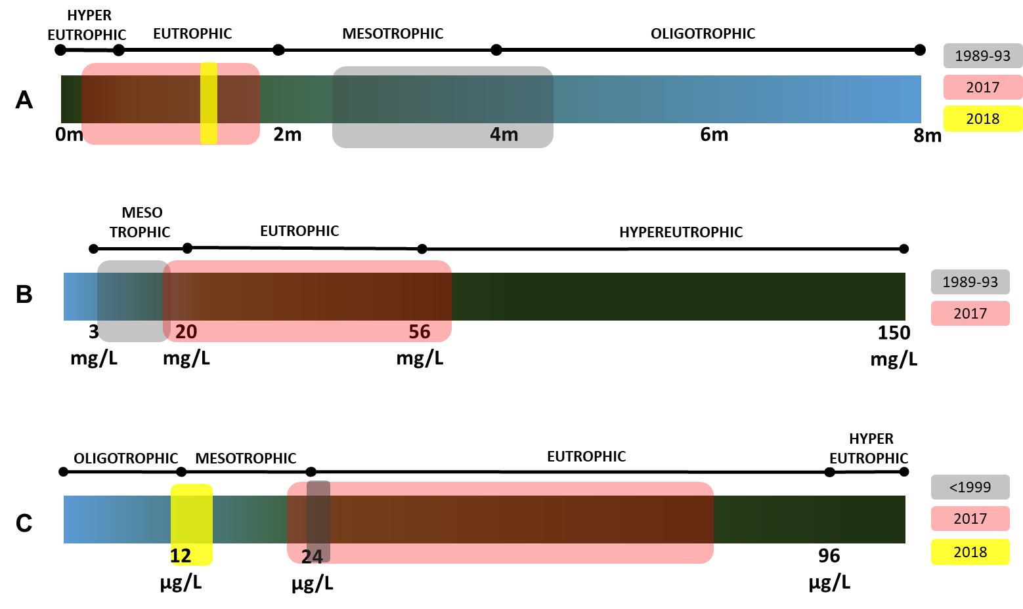
Describe changes in their lake over time

Slide 8
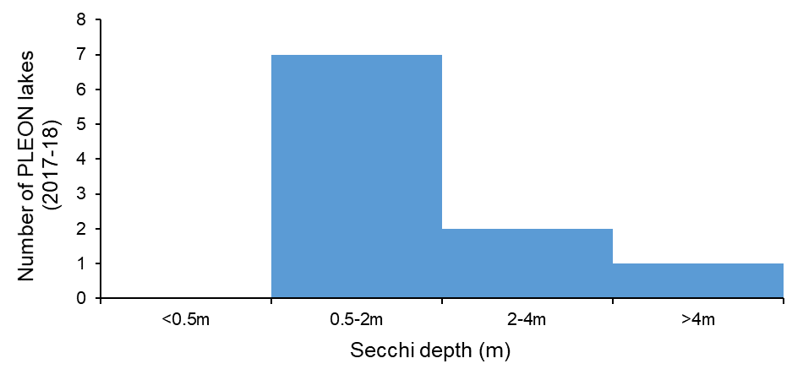
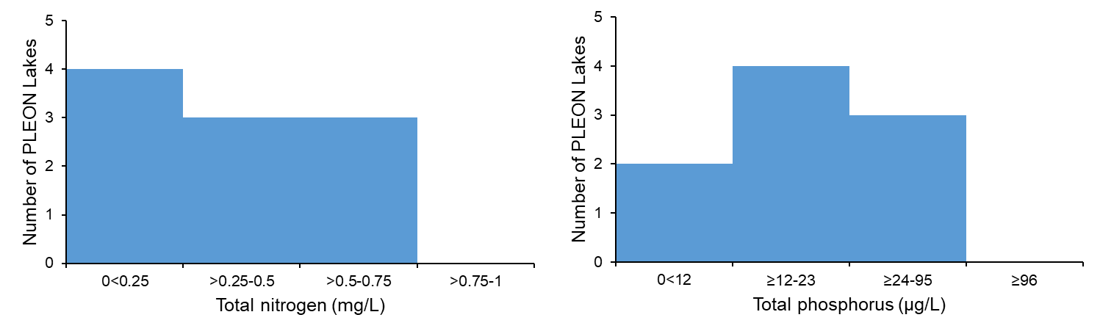
Put the lake into context of the Poconos

Slide 9
Put the lake into context of the Poconos

Slide 10
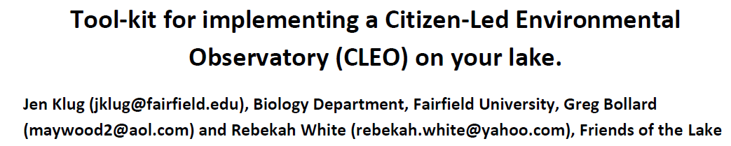
3 PLEON Components: Citizen Science
Understand spatial and temporal patterns within a lake
Work with individuals and families
Provide lake monitoring kits and training
Visual reporting of data
Volunteer Lake Monitoring
Newest component of PLEON…2018 was a beta test

Slide 11
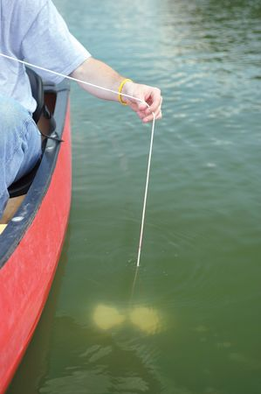
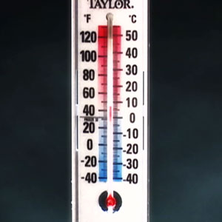
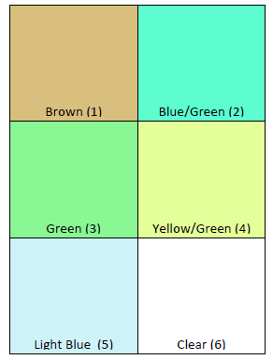
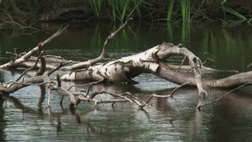
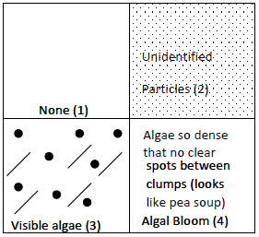
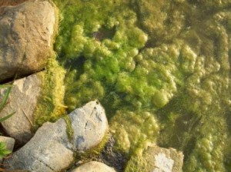
Dock or Boat-side Monitoring Station
Secchi Depth
Temperature
Water Color
Woody Debris
Particles
Surface Scum
Water Samples
TP
TN
Chlorophyll
Cyanotoxins

Slide 12
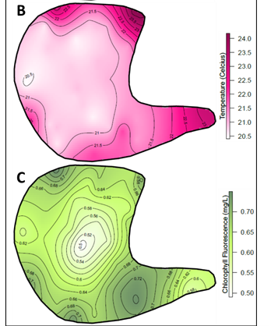
Display Spatial Data Visually for Impact

Slide 13
PLEON Today and Tomorrow
Since 2017
  Monitor 13 lakes
  Work with 5 lake associations
  Across 3 Pocono counties
  Make dataset publically available (EON philosophy)
  Include HABs and AIS response strategies for small lakes
  More in-house sample analysis
  Grow the Citizen Science Component
Moving forward

Slide 14
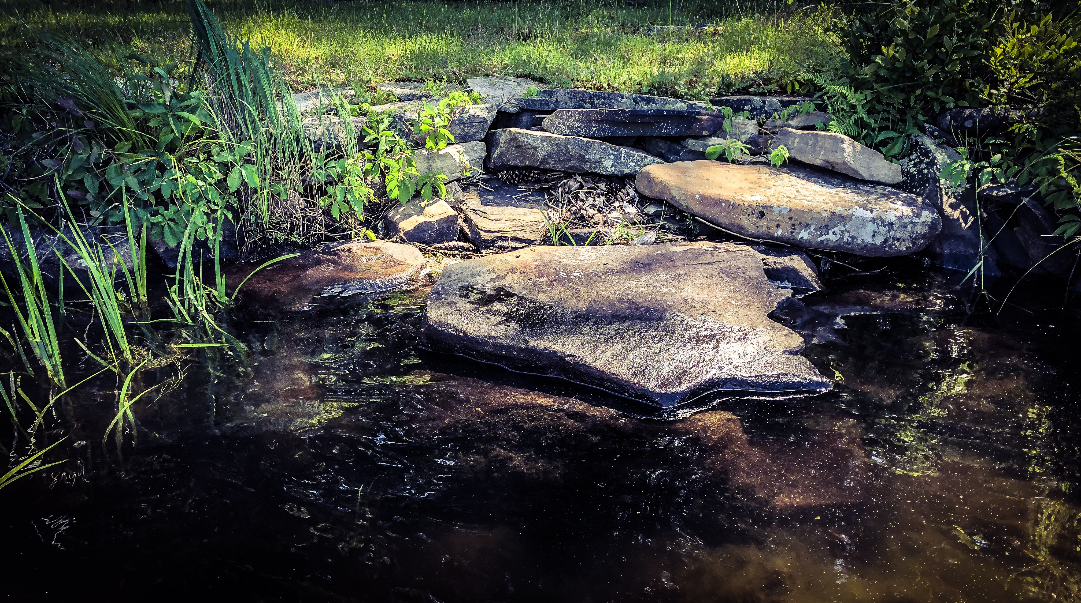
What has worked well…
  Focus on personal interactions
  Flexibility of monitoring program design
  Question and answer sessions with scientists and managers
  Community approach

Slide 15
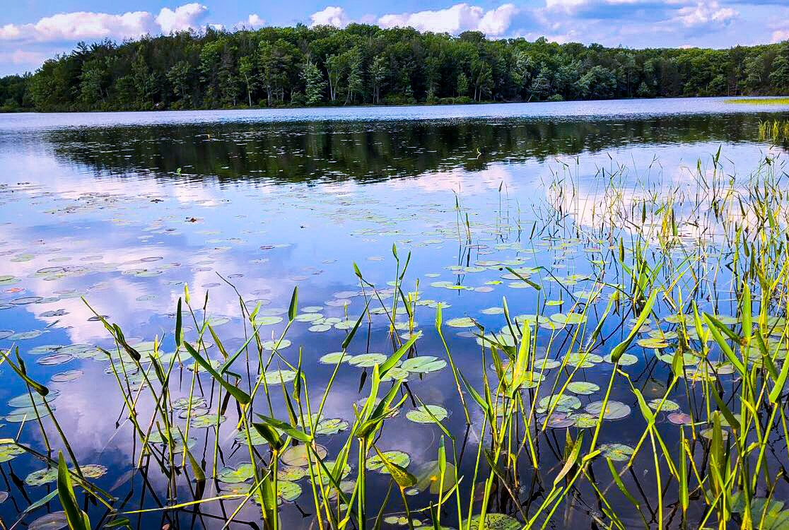
Lessons learned…
  Lake associations are political bodies
  Remain a source of information, not recommendations
  Some people need convincing that lake monitoring is important
  Lake associations have real-world constraints

Slide 16
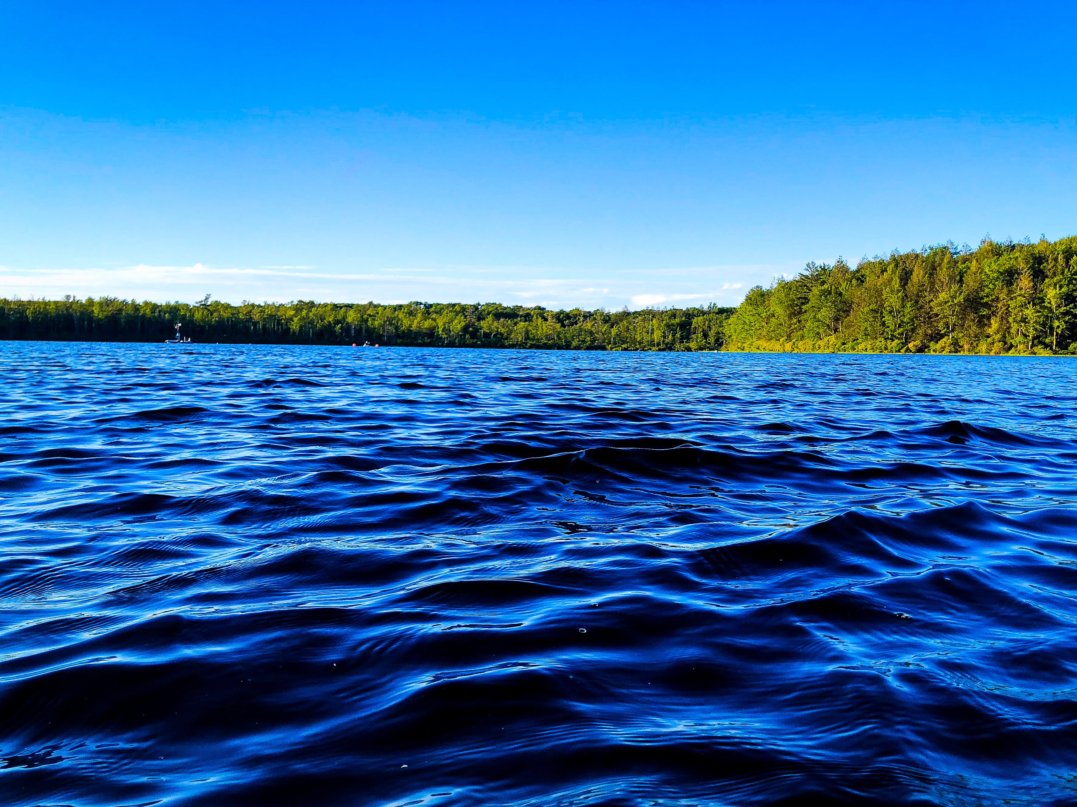
Beth Norman
Director of Science and Research
Lacawac Sanctuary
beth.norman@lacawac.org
www.lacawac.org

