Slide 1
Pennsylvania Lake Management Society
A voice for sound Lake and Reservoir Management in Pennsylvania

Slide 2
Who are we?
Formed in 1989 as a Chapter of the North American Lake Management Society (NALMS)
Currently an Affiliate Member of NALMS and a 501 (c)(3).
2016 Friends of NALMS award recipient.

Slide 3
Who makes up PALMS?
PALMS is made up of a statewide board of directors:
President, President Elect, Secretary, Treasurer
6 Region Directors
2 East, 2 West, 2 Central
Executive Director – Kate Harms
Membership ~150 - 200 members.

Slide 4
Services to the Commonwealth
Annual Conference /Workshops
Newsletters and Fact Sheets
Technical Assistance (C-SAW)
Pennsylvania Lake Awareness Month
Governors Invasive Species Council of Pennsylvania
General Support / Awards

Slide 5
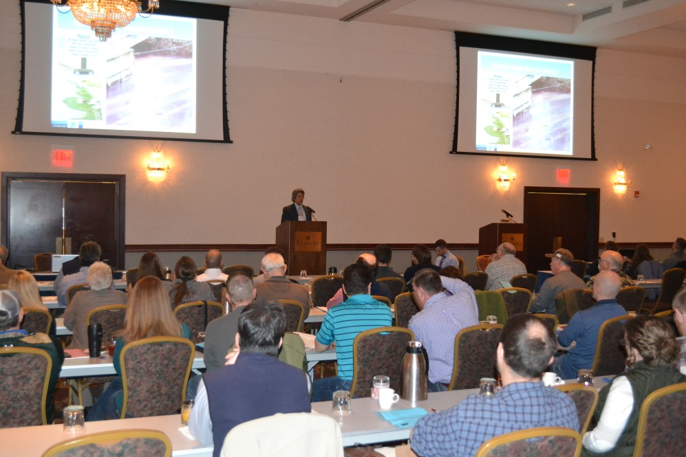
PALMS Annual Conference
Largest annual gathering of lake and reservoir management stakeholders in PA.
Plant management, Fisheries, Algae, WQ.
2018 conference March 7, 8 in State College.
Aquatic pesticide applicator credits. (PA, NY, OH, DE, NJ)

Slide 6
Technical Assistance
Regional workshop support
Provide lake and reservoir assistance through the C-SAW Technical Assistance Grant program.
https://c-saw.info/

Slide 7
Pennsylvania Lake Awareness Month
Pennsylvania annually petitions the Governor to proclaim July as Lake Awareness Month.
Promotes local and regional lake and reservoir festivals, events, presentations.

Slide 8
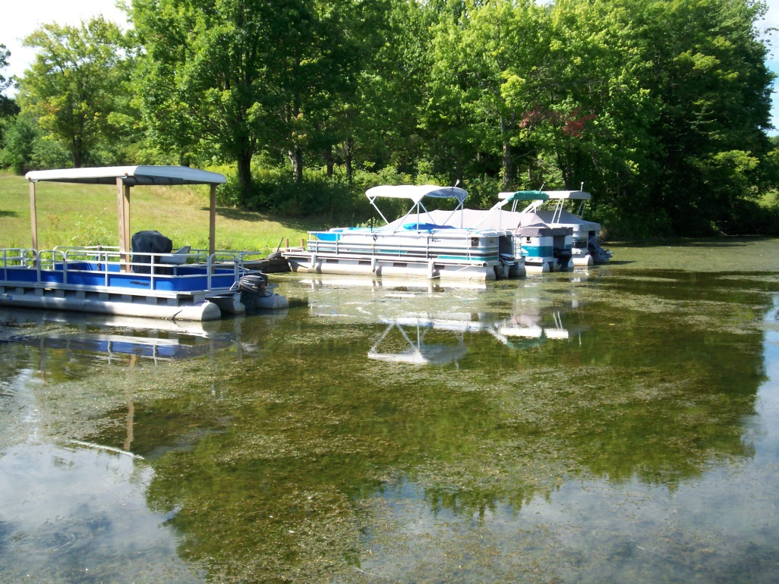
Governors Invasive Species Council of Pennsylvania
PALMS has a an appointment to the PISC as a lake management resource.
Provides leadership and technical assistance relating to aquatic invasive species management to PISC.

Slide 9
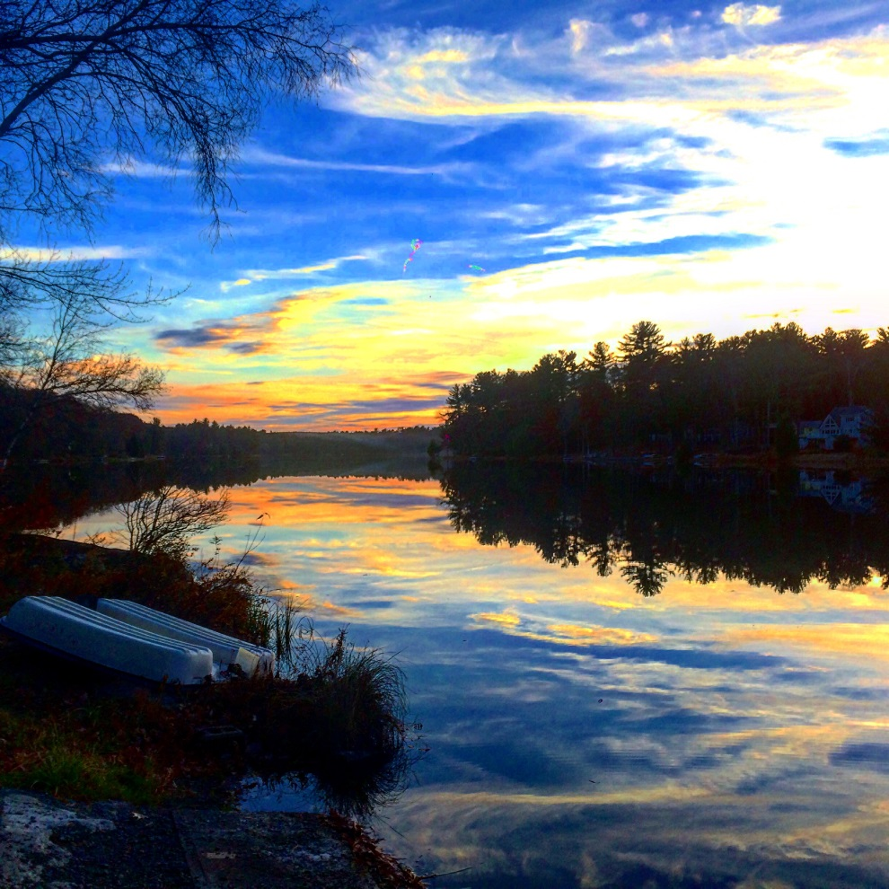
General Support / Awards
PALMS lake management awards
Individual
Organization
Photo Contest
Aquatic Herbicide Applicator Credits
General Inquiries
“Common Thread”

Slide 10
Brian S. Pilarcik
Watershed Specialist
Crawford County Conservation District
brian@crawfordconservation.org
21742 German Road
Meadville, PA 16335
814-763-5269
Past-President
Pennsylvania Lake Management Society
www.palakes.org

