Slide 1
Harmful Algal Blooms:
Understanding the Need for Management
West M. Bishop, Ph.D., CLP
Algae Scientist and Water Quality Research Manager
SePRO Research and Technology Campus
16013 Watson Seed Farm Rd., Whitakers, NC 27891
252-801-1623 (mobile); westb@sepro.com (email)

Slide 2
Overview
Cyanobacteria and negative implications
Risks of no action
Need for management

Slide 3
Anthropogenic Acceleration
Environmental Changes
Atmospheric CO₂ passed 400ppm (NOAA)
UV light increases
Salinity increases
Global temperature increasing (Miller 2002)
Stratification
Water use dynamics
Ecosystem degradation
Invasive species proliferation
Rough fish dominance
Eutrophication accelerated by 100’s to 1000’s of years (Anderson et al. 2002)
Notes:
Kosten, S, VLM Huszar, E Bécares, LS Costa, E Donk, LA Hansson. 2012. Warmer climates boost cyanobacterial dominance in shallow lakes Global Change Biology 18 (1), 118-126

Slide 4
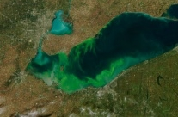
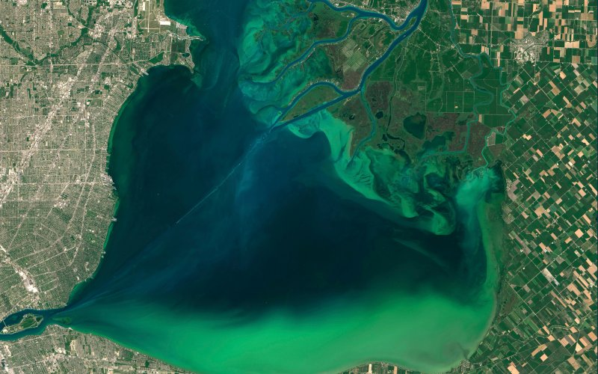
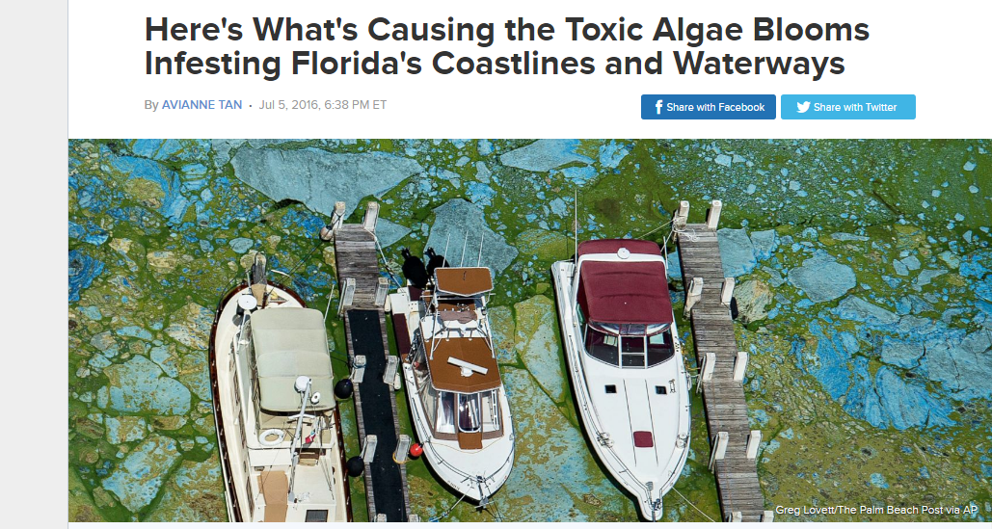
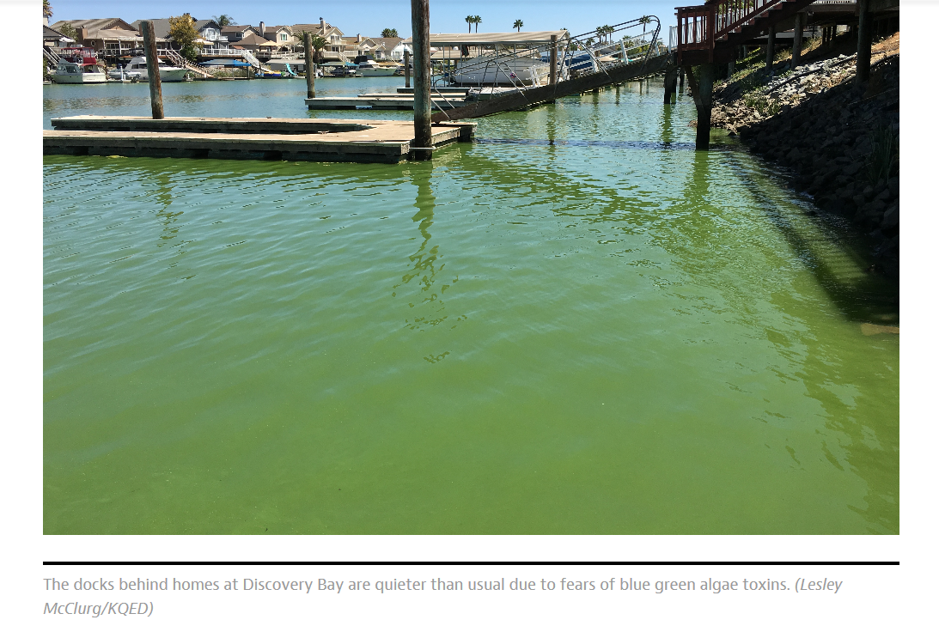
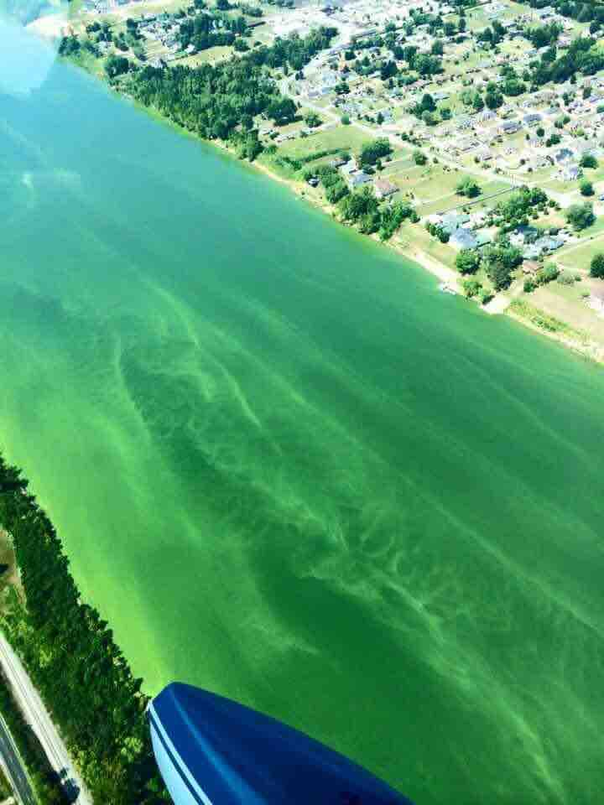
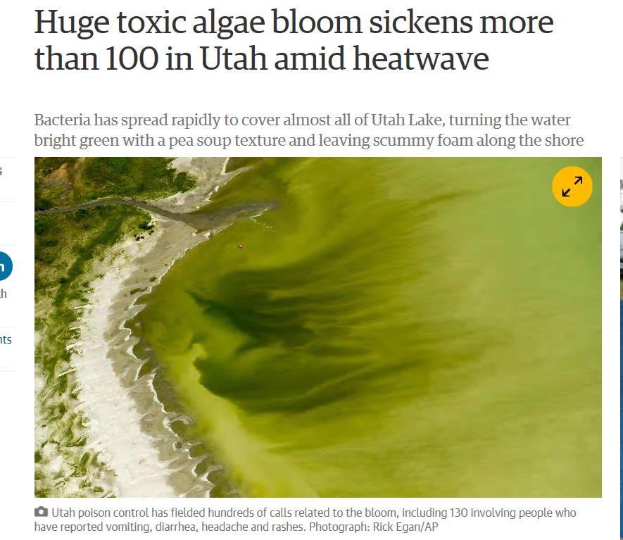

Slide 5
Toxins
The real story
From Hudnell 2010
Notes:
Saxitoxin story

Slide 6
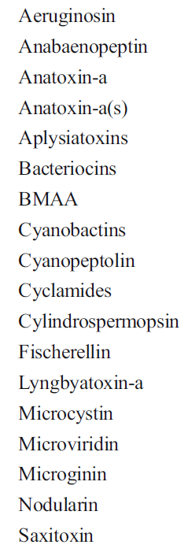
Toxins
Cyanobacteria Toxins
Hepatotoxins “liver”
Neurotoxins “brain”
LPS “stomach”
Aplysiatoxins “skin”
EPA CCL (USEPA 2012)
microcystin-LR, anatoxin-a, and cylindrospermopsin
EPA Health Advisory
< 6 years old; 10 day exposure
0.3 ug/L microcystins and
0.7 ug/L cylindrospermopsin (USEPA 2015a,b)
Recreational guidelines 4ppb; 8ppb
Notes:
Pictures of lakes shut downUnited States Environmental Protection Agency (USEPA), Office of Water. 2012. Cyanobacteria and Cyanotoxins: Information for Drinking Water Systems. EPA-810F11001.

Slide 7
Are we safe if no toxin detected?
Toxin production is intermittent
Shown to be toxic but no toxin has been isolated and characterized
Coelosphaerium, Cylindrospermopsis, Fischerella, Gloeotrichia, Gomphosphaeria, Hapalosiphon, Microcoleus, Schizothrix, Scytonema, Spirulina, Symploca, Tolypothrix, Trichodesmium (Scott 1991; Skulberg et al. 1992b)
New toxin classes
Lyngbyaureidamides, nodulopeptins, jamaicamides, aeruginosins (Edwards et al. 2004; Ishida et al. 2009; Zi et al. 2012; Schumacher et al. 2012)
Notes:
Crude extracts, toxin mixtures, not yet discovered active compounds

Slide 8
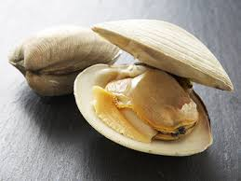
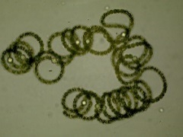
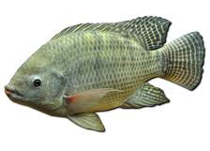
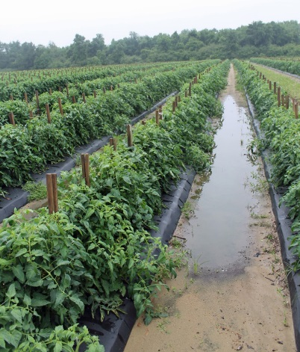
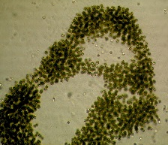
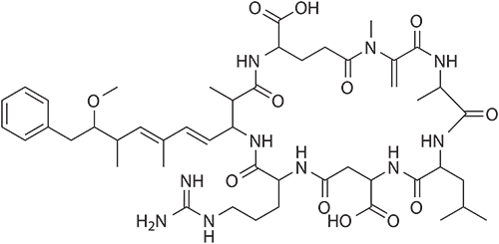
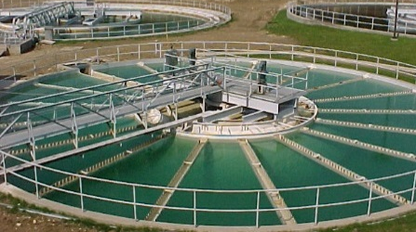
Potential exposure routes to CHAB toxins
Irrigated crop accumulation
Seafood accumulation
Recreation
Aerosolization
Terrestrial transfer
Drinking water contamination
Fish accumulation
Freshwater Lakes and Reservoirs
Estuary
Ocean

Slide 9
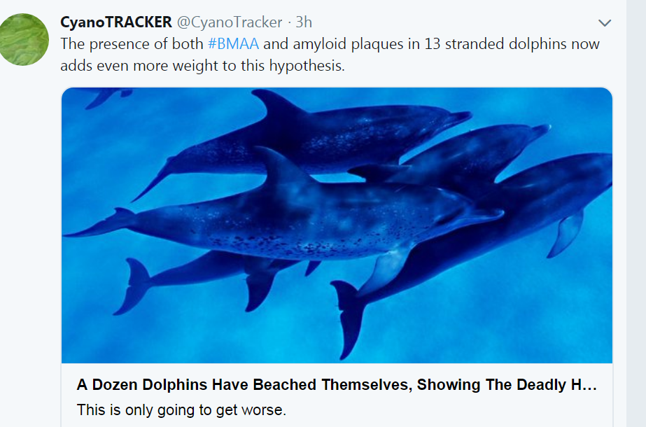
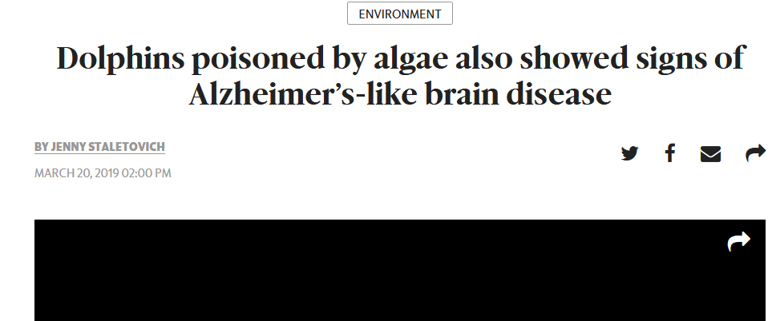
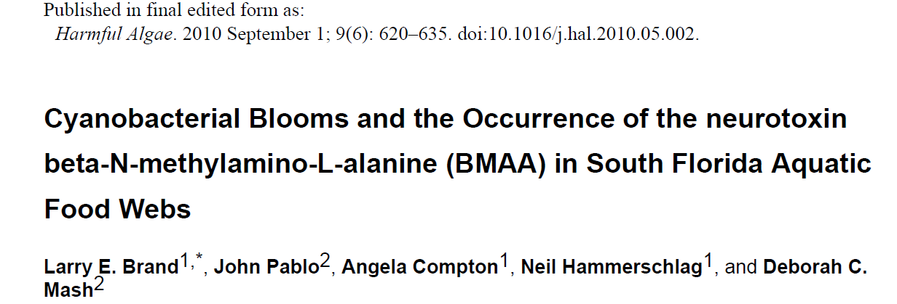
In the news
BMAA food web
Cox, P.A., Banack, S.A., Murch, S.J., Rasmussen, U., Tien, G., Bidigare, R.R., Metcalf, J.S., Morrison, L.F., Codd, G.A., Bergman, B. 2005. Diverse taxa of cyanobacteria produce β-N-methylamino-L-alanine, a neurotoxic amino acid. Proceedings of the National Academy of Sciences. 102 (14): 5074-5078.

Slide 10
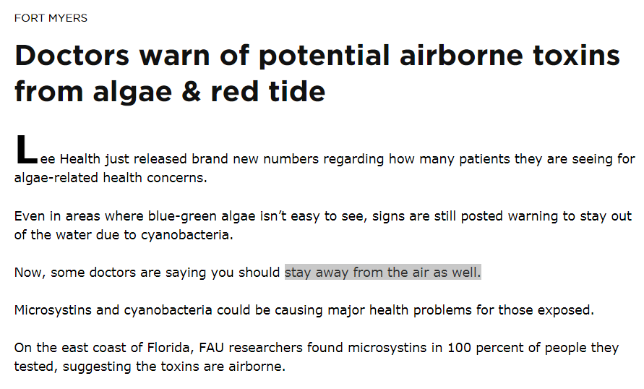
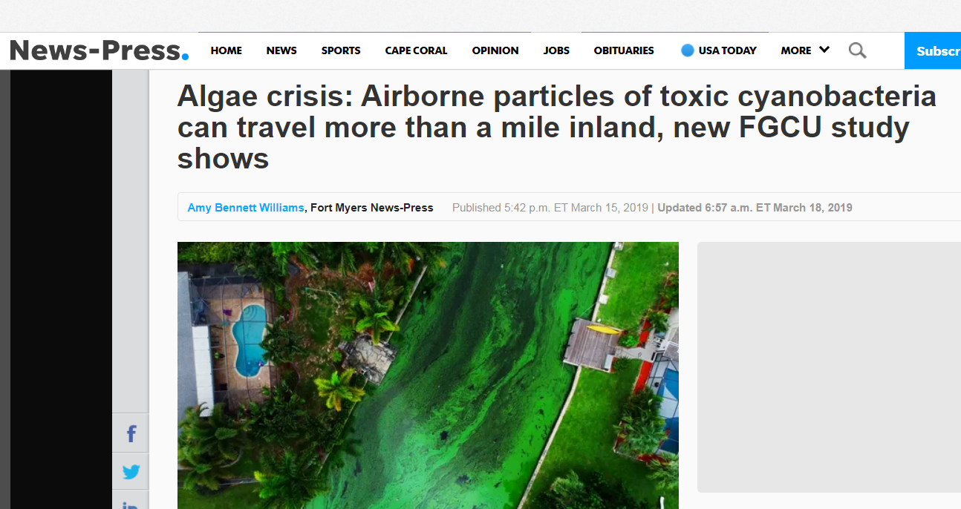

Slide 11
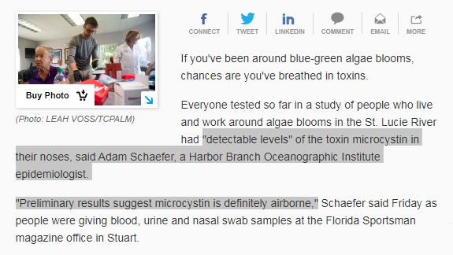

Slide 12
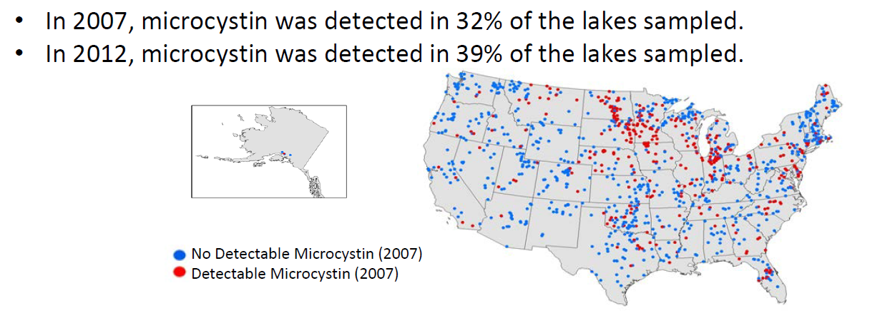
Magnitude of toxins
Cyanobacteria found in 98 percent of lakes and reservoirs sampled throughout the US (Loftin et al. 2007)
Potential toxin producing (cylindrospermopsin-, microcystin-, and saxitoxin) cyanobacteria genera were present in > 80% of samples
4% Cylindrospermosins; 7.6% Saxitoxins (Loftin et al. 2016)
Microcystins in 39 percent of the streams with median of 0.29 micrograms per liter (µg/L) in the SE US (Loftin et al. 2016)
https://www.epa.gov/sites/production/files/2016-12/documents/nla_report_dec_2016.pd

Slide 13
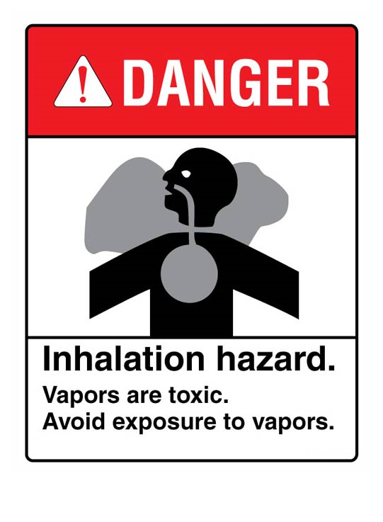
Human health risks
Backer, L. C., McNeel, S.V., Barber, T., Kirkpatrick, B., Williams, C., Irvin, M., et al. (2010). Recreational exposure to microcystins during algal blooms in two California lakes. Toxicon, 55, 909–921.
Banack SA, Caller T, Henegan P, Haney J, Murby A, Metcalf JS, Powell J, Cox PA, Stommel E. Detection of cyanotoxins, β-N-methylamino-L-alanine and microcystins, from a lake surrounded by cases of amyotrophic lateral sclerosis. Toxins. 2015. 29;7(2):322-36
Cheng, Y. S., Zhou, Y., Irvin, C.M., Kirkpatrick, B., & Backer, L.C. (2007). Characterization of aerosols containing microcystin. Marine Drugs, 5, 136–150.
Stommel, E.W., Field, N.C., Caller, T.A. Aerosolization of cyanobacteria as a risk factor for Amyotrophic Lateral Sclerosis. Med. Hypotheses 2013, 80, 142–145.
Wood SA and DR Dietrich. 2011. Quantitative assessment of aerosolized cyanobacterial toxins at two New Zealand lakes. J. Environ. Monit., 2011: 13, 1617-1624
Shutting down the lake is not without risks
Notes:
Toxins released and more

Slide 14
Approaches to Management

Slide 15
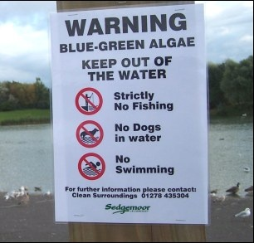
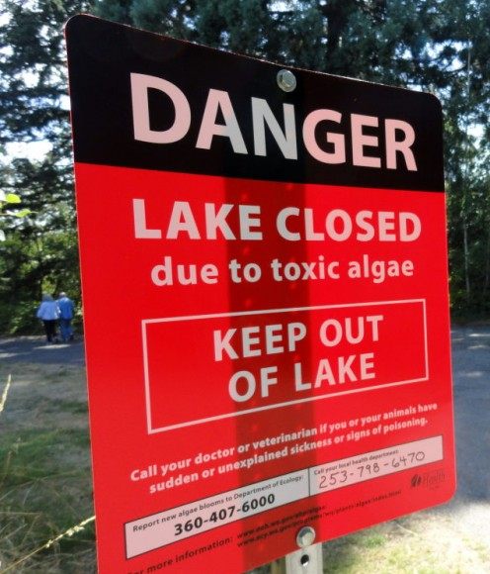
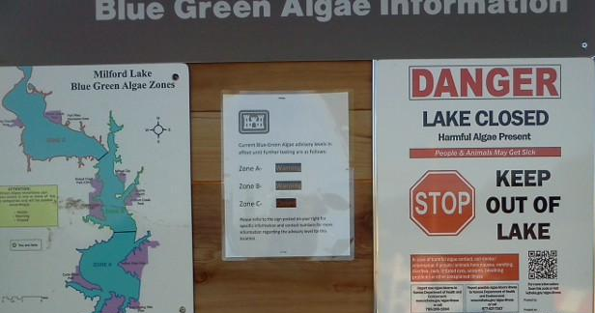
One Approach
Monitoring
Close the lake
Less risk? More risk?
Notes:
Safe right, smart to close lake and stay away. Toxic sespool when gone unabated.

Slide 16
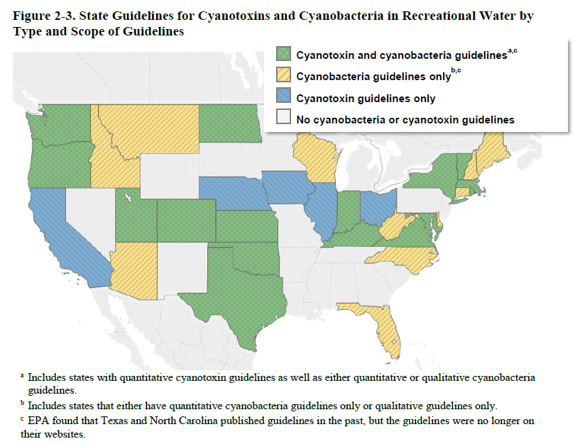
EPA Summary Guidelines
Measurement parameters
Cell densities, proportion of toxigenic cyanobacteria, chlorophyll concentration, and Secchi disk depth measurement
State guidelines address up to four cyanotoxins, Mcyn most prevalent (n=20)
Routes of exposure. Exposure to cyanotoxins from recreational water sources can occur via oral exposure (incidental ingestion while recreating); dermal exposure (contact of exposed parts of the body with water containing cyanotoxins during recreational activities such as swimming, wading, surfing); and inhalation exposure to contaminated aerosols (while recreating).
USEPA 2016
Human Health Recreational Ambient Water Quality Criteria or Swimming Advisories for Microcystins and Cylindrospermopsin
Notes:
Human Health Recreational Ambient Water Quality Criteria or. Swimming Advisories for Microcystins and Cylindrospermopsin. Draft. Prepared by: U.S. Environmental Protection Agency. Office of Water (4304T). Health and Ecological Criteria Division. Washington, DC. EPA Document Number: 822-P-16-002

Slide 17
Recommended Action
Recreation
Close system, issue advisory, post warning signs, contact health department
Utah
Consider closure
Nebraska
Close beach, allow recreation
But public advised to use caution and avoid prolonged exposure to the water
Maine
Do not drink lake water during a bloom. Well maintained domestic water treatment systems may make lake water safe to drink in many instances, but they are not guaranteed to remove algal toxins.
http://www.maine.gov/dep/water/lakes/cyanobacteria.htm
Notes:
https://www.epa.gov/research-grants/freshwater-harmful-algal-blooms#SUMMARY

Slide 18
One State
Kansas
Extreme bloom
Picnic, camping and other public land activities adjacent to affected waters be closed

Slide 19
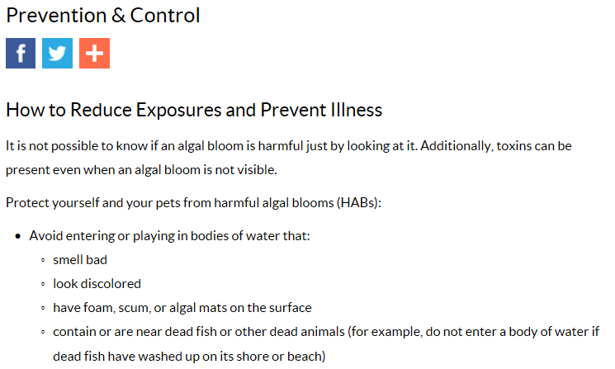
CDC Recommendation
https://www.cdc.gov/habs/prevention-control.html

Slide 20
Why is applied management halted?

Slide 21
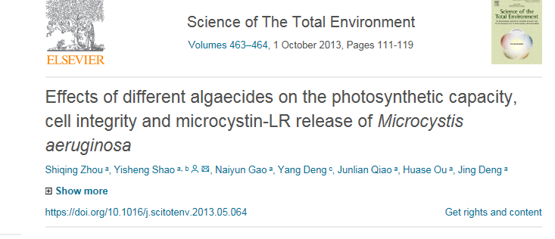
Leaky Cell Hypothesis
Internal toxin can be released with some chemical treatments/concentrations
Kenefick et al. 1993; Jones and Orr 1994; Peterson et al. 1995; Daly et al. 2007; Touchette et al. 2008; Greenfield et al. 2014; Lurling et al. 2014; Tsai 2015
If treat:
Dilutes through water
Even leaky cell papers < 1 d half-life open water
Dermal absorbed dose of microcystins is likely to be negligible (EPA 2016)
No hot spot accumulation potential
Total toxin decreases
Possible to treat without releasing
Formulation/ concentration
Tsai 2015; Iwinski et al. 2016
If fear free toxin, need to fear total toxin
Only way to not have an exposure is not have produced

Slide 22
If afraid of being released, why not afraid of it already out there.. Impending release
Risks and guidelines based on total toxin
May release anyway
A portion is often in water
Natural senescence
Don’t necessarily impact bacteria involved in biodegradation
Increase biodegradation rates when released
Bacteria growing simultaneous with some blooms
Maintained viability (Iwinski et al. 2017)

Slide 23
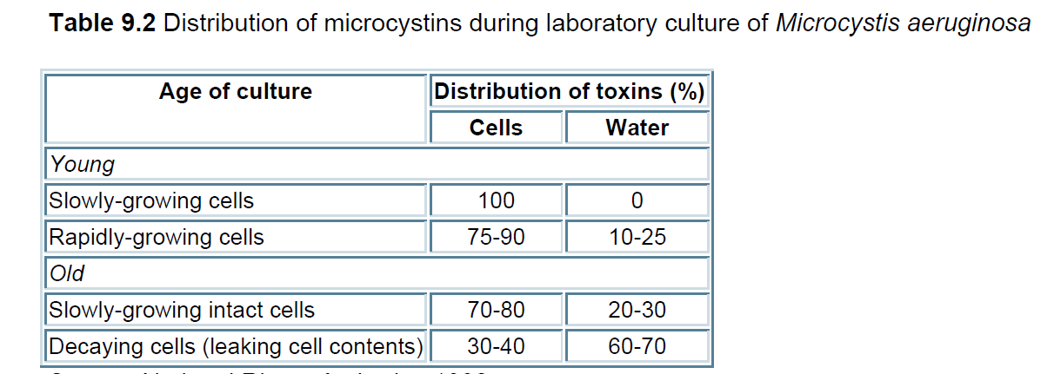
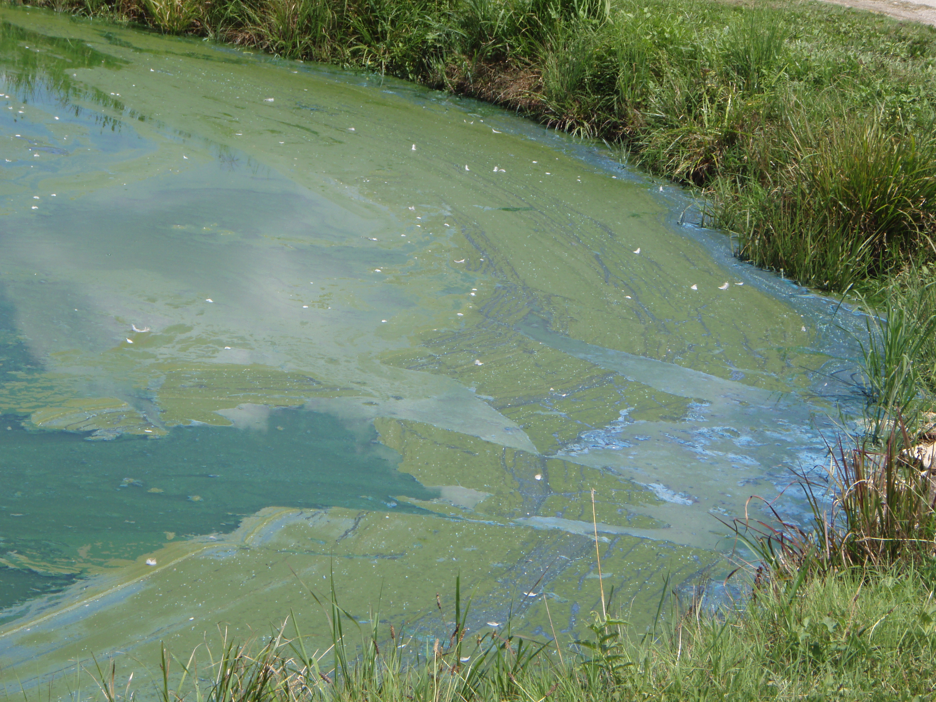
Total or free toxin?
In latter bloom stages, more cells lyse, extracellular Mcyn becomes more abundant
White et al. 2005
Mcyn release from cultured Microcystis aeruginosa began to occur late in the exponential growth phase and increased significantly during stationary phase
Chorus and Bartram 1999
Increase in population numbers could produce a more intense toxin level (described or unknown) and impending natural release
White et al. 2005; Lehman et al. 2013
Dried Ma scums may contain high concentrations of mcyn for several months
Released back into the water when re-immersed
“Under bloom conditions, a substantial proportion of toxin would also be expected to be released to the water column, making removal of soluble toxin an unavoidable concern.”
Chorus and Bartram 1999 (and references therein)
Chorus, I, Bartram J. 1999. Toxic Cyanobacteria in Water: A Guide to Public Health Significance, Monitoring and Management. WHO. Chapman & Hall, London, 416 pp.
Notes:
Dziallas, C, Grossart H. 2011. Increasing oxygen radicals and water temperature select for toxic Microcystis sp. PLoS One 6(9): 25569
Allowing an increase in population numbers could produce a more intense toxin level (described or unknown) and impending natural release (White et al. 2005; Lehman et al. 2013).
White, SH, Duivenvoorden L, Fabbro LD. 2005. A decision‐making framework for ecological impacts associated with the accumulation of cyanotoxins (cylindrospermopsin and microcystin). Lakes & Reservoirs: Research & Management 10(1): 25-37.

Slide 24
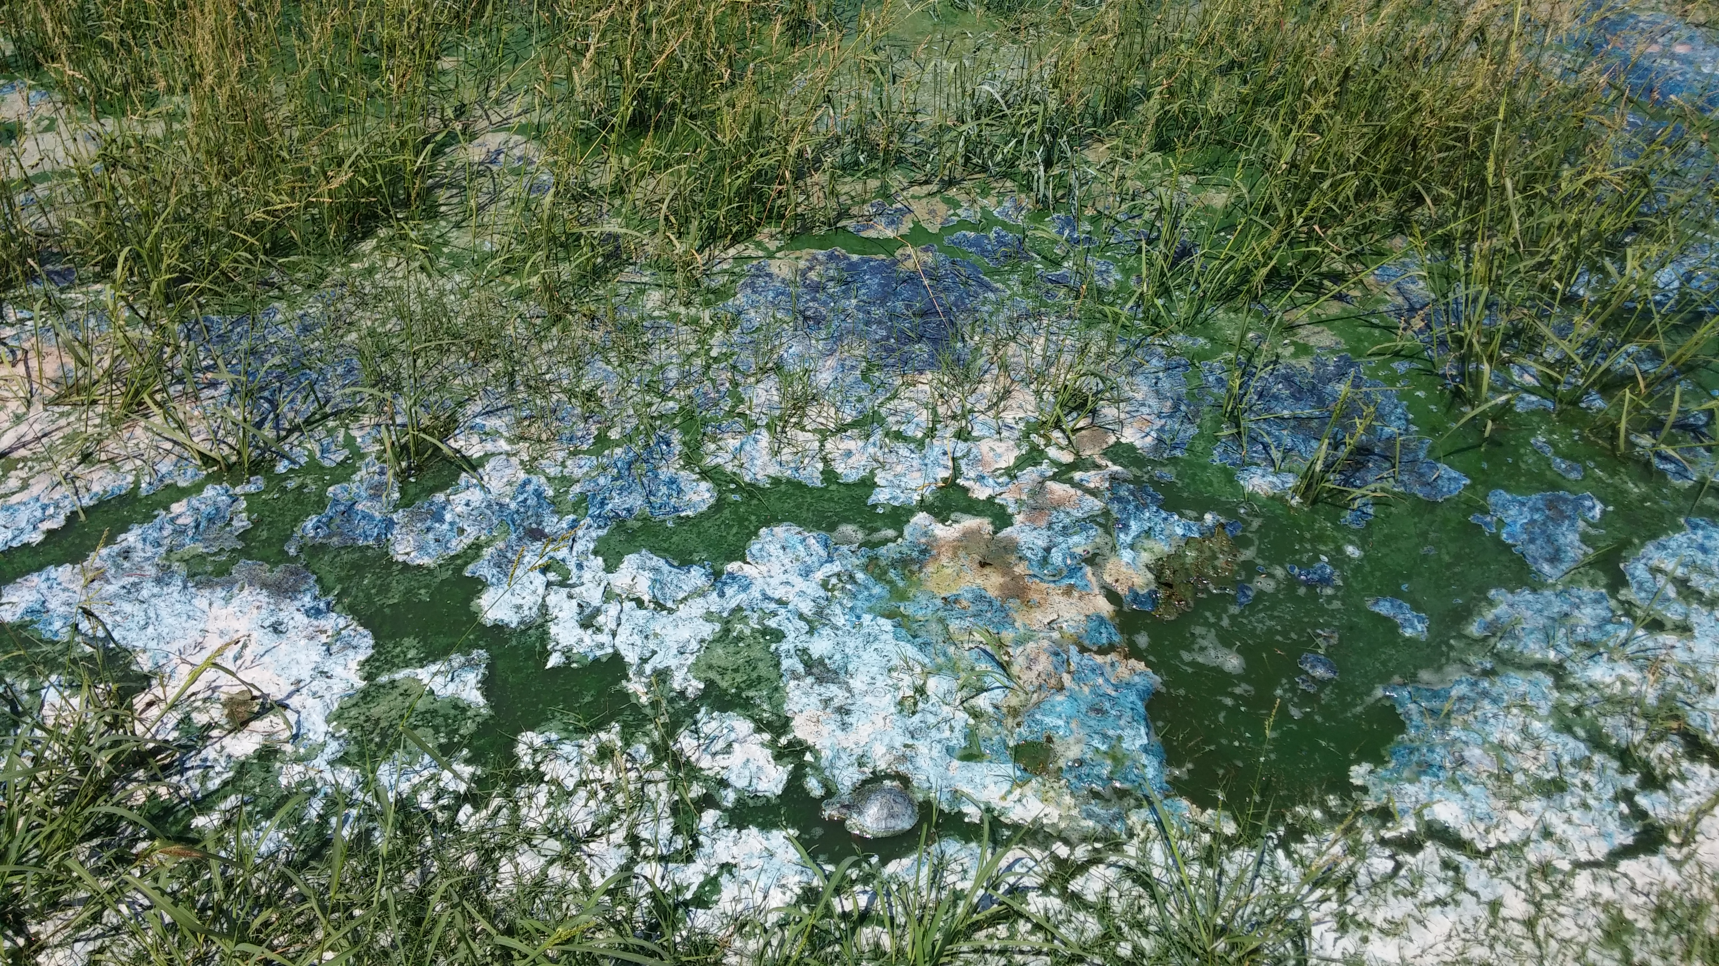
Risks of Not Treating
Predicted to be warmer later in season and more UV light
More biomass often means more toxin
Microcystin may have a role in quenching hydroxy free radicals
Paerl and Huisman 2008; Davis et al. 2009; Dziallas and Grossart 2011
Higher bioaccumulation risks from total toxin
Chronic toxin exposure
When the cell dies or the cell membrane ruptures the toxins are released into the water (extracellular toxins)
However, in other species, a significant amount of the toxin may be naturally released to the water by the live cyanobacterial cell
EPA, “Cyanobacteria and Cyanotoxins: Information for Drinking Water Systems, July 2012

Slide 25
Cylindrospermopsin
CYN is hydrophilic and commonly found in extracellular toxin fractions
Sivonen & Jones 1999; Shaw et al. 2000; Griffiths & Saker 2003
Cyn production can correlate with cell division in exponential growth phase
Though 2x toxin produced in stationary phase verses cell division; Hawkins et al. 2001
Extracellular CYN accounted for 50% in day 20 of culture of one C. raciborskii strain
Saker and Griffiths 2000
Extracellular CYN varied between 19% and 98% of total in C. raciborskii, based on bloom stage
Chiswell et al. 1999
85% of the CYN produced by Aphanizomenon ovalisporum was extracellular
Shaw et al. 1999
Similarly,
Hawkins et al. (2001) showed that on a cellular basis
the rate of intracellular CYN production matches the rate of
cell division.
Cultures in the postexponential phase, growing at a rate
of 0.04 doublings per day (compared with 1.0 doublings per
day during exponential growth) increased cellular CYN at a
rate of 0.08 doublings per day, that is, twice the rate of cell
division ().

Slide 26
Toxin Risk Summary
MCYN going to release anyway
Up to 50%+
Some MCYN extracellular as part of population dying
Much CYN extracellular
50-98% depending on bloom stage
More toxin produced in stationary phase
Fish wildlife?
Spread, auto engineer
Regulations based on total toxin
More risks total toxin
‘Hot spot’ potential
Increased aerosols
More risks by not treating
Often increased production with growth stage, larger blooms, warmer temperature, more UV light
Zilliges et al. 2011

Slide 27
Risk-based Analysis
Cyano toxins
Copper
No good level to have
EPA candidate contaminate list drinking water; HA listings
0.3µg/L MCYN in drinking water- EPA guideline children
WHO/ EPA guidelines in recreational water
WHO possible carcinogen list
Accumulates through time
ALS, PDS, Alzheimer's link
Caused deaths of cows, elk, dogs, birds, people etc.
Essential nutrient
Hemocyanin
Suggested Daily Intake (2mg)
1,300 µg/L is MCL in drinking water
26th most abundant element in Earths Crust
Does not bio-accumulate
Transfers to less available sediment forms through time
No swimming/ drinking/ irrigation restrictions on USEPA approved label

Slide 28
Peroxide = Selective Control
Selective control of cyanobacteria
ROS-eliminating enzymes, like ascorbate peroxidase, lacking in cyanobacteria (Passardi et al., 2007)
Cyanobacteria more sensitive than green algae and diatoms (Drabkova et al. 2007b)
Effective and potential long-term impacts
Cyanobacterial population and microcystin concentration collapsed by 99%; remained very low until 7 weeks after treatment (Matthijs et al. 2012)
‘prolonged suppression of cyanobacteria’ and “new state with a diverse phytoplankton community” (Weenink et al. 2015)
Eukaryotic phytoplankton and macrofauna thrived at all peroxide concentrations applied in whole lake treatment (2mg/L) (Matthijs et al. 2012)

Slide 29
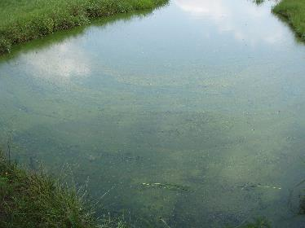
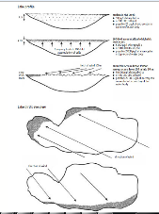
No Action
Risks of no treatment
Water quality degradation
More toxin produced
More risk
Eventually released anyway
Leaky cell mindset flawed
Chronic exposure potential
Hot spot exposure potential
Wildlife…..
Chorus and Bartram 1999
Notes:
Nuisance Phytoplankton Blooms in Coastal, Estuarine, and Inland Waters.. Continue grow, build up, senesce on own

Slide 30
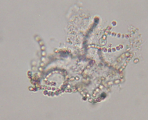
Action
Risks of treatment
Dead algae biomass
But going to die anyway
Product risks to non-targets
Select high affinity to target
Toxin biodegradation/ dilution
Total toxin decreases
with effective treatment
No chronic or concentrated
exposure potential
Leaky cell hypothesis…

Slide 31
Summary
Many toxins and exposure routes
Not directly managing toxic cyanobacteria is not without risk
Released toxin mindset flawed
Total risk, accumulation risks, external toxin, wildlife, other exposures
Source control of bacterial infections critical

Slide 32
Suggested Approach
‘guilty until proven innocent approach’
Otten and Paerl 2015
Data support more toxins being identified, more exposure routes, more knowledge on impacts (acute and chronic)
Acknowledge both known and unknown risks
Approach to ensure safety of the water resource
Low tolerance for toxic cyanobacteria
Not allow toxin to be produced in sufficient amounts to harm humans/wildlife
Mitigate source and/or toxin if found

Slide 33
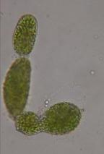
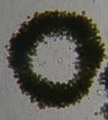
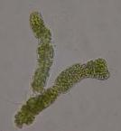
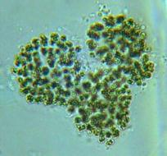
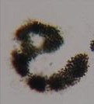
Questions
West Bishop, Ph.D., CLP; Algae Scientist and Water Quality Research Manager
SePRO Research and Technology Campus,
16013 Watson Seed Farm Rd., Whitakers, NC 27891
252-801-1623 (mobile); westb@sepro.com (email)
Host of: Algae Corner
Notes:
1961 Santa Cruz CA toxin accumulated in the anchovies the birds ate

