Slide 1
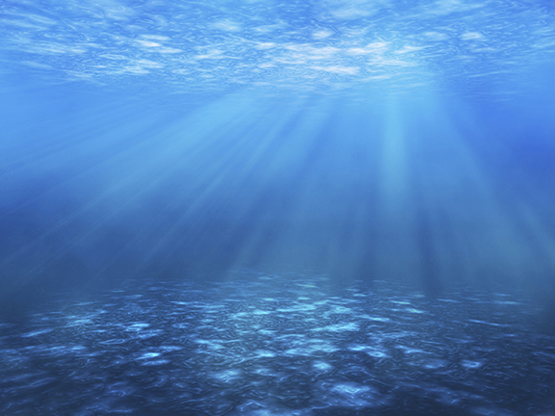
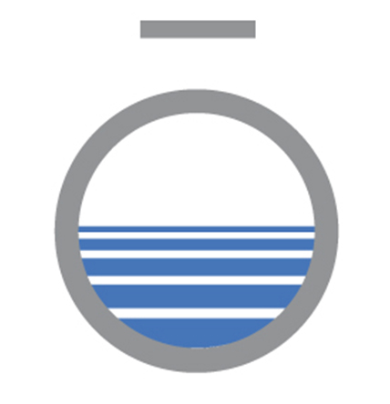
Sustainable Lake & Pond Management Practices
By J. Wesley Allen
Environmental Scientist and Regional Manager
Restoring Balance. Enhancing Beauty.
April 8, 2019

Slide 2
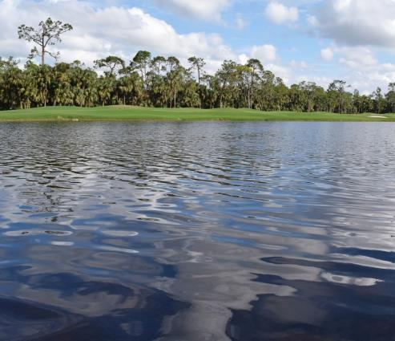
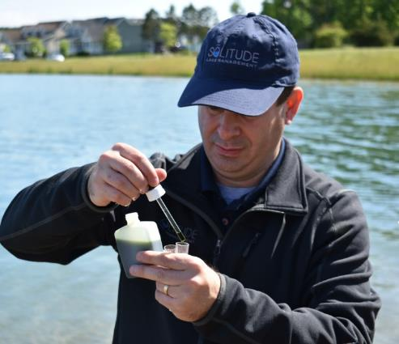
Assessing the Situation
Different bodies of water may require different management strategies depending on the use and the goals for that waterbody.
Successful lake, pond, fisheries and wetland management strategies begins with establishing a baseline understanding of the current conditions.
Monitoring and Assessment are the key to developing a sustainable pond and lake management program

Slide 3
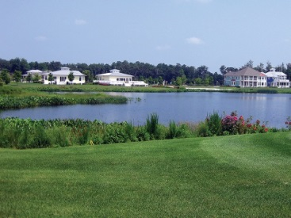
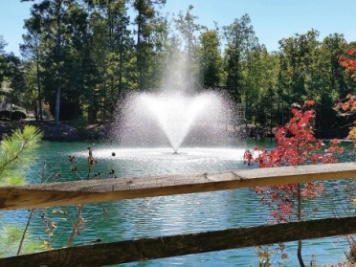
Lake and Pond Management Solutions
Aquatic Weed and Algae Control
Aeration
Fountains
Buffer Management
Erosion Control
Biological Assessments
Invasive Species Management
Wetland Management
Lake Mapping and Bathymetry
Water Quality Testing and Restoration
Nutrient Remediation
Mechanical Harvesting
Hydro-raking
Stormwater BMP Inspections & Repair
Fisheries Management
Reservoir Management
Plant Mapping and Surveys
Mosquito Control
Regulatory Compliance and Permitting
Notes:
Include only the services/solutions relevant to your given presentation.

Slide 4
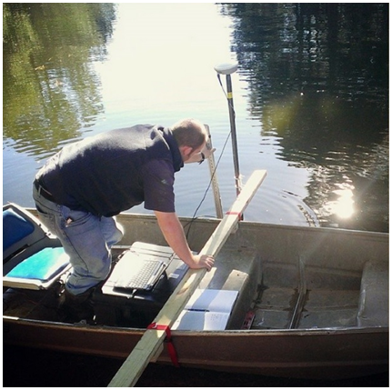
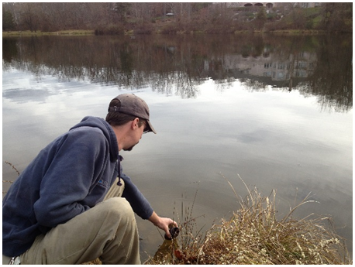
Lake and Pond Studies
Aquatic Plant Mapping
Visual vs. GPS-referenced data collection
Determining the species actually present
Other Biological Surveys
Fish
Algae Sampling and ID
Phytoplankton and Zooplankton
Benthic Macro-invertebrates
Notes:
Include only the services/solutions relevant to your given presentation.

Slide 5
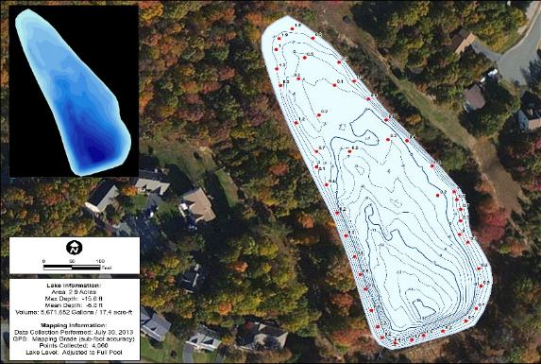
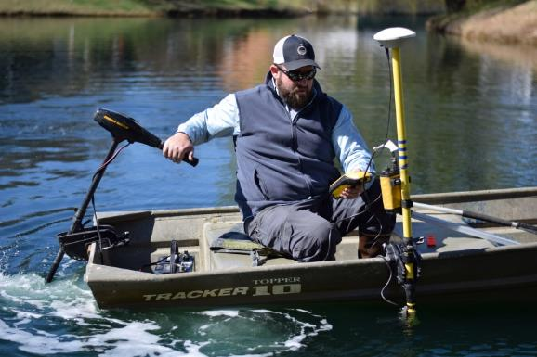
Lake Mapping and Bathymetry
Types of Lake Mapping:
Surface Mapping, Bathymetric Studies, Sediment Analysis
Lake mapping data can be utilized to:
Develop programs to manage aquatic vegetation or algae
Improve fisheries
Plan and budget for future dredging or sediment removal
Notes:
Talking points:
-Surface mapping: Surface mapping utilizes GPS software and satellite imagery, which enables specialists to determine a waterbody’s surface area. It’s also important to identify the locations of the physical and structural components of your waterbody, such as inlet and outlet structures, fountains, aeration systems, and fish habitat. -Bathymetric Studies: Bathymetric mapping involves the use of integrated GPS and depth sensing technology to create a three-dimensional model of your waterbody. As a result, this model has detailed bottom contours and highly accurate volume calculations.
-Sediment analysis: Data collected will serve as a baseline for owners and lake managers to help establish an accurate budget and timetable for potential dredging projects.

Slide 6
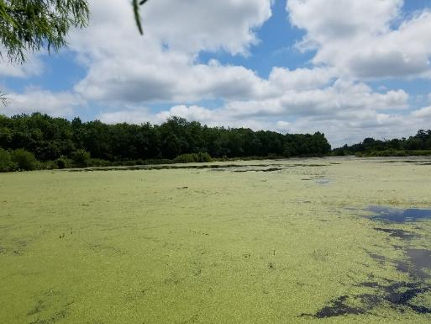
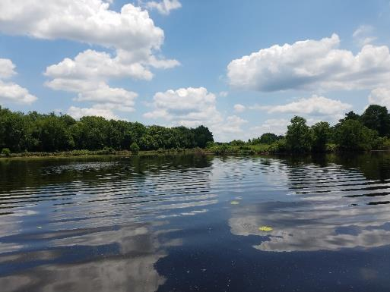
Water Quality Testing
Proactive testing and monitoring is vital when it comes to helping prevent water quality problems.
Helps to document annual trends and acts as a reference for emerging water quality impairments.
Important Testing Parameters: turbidity, algae presence, toxic algal species, taste and odor compounds, pH, temperature, dissolved oxygen, conductivity, phosphorus, ammonia, nitrogen, hardness, alkalinity, e. coli, and fecal coliform.
Before
After
Notes:
Talking points:
-Knowing the chemical and biological constituents and demands on your waterbody, and understanding their impacts on water quality, is essential to your management program.
-Different bodies of water might also require different management strategies depending on the use and the goals for that waterbody.

Slide 7
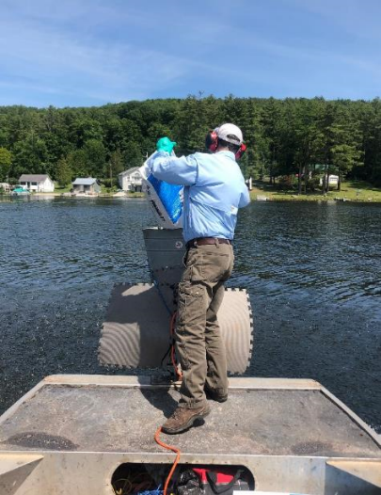
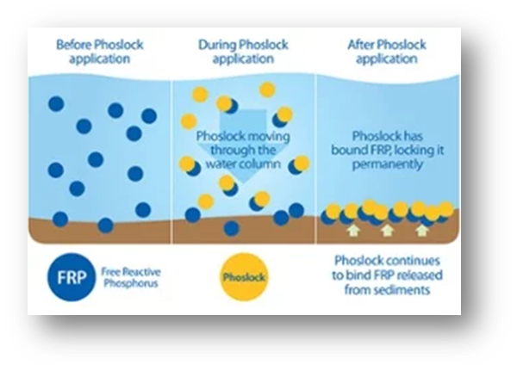
Nutrient Management
Nutrient management strategies can help limit undesirable growth.
Reduce over-fertilization on lawns and landscaping
Prevent geese from swimming in water resources
Remove trash and organic materials in and around lakes and ponds
Apply eco-friendly Phoslock, Alum or Biochar
Notes:
Talking points:
-As lakes and ponds age, they become enriched with nutrients like phosphorus and nitrogen.
-This is a natural aging process known as eutrophication. Cultural eutrophication, considered a form of water pollution, occurs when human activity speeds up eutrophication by causing accelerated land runoff through urbanization and by allowing things like detergents, sewage and fertilizers to enter the ecosystem.
-Phoslock is derived from a naturally occurring mineral called lanthanum, which rapidly binds with and removes free reactive phosphorus (FRP) from the water column.
-Phoslock, it is also a highly effective solution for nutrient remediation in lakes and ponds. When applied to the waterbody, Alum forms a floc which binds to phosphorus and settles to the bottom.

Slide 8
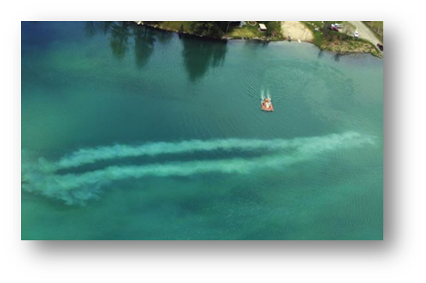
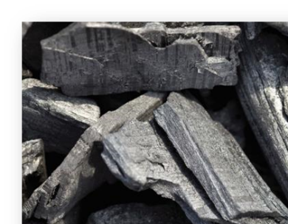
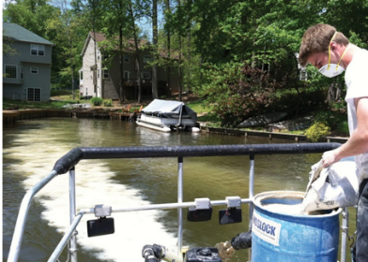
Water Quality Restoration
Phoslock Alum Biochar
Unique lanthanum-modified clay
Rapidly binds and permanently removes free reactive phosphorous from water column
It is effective in locking up the phosphorus in the bottom sediments
Aluminum sulfate
Used for chronic nutrient loading or highly turbid water
Effective management strategy for restoring water quality and improving clarity
Highly adsorbent material similar to activated charcoal
Often contained bag that allows water to flow through while pulling nutrients from the water
Bags typically placed near inlets or in moving water

Slide 9
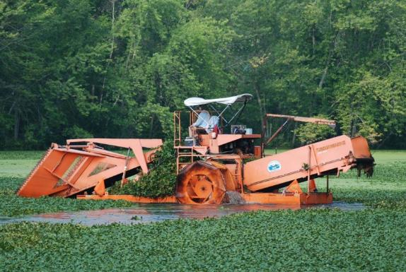
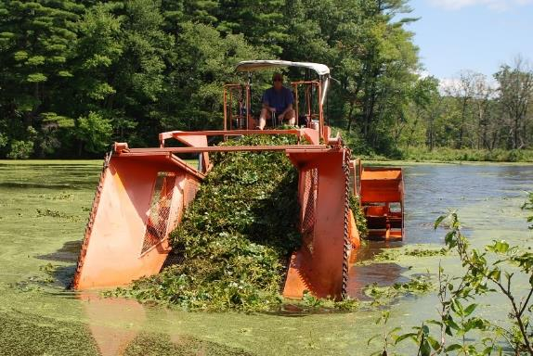
Mechanical Harvesting
Technique used for achieving “area selective” control of nuisance aquatic vegetation.
An effective alternative on sites with annual plant varieties or where herbicides are not appropriate.
One to two harvests are recommended to provide a season-long control of targeted species.
Notes:
Talking points:
-Mechanical harvesting is well-suited for clearing large areas of nuisance vegetation or cutting channels through dense vegetation
-Harvesting can be performed for many different species of vegetation, but is most effective for plants that form a dense surface canopy like water chestnut or water hyacinth.

Slide 10
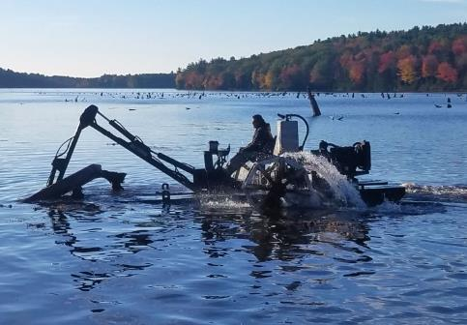
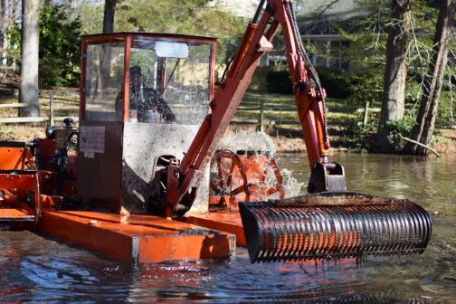
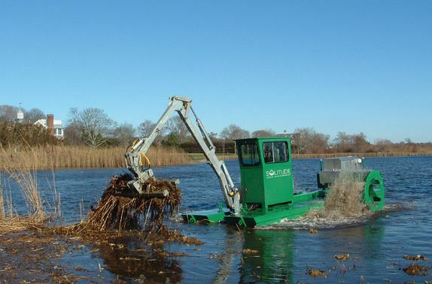
Hydro-Raking and Sediment Removal
Technique for area selective removal of nuisance, rooted vegetation as well as accumulations of unconsolidated bottom muck and debris.
Maintenance that will help to prolong or prevent future dredging.
Removal of plants and debris will reduce the nutrient load, foul odors, nuisance algae blooms and improve water quality.
Notes:
Talking points:
-The hydro-rake is also used to clear accumulations of unconsolidated bottom muck and debris (i.e. decaying leaves, peat, etc.)
-The hydro-rake can best be described as a floating barge upon which is mounted a backhoe with several different size and functioning rake attachments.
-Can remove nuisance vegetation and bottom debris from water depths ranging from 18 inches to 10 feet.

Slide 11
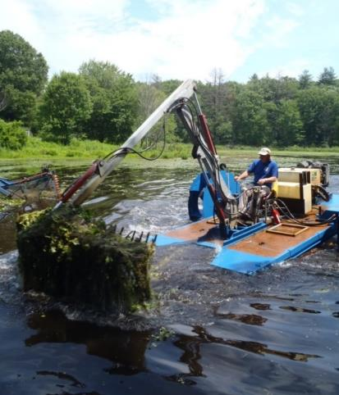
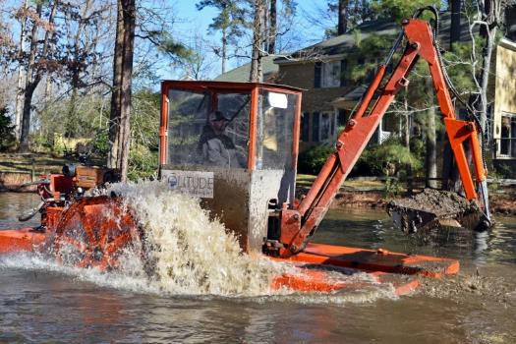
Hydro-raking
Removes plants and debris at the sediment-water interface.
Operates in water depths ranging from 18 inches to 10 feet.
Clears selective areas including beaches as well as boating and fishing lanes.
Offers an environmentally friendly solution with no water use restrictions, since chemicals are not used.
Acts as a budget-friendly alternative to traditional dredging.
Notes:
Talking points:
-The hydro-rake is also used to clear accumulations of unconsolidated bottom muck and debris (i.e. decaying leaves, peat, etc.)
-The hydro-rake can best be described as a floating barge upon which is mounted a backhoe with several different size and functioning rake attachments.

Slide 12
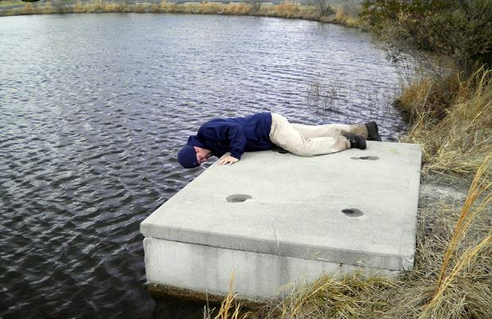
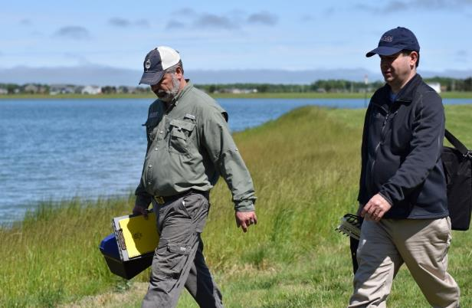
Stormwater BMP Inspections and Repairs
Stormwater ponds reduce flooding, slow down water flow and clean pollutants from water.
Annual inspections allow you to plan your long-term maintenance budgets, while also identifying and resolving issues that might otherwise require more expensive structural repairs if left unaddressed.
Notes:
Talking points:
-An annual inspection of your stormwater facility is not only a good idea, but in many cases it is a local or state requirement.
-Your facility is an engineered structure, designed to accumulate sediment runoff. Identifying and correcting erosion issues on site will slow down the sedimentation rate, thus extending the useful life of your facility.

Slide 13
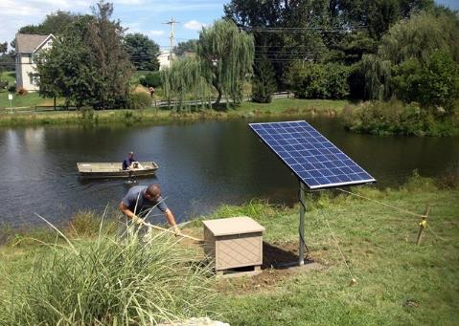
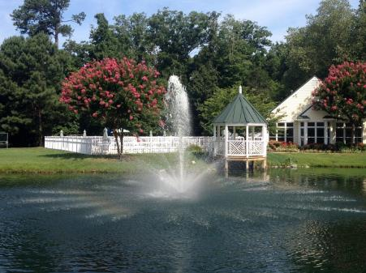
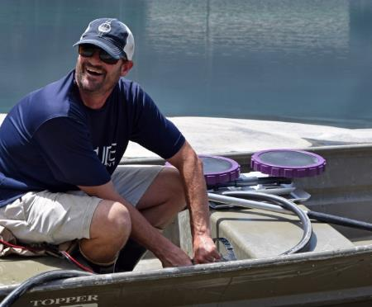
Aeration
Induces circulation and adds dissolved oxygen, thereby…
Reducing stagnation and accumulation of organic sediment
Mitigating many of the causes of poor water quality
Types of aeration include:
Submersed, floating, solar and windmill
Notes:
Talking points:
-Helps defend against algae pockets form forming
-It will also aid in the promotion of a healthy habitat for fish and other aquatic life.

Slide 14
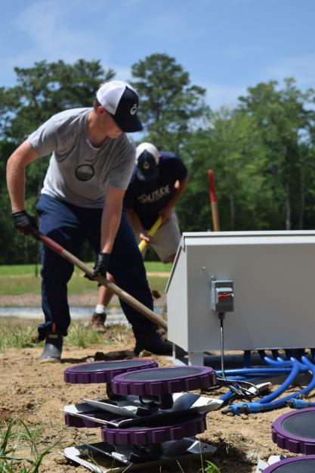
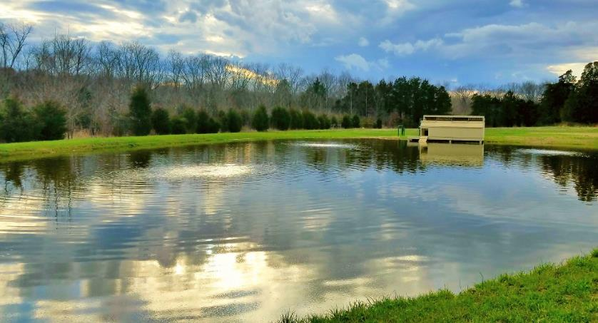
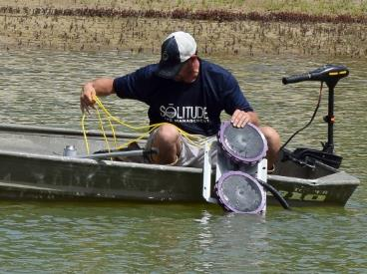
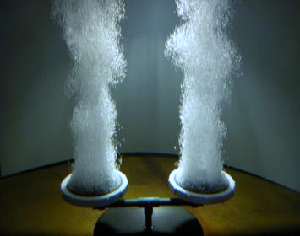
Submersed Aeration
This style of aeration more effectively oxygenates the water and decreases stratification without disturbing the natural look of the pond.

Slide 15
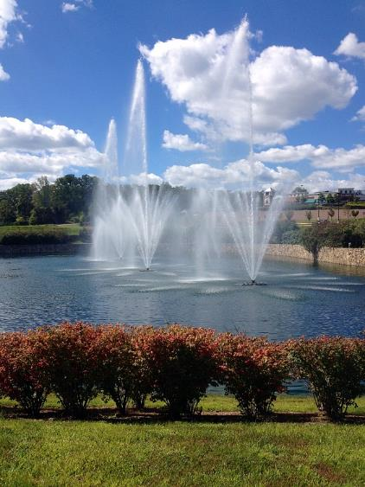
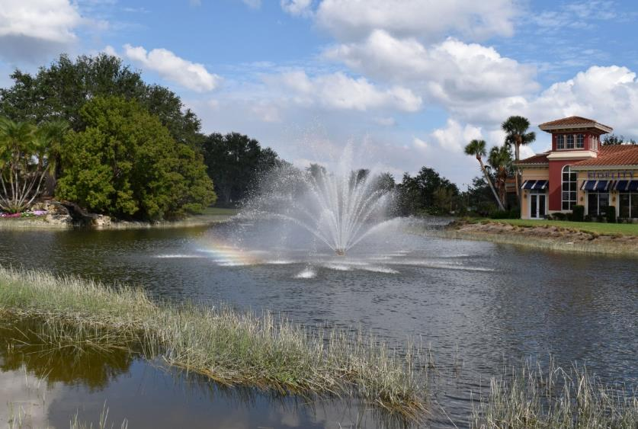
Floating Fountains
This style of aeration provides high turnover rates reducing stratification and increases oxygenation, which helps mitigate excessive nutrient loading while giving an aesthetic aspect to the pond.

Slide 16
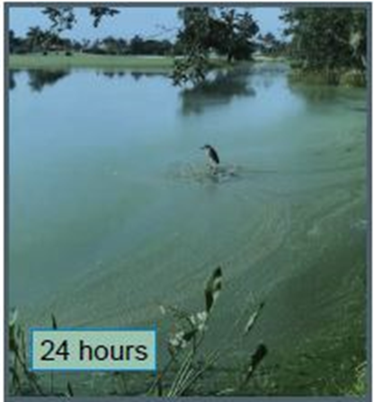
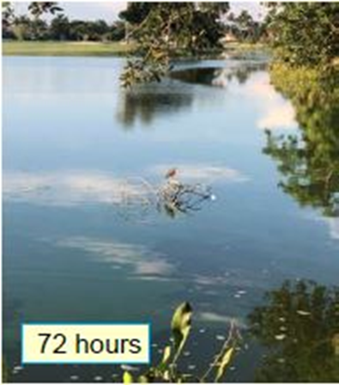
Natural Solutions: Nanobubble Technology
Nanobubble aeration is a relatively new technology designed to exceed the oxygenation capabilities of traditional aeration systems.
Nanobubbles produced by submersed generators are ultra-fine and nearly invisible to the eye; in fact, at less than 1 micrometer, they are about 400 times smaller in diameter than human hair and 1 million times smaller than ordinary bubbles.
We are still learning more about the benefits of this technology

Slide 17
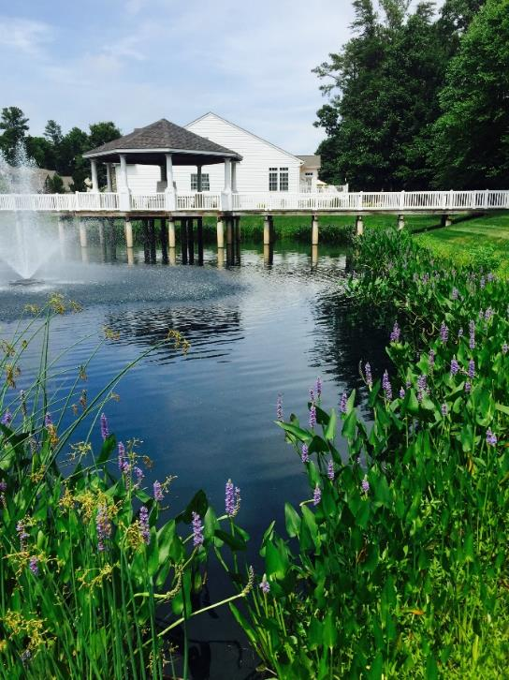
Buffer Management
Beneficial vegetation helps to filter excess nutrients from entering the water, maintain shoreline stability, and prevent erosion and sedimentation.
Effective buffer zones include a mix of native plants:
Aquatic grasses
Sedges and rushes
Beneficial flowering species
Upland plants
Notes:
Talking points:
-Shoreline vegetative buffers may be the single most important natural aspect to promoting and maintaining good water quality.
-Buffers on lakes or ponds should be three feet tall or greater, and maintained in such a way that they are dense and thick
-They can also provide a major deterrent to nuisance Canada geese from becoming full time residents to the site.
-Without these vegetative buffers, lakes and ponds are much more likely to struggle with persistent algae growth, turbidity, foul odors, mosquitos, geese, erosion, sedimentation, and many other water quality issues.
-Buffer management should be performed several times annually to eliminate any nuisance vegetation species.

Slide 18
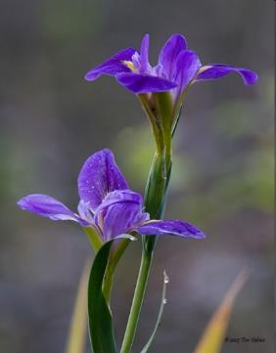
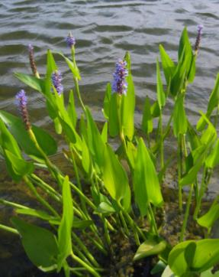
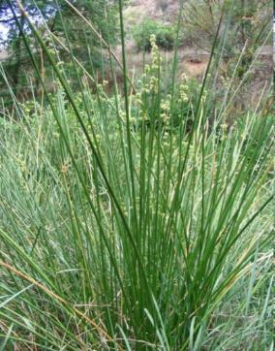
Beneficial Aquatic Plants
Aquatic plants may be submersed, floating, or emergent, and native species are essential to a healthy aquatic habitat.
Beneficial plant species help absorb excess nutrients already in the pond, reducing availability for unwanted plants and algae.
Provide habitat, refuge, and food for a wide variety of organisms including fish, invertebrates, and waterfowl.
Blue flag iris
Pickerelweed
Soft stem bulrush

Slide 19
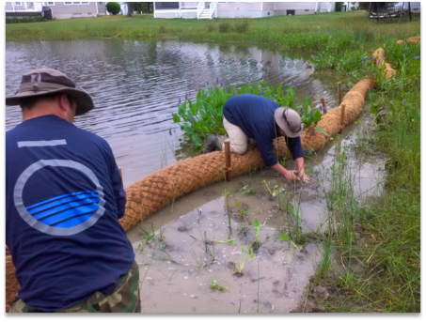
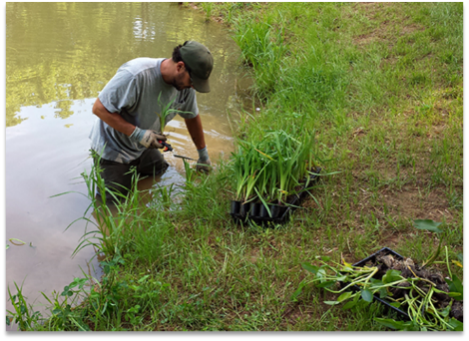
Erosion Control: Eco-friendly Solutions
SOX Erosion Solutions
Coconut Fiber Logs Vegetative plantings
Notes:
Talking points:
-As lakes and ponds age, they become enriched with nutrients like phosphorus and nitrogen.
-This is a natural aging process known as eutrophication. Cultural eutrophication, considered a form of water pollution, occurs when human activity speeds up eutrophication by causing accelerated land runoff through urbanization and by allowing things like detergents, sewage and fertilizers to enter the ecosystem.
-Phoslock is derived from a naturally occurring mineral called lanthanum, which rapidly binds with and removes free reactive phosphorus (FRP) from the water column.
-Phoslock, it is also a highly effective solution for nutrient remediation in lakes and ponds. When applied to the waterbody, Alum forms a floc which binds to phosphorus and settles to the bottom.

Slide 20
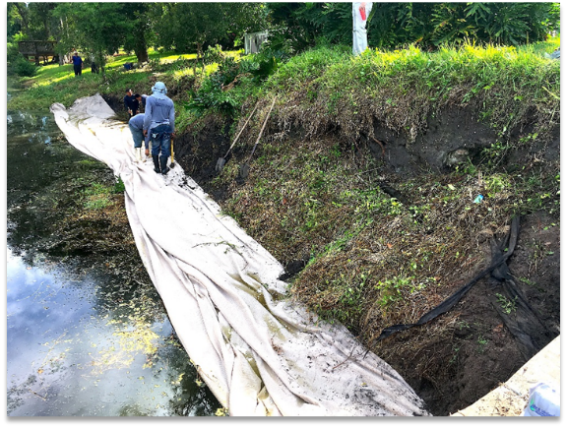
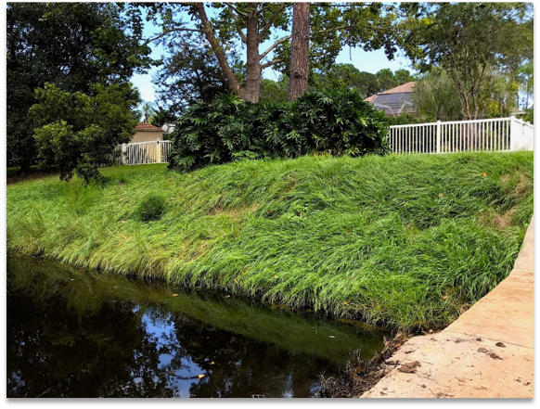
Erosion Control: ShoreSOX
Patented biodegradable knitted mesh system
Utilized to create a long-lasting sediment containment barrier
Native vegetation can be installed directly in to the mesh
Provides up to 10 years of stabilization
Notes:
Talking points:
-As lakes and ponds age, they become enriched with nutrients like phosphorus and nitrogen.
-This is a natural aging process known as eutrophication. Cultural eutrophication, considered a form of water pollution, occurs when human activity speeds up eutrophication by causing accelerated land runoff through urbanization and by allowing things like detergents, sewage and fertilizers to enter the ecosystem.
-Phoslock is derived from a naturally occurring mineral called lanthanum, which rapidly binds with and removes free reactive phosphorus (FRP) from the water column.
-Phoslock, it is also a highly effective solution for nutrient remediation in lakes and ponds. When applied to the waterbody, Alum forms a floc which binds to phosphorus and settles to the bottom.

Slide 21
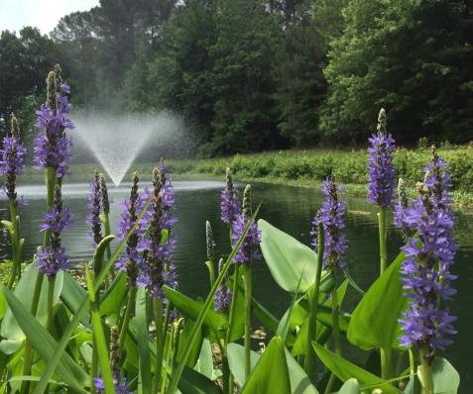
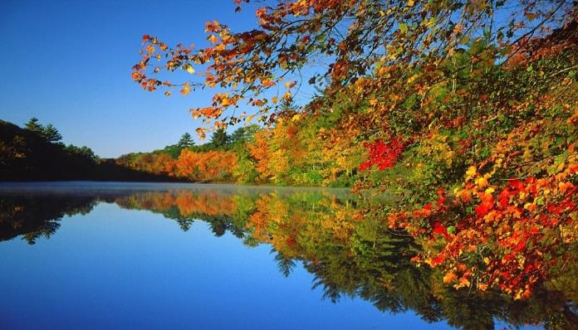
Biological Augmentation
Biological augmentation: using microbial and enzyme-enriched products that aid in the maintenance of healthy aquatic ecosystems.
Results are enhanced when combined with proper aeration and beneficial buffer plants.
Notes:
Talking points:
-Over time, lakes and ponds begin to fill in because of the natural breakdown of organic matter in the water which causes a buildup of bottom sludge.
-Leaves, branches, trash and other natural runoff can cause the bottom sludge to build.
-As part of a sound lake and pond management plan, biological augmentation can help slow the buildup of sludge.
-When combined with proper aeration and beneficial aquatic plants, the results of biological augmentation are further enhanced.

Slide 22
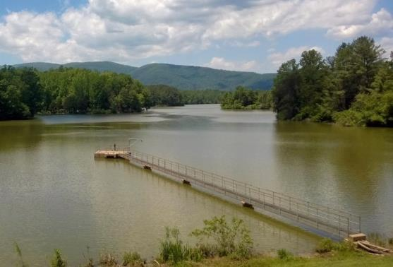
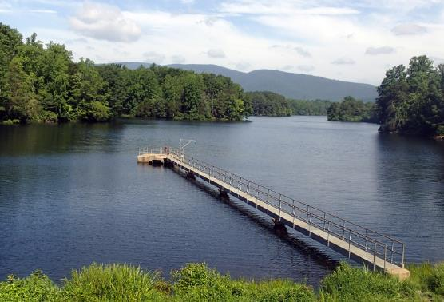
Aquatic Weed and Algae Control
Invasive algae and aquatic weeds are not only unsightly, but they can sometimes be a danger to aquatic life and humans depending on the species.
Properly identifying the target algae and aquatic weeds is an important factor in achieving the desired results.
Notes:
Talking points:
-Choosing the right product and applying it at the right rates at the right times will provide you with lasting results.

Slide 23
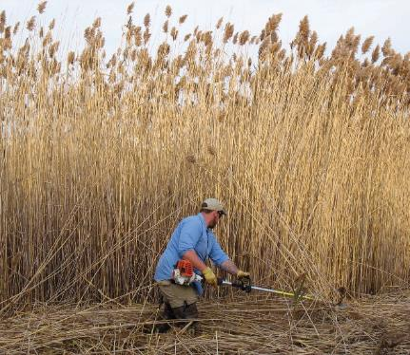
Invasive Species Management
Invasive plants are species that were introduced to an area that is outside of their natural range of dispersal.
Variety of species:
Submerged, Emergent, Floating, Wetlands
Adaptive and aggressive, high reproductive rate.
Notes:
Talking points:
-Submerged or submersed plants are those plants that grow almost entirely under the surface of the water, although they do have the potential to "top out" and reach the surface.
-Emergent plants are those species that are rooted in shallow water, but that stand upright with the majority of their plant tissue showing above the surface of the water. Typically these species will only grow in very shallow water or along the edges of the water and slightly up onto dry land.
-Floating plants are those plants that are vascular and do have roots, but their roots are not necessarily established in the bottom sediment. These species, whether rooted or not, have most if not all of their leaves and other plant tissue floating on the surface of the water.
-Wetlands provide food and shelter for many different species and are vital filters for surrounding watersheds. Human disturbance often leads to non-native species being introduced to wetlands and such species reduce existing native vegetation.
-Eventually dominate the native species and, in some cases, destroying the ecosystem by eliminating all native plants and making the area useless to the animal life that once called these areas home.
-A management program will help you combat these potentially harmful intruders and preserve ecological balance.

Slide 24
Drinking Water Reservoir Management
Cyanobacteria is a major concern for drinking water reservoirs.
Cyanobacteria Impacts Include:
Taste and Odor Problems
Fish Kills
Toxin Production
Action Threshold Based Management
Assessment
Prescription
Implementation
Before
After
Notes:
Talking points:
-At SOLitude, we work with water managers to assess reservoir conditions such as the nutrient level in order to manage run-off from fertilizers and sewage, and sediment build up from organic matter.
-Without this management strategy, reservoirs are vulnerable to toxic, harmful algae such as cyanobacteria (blue-green algae).
-Algae affects taste and odor of the water.
-Without intervention, the cyanobacteria are likely to continually grow and increase the amount of toxins produced.
-Action Threshold Based Management…
-Assessment: We work with water managers to assess reservoir conditions, evaluate water quality data and identify the species, location and density of the current algae and cyanobacteria populations.
-Prescription: Based on assessment information, water quality objectives and available resources, we will design a site specific management program.
-Implementation: After determining the right management program to meet your specific needs and objectives, our professionals will implement all aspects of the management plan, to include ongoing monitoring and engagement with water reservoir managers.

Slide 25
Fisheries Management
Fisheries Management Plan
Habitat Management
Electrofishing
Stocking
Predator to Prey Management
Species Management
Supplemental Feeding
Trophy Fisheries Programs

Slide 26
Mosquito Management
Natural Management Methods:
Fish stocking
Aeration and Fountains
Beneficial shoreline vegetation
Implement an Integrated Mosquito Management (IMM) program
Notes:
Talking points:
Due to the health risks of mosquitos, it is important that your lake, pond or wetland management program includes integrated mosquito prevention and control measures for all breeding habitat found on your site.
Natural control methods:
-Fathead minnows, golden shiners and bluegill are some of the fish that are known to feed on mosquito larvae.
-Fountains or submersed aeration systems makes the waterbody less hospitable to algae, which leads to less isolated pockets where mosquitos can reproduce.
-Beneficial shoreline plants that provide habitats for mosquito predators such as dragon flies
Integrated Mosquito Management program:
-Communities can implement a large-scale Integrated Mosquito Management (IMM) program which typically includes:
Public education
Surveillance
Testing and control

Slide 27
Regulatory Compliance and Permitting
On October 31, 2011, the National Pollutant Discharge Elimination System (NPDES) permit went into effect.
This requires all waterbody owners must meet all local and state regulations regarding pesticide applications.

Slide 28
Please Share Your Takeaways Thank You
By J. Wesley Allen
Environmental Scientist and Regional Manager
wallen@solitudelake.com
solitudelakemanagement.com • 888.480.LAKE
April 8, 2019

