Slide 2
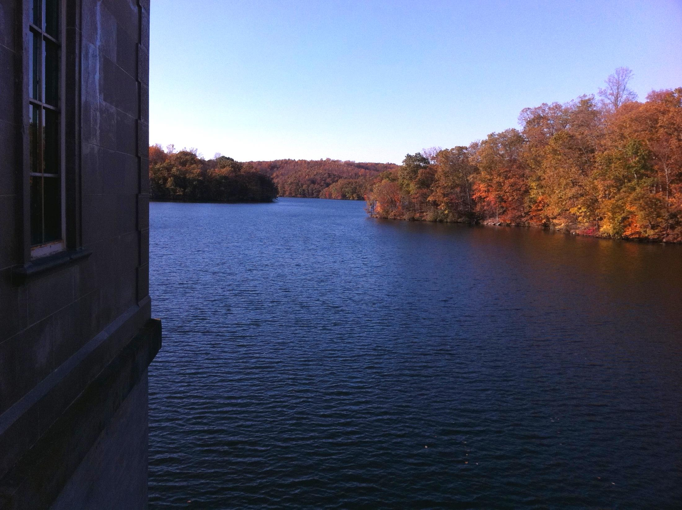
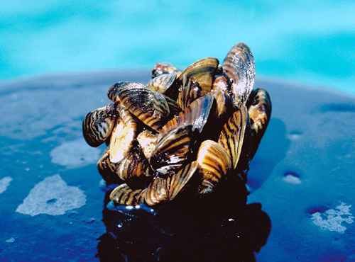
City of Baltimore Raw Water Supply Zebra Mussel Monitoring and Control
Clark Howells
Watershed Section Manager
Department of Public Works
Bureau of Water and Wastewater
Baltimore City Department of Public Works

Slide 3
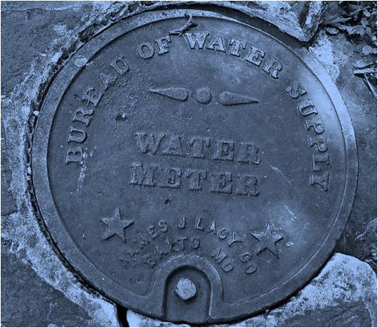
RESERVOIR WATERSHEDS
The City of Baltimore, Department of Public Works is responsible for the operation and maintenance of a water supply system which services approximately 1.8M people in the greater Baltimore metropolitan region.
This 215 square mile service area, includes the City of Baltimore and portions of Anne Arundel, Baltimore, Howard, Carroll, and Harford Counties.
The two primary sources of this supply are the Gunpowder Falls and the North Branch of the Patapsco River. A secondary source is available from the Susquehanna River at Conowingo.
Baltimore City Department of Public Works

Slide 4
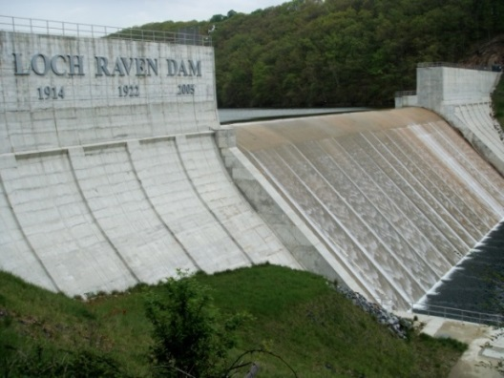
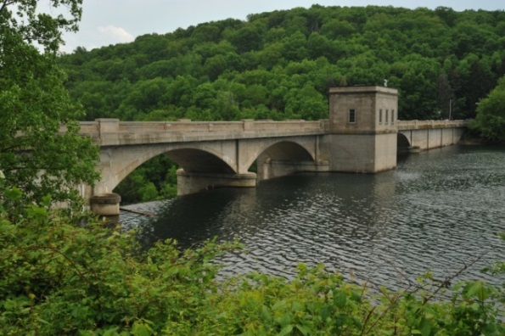
RESERVOIR WATERSHEDS
City of Baltimore uses surface water from rainfall and snowmelt as the primary source of its water.
Loch Raven Reservoir
Located in northern Baltimore County, small parts of western Harford County and southern York County, Pennsylvania.
The source of reservoir water is Gunpowder Falls.
Raw water from Loch Raven Reservoir travels through a 7.3 mile long, 12 foot diameter tunnel for treatment at the Montebello Filtration Plant in Baltimore.
Prettyboy Reservoir
Located in the northwest corner of Baltimore County
80 square mile watershed.
It impounds about 19 billion gallons of water.
The reservoir has an outlet through the Prettyboy Dam into the Gunpowder River.
Baltimore City Department of Public Works

Slide 5
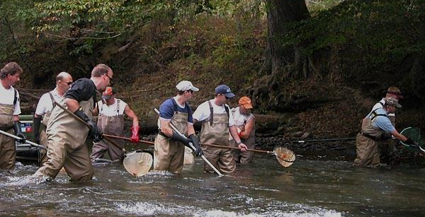
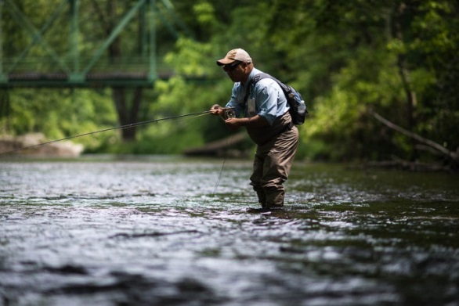
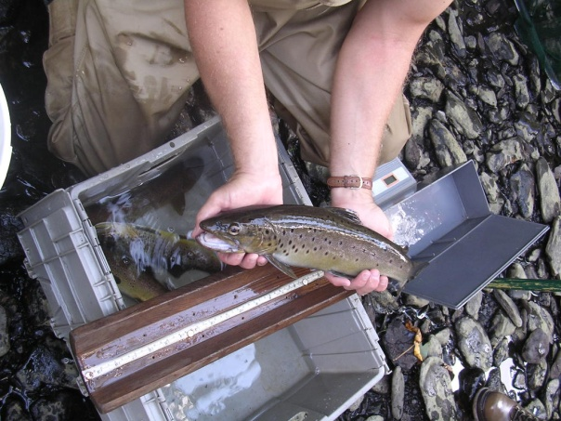
RESERVOIR WATERSHEDS
Trout Unlimited Agreement
In 1986, the Maryland Chapter of Trout Unlimited and the Department of Natural Resources negotiated an agreement with the City of Baltimore for a minimum flow release of cold water from Prettyboy Reservoir.
The 11.5 cfs. discharge created the cold water conditions necessary to support the tailwater trout fishery.
For almost 30 years this partnership has been able to maintain a blue ribbon trout fishery in the Gunpowder Falls.
This is a phenomenal publicly accessible wild trout resource that due to an adaptive management approach has been able to weather significant drought, multiple flood events and the introduction of invasive didymo into the river system.
Baltimore City Department of Public Works

Slide 6
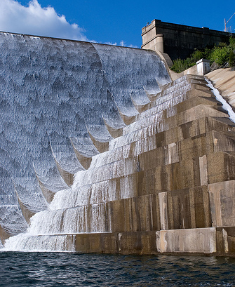
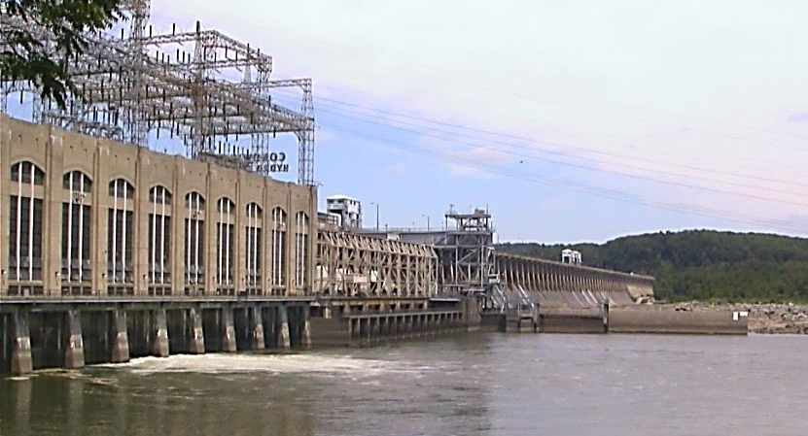
RESERVOIR WATERSHEDS
Liberty Reservoir
Located on the North Branch of the Patapsco River on the boundary between Baltimore and Carroll Counties.
It collects water from a 164 square mile drainage area that includes eastern Carroll County and southwestern Baltimore County.
Water from the reservoir flows, by gravity, through a 12.7 mile long, 10 foot diameter tunnel to the Ashburton Water Filtration Plant for treatment.
Conowingo Intake
Auxiliary water intake on the Susquehanna River, approximately 11 miles north of Aberdeen near the Pennsylvania State line.
Pumped via the Deer Creek Pumping Station to the Montebello Filtration Plants through the 38 mile long Susquehanna Conduit.
Baltimore City Department of Public Works

Slide 7
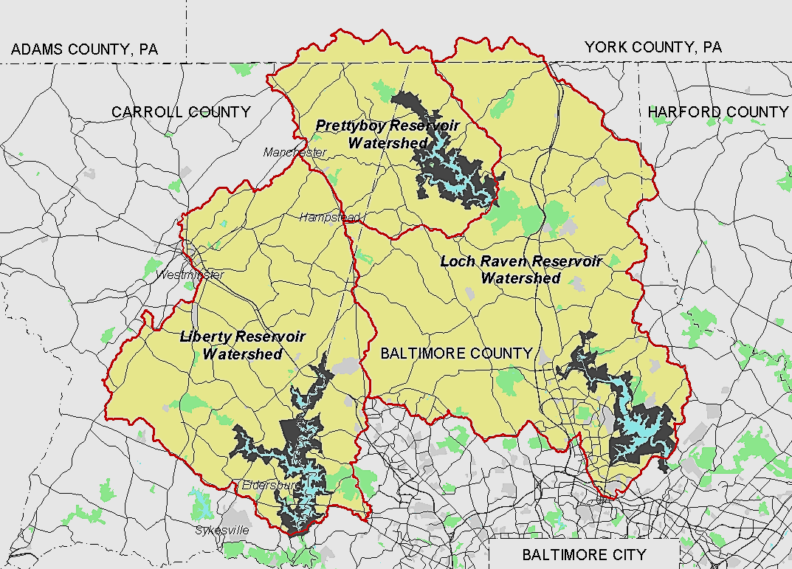
RESERVOIR WATERSHEDS
Baltimore City Department of Public Works

Slide 8
MANAGEMENT ACTIONS
The presence of several dreissenid mussels in the Susquehanna River near Binghamton, NY, in the early 1990s, prompted City of Baltimore to evaluate the dreissenid mussel control options and to explore alternatives to dreissenid mussel control.
1992 - Enacted boating moratorium
1992 - Modified boating permits to restrict access to Liberty, Loch Raven, and Prettyboy reservoirs
Signed affidavit: use only on City’s three reservoirs
No gasoline-powered motors on boats
No boats longer than 18 feet (currently 20 feet)
Boating moratorium could be reinstated if necessary
1992 - Required live bait used by anglers in City reservoirs to be certified zebra mussel-free
1992 - Established ongoing zebra mussel monitoring program, April-November, using multi-plate samplers, at City reservoirs and intake of Conowingo Pool
Baltimore City Department of Public Works

Slide 9
MANAGEMENT ACTIONS
1993 - Constructed zebra mussel control facilities at all 4 water supply intakes
2008 – Created a Watershed Ranger force to help improve compliance with watershed regulations and enforce boating regulations,
2010 - Completed new vulnerability assessment of City’s reservoir system’s to dreissenid infestation, and reviewed current control methods
2013 - Started evaluating renovations to intake in Conowingo Pool
2015 to Present – Press Releases related to Zebra Mussel control and local NPR interviews.
Baltimore City Department of Public Works

Slide 10
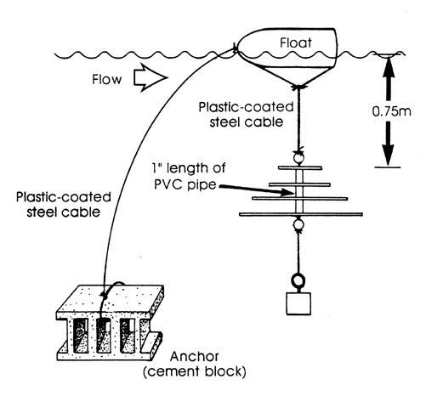
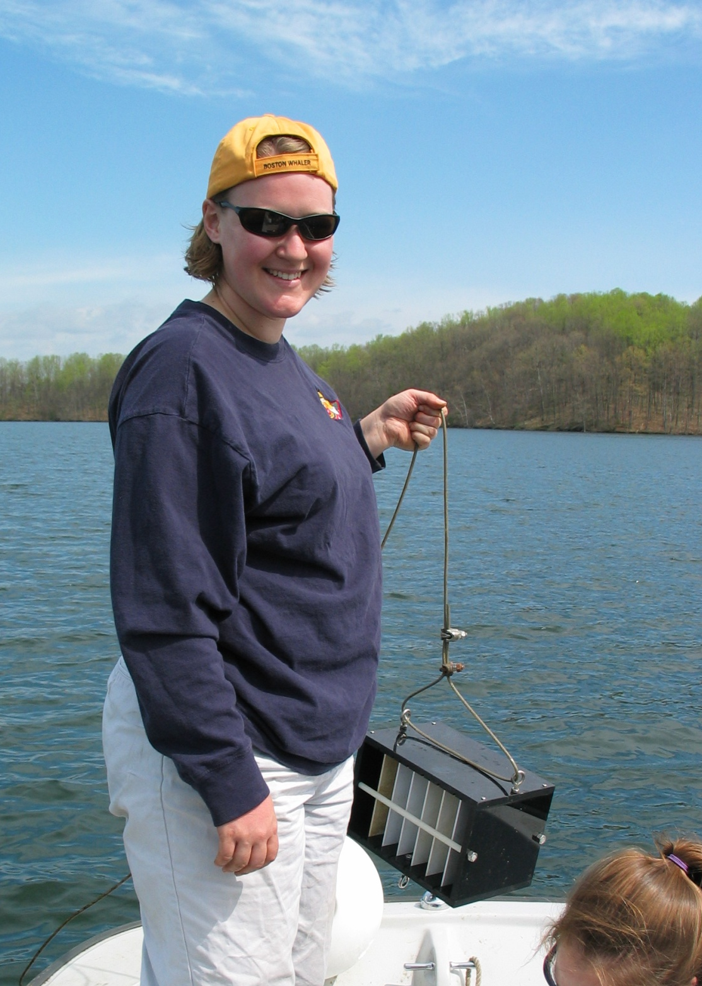
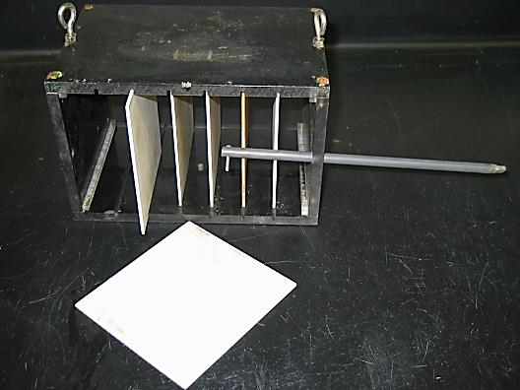
MANAGEMENT ACTIONS
Monitoring stations established at each of the city-owned reservoirs and at the Conowingo Intake
Sampling stations located at each the intakes and boat ramp areas
Multi-plate sample design
Samples collected every two weeks during the monitoring season.
Baltimore City Department of Public Works

Slide 11
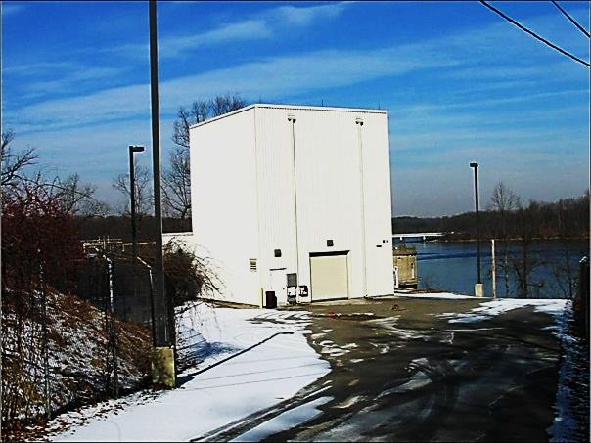
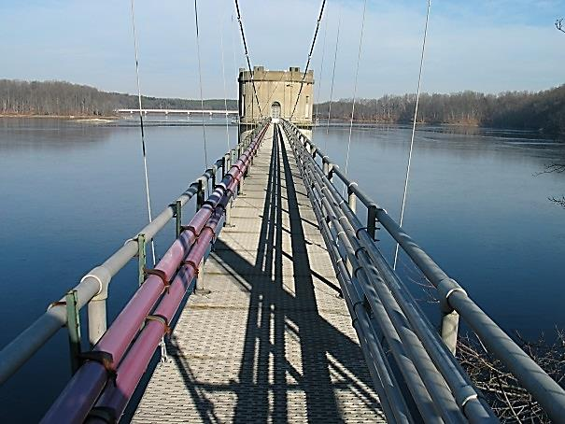
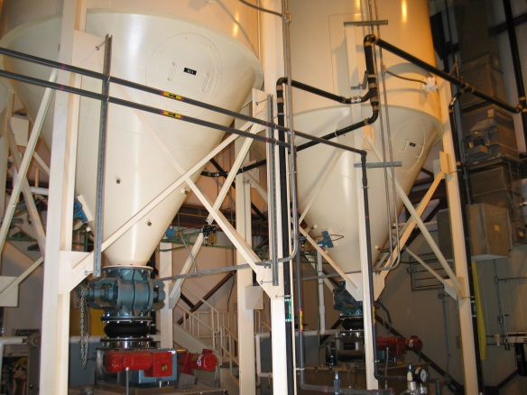
MANAGEMENT ACTIONS
Zebra Mussel Control facilities were constructed at each of the three reservoir locations and the Conowingo Intake.
With the exception of the Prettyboy Reservoir, all facilities use potassium permanganate as the primary control chemical with a chorine backup system.
Potassium permanganate is commonly used in the treatment process and does not negatively impact water quality.
The Prettyboy system, due to the potential discharge of treatment chemicals into the Gunpowder Falls, is designed for thermal treatment superheating water for control.
Baltimore City Department of Public Works

Slide 12
VULNERABILITY ASSESSMENT
2010 “Vulnerability of City of Baltimore Drinking Water Reservoirs and Intakes to Dreissenid Infestation” Renata Claudi, M. Sc. & Katherine Prescott , M. Eng., RNT Consulting Inc.
RNT examined data available on the environmental parameters of to better understand the size of the potential infestation.
The data available generally showed alkalinity or calcium levels which would at best support
Low infestation levels for Prettyboy and Liberty Reservoirs
Moderate for Loch Raven Reservoir
Additional mitigating factors such as low pH and low levels of oxygen below the thermocline of the reservoirs may further depress any developing dreissenid population.
All three reservoirs have been closed to boats coming in from other water bodies since 1992. Recreational boats are a common transport vector for mussel infestation. This proactive step has significantly decreased the potential for introduction of dreissenid mussels.
It is also recommended to monitor the progress of Zequanox (Pseudomonas fluorescens), a new bacterial product which specifically controls only dreissenid mussels.
Baltimore City Department of Public Works

Slide 13
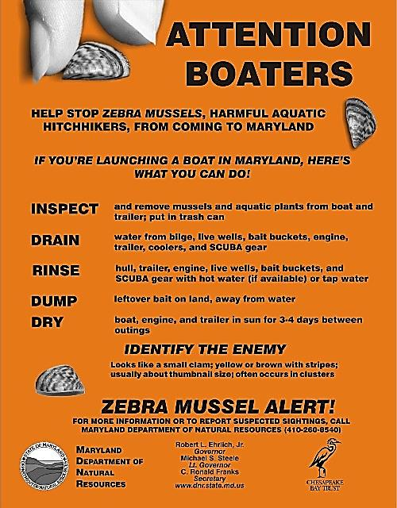
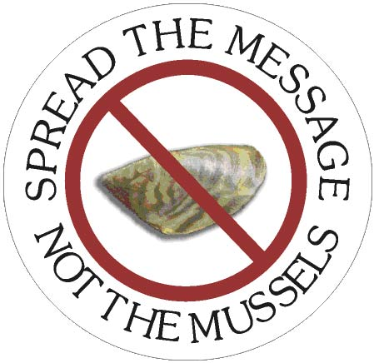
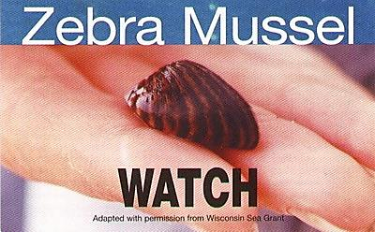
CURRENT CONDITION
In 2013 a cluster of adult zebra mussels were found on the Conowingo intake structure by divers working on intake structure improvements.
Later that year zebra mussels were found by RNRS biologist on the multi-plate sampler at the Conowingo intake.
Currently, zebra mussels have not been found at any of the primary source water supply reservoirs.
Ongoing exchange of information with other users upstream, such as water filtration plants and nuclear energy plants when zebra mussel numbers change.
Baltimore City Department of Public Works

Slide 14
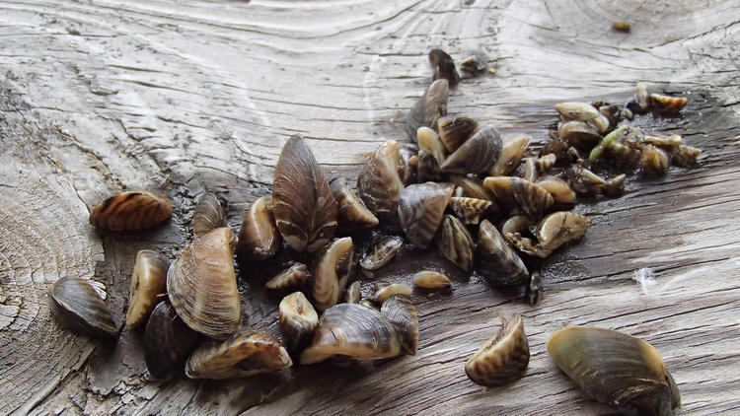
CURRENT CONDITION
Carroll County approves $350K plan to eradicate zebra mussels from Hyde's Quarry
The county approved a $349,966 plan to eradicate the zebra mussels that have been dwelling and reproducing in Hyde’s Quarry for at least three years. Maryland’s Department of Natural Resources confirmed that the mussels — an invasive species that has not been seen on inland Maryland before — were present in the Westminster quarry last May. Since then, the Carroll County Land and Resource Management Department has been seeking a way to remove them before the warm reproductive season, and before they spread to any other water bodies. (Carroll County Times)
Baltimore City Department of Public Works

Slide 15
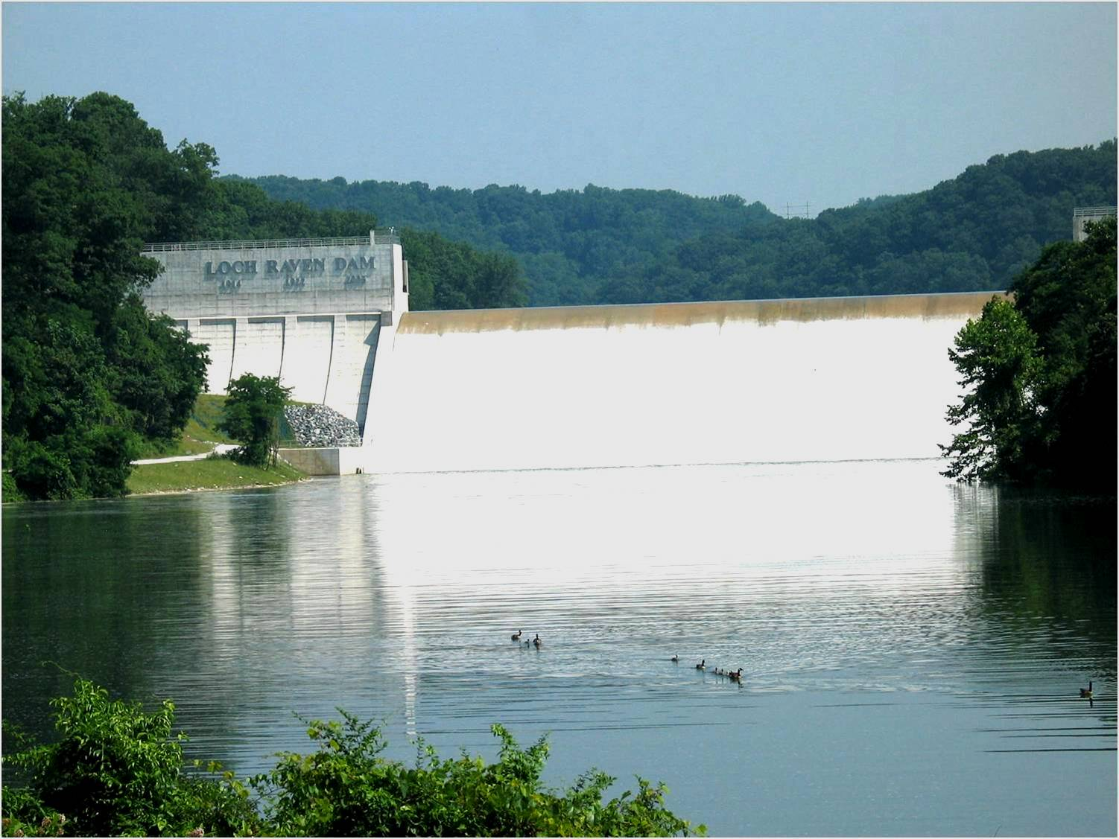
ADDITIONAL INFORMATION
For More Information about the Reservoir Watersheds:
www.baltimorecity.gov
Baltimore City Department of Public Works

